Slide 1
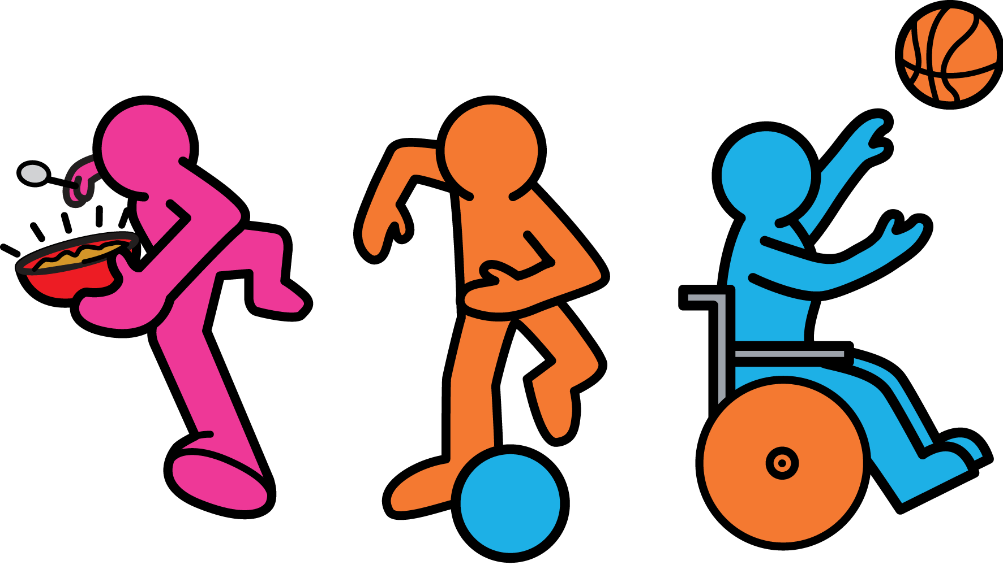
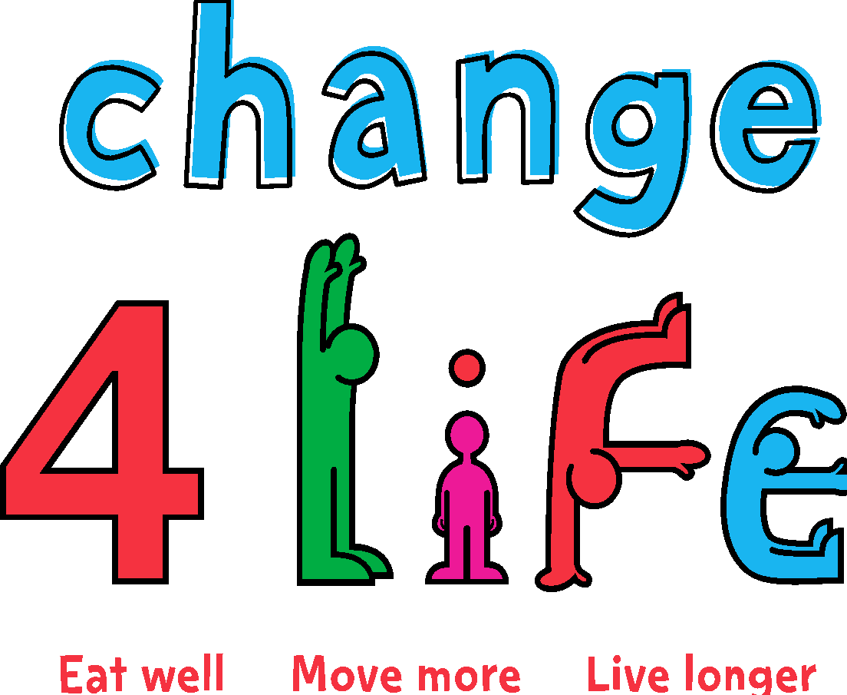
Notes:
Read this story about Evie and Jack’s healthy day and ask pupils to put their thumbs up every time they hear a healthy behaviour mentioned and thumbs down every time they hear about an unhealthy behaviour.
Alternatively, you could even build in some healthy activity by asking them to stand and jump up to touch the air, or jump down to touch the floor instead of putting thumbs up or down.

Slide 2

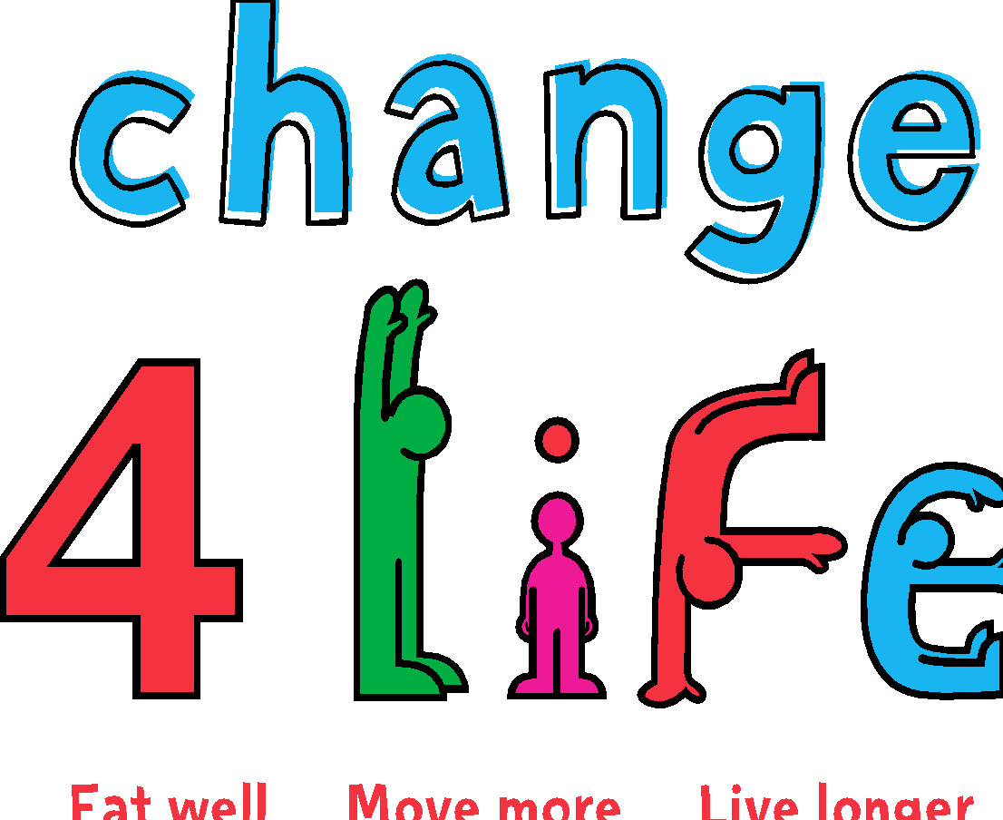
Notes:
Evie and Jack are twins. They live with their mum.

Slide 3




Notes:
It was the first day of the summer holidays. They were off school for six whole weeks – Evie and Jack were very excited!

Slide 4

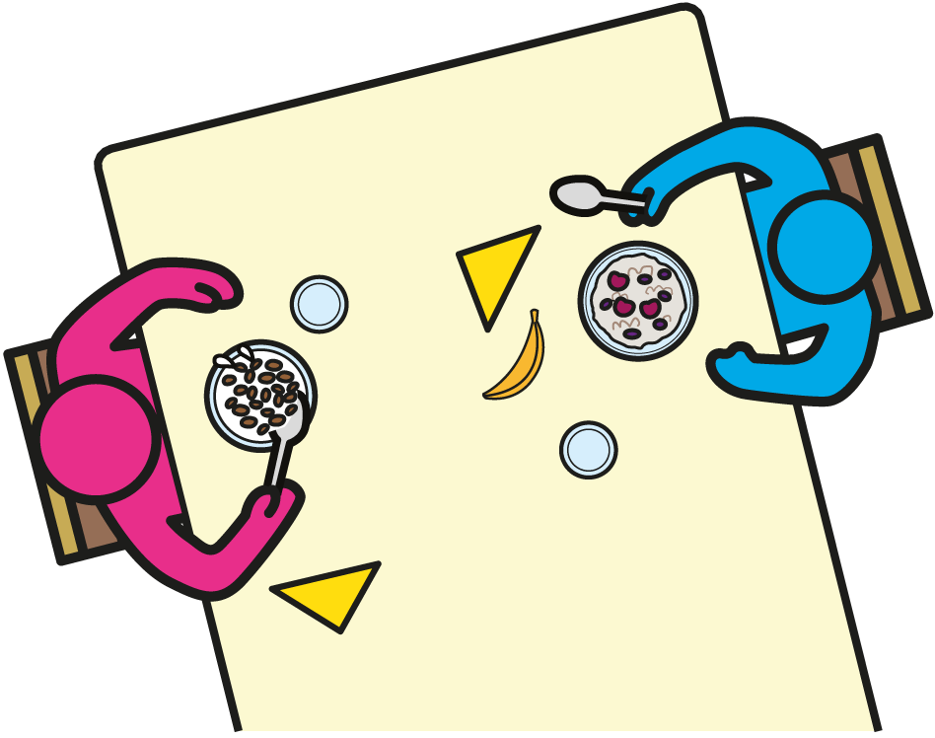
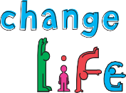
Notes:
They got up really early, and hopped, skipped and jumped to the kitchen to get breakfast.
Jack chose his favourite choco sugar lumps cereal. Evie had some porridge and fruit.
Can you think of something healthier that Jack could have eaten?

Slide 5

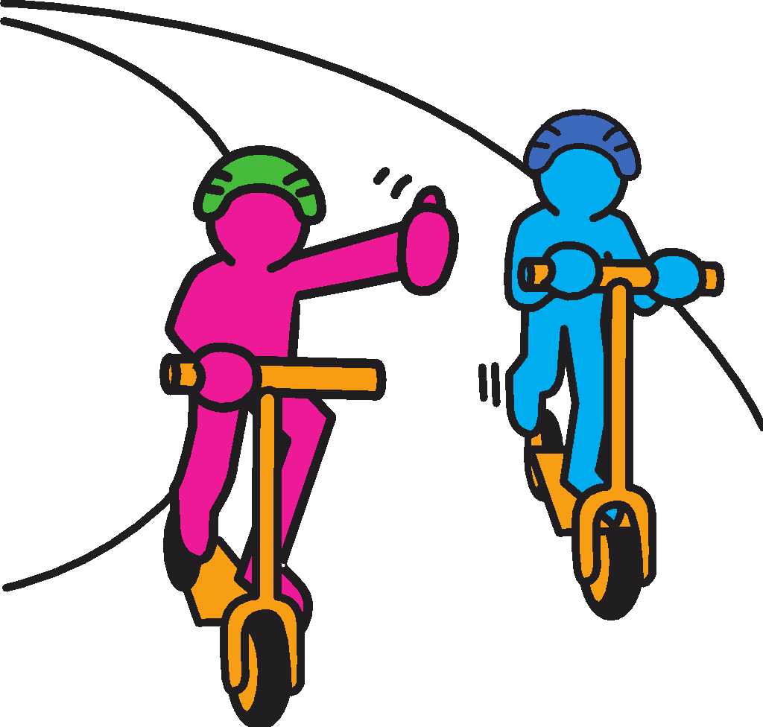
Notes:
Mum said that they needed to go to shop to buy some food.
Jack and Evie asked if they could go on their scooters instead of in the car.
What other healthy ways are there of getting around?

Slide 6

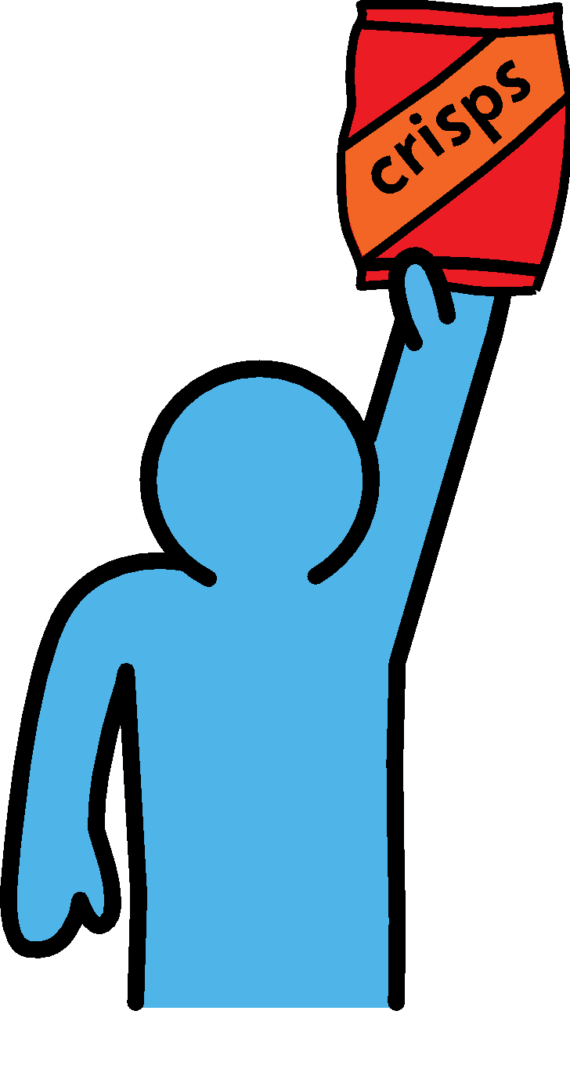
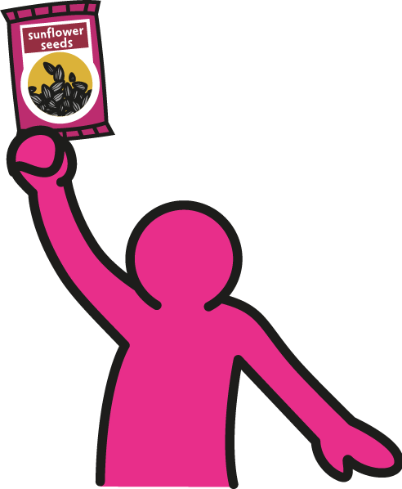
cris^{ps}
Raisins
Notes:
At the shops, mum said they could choose a snack.
Jack chose some sunflower seeds and Evie chose some crisps.
What could Evie have chosen instead?

Slide 7

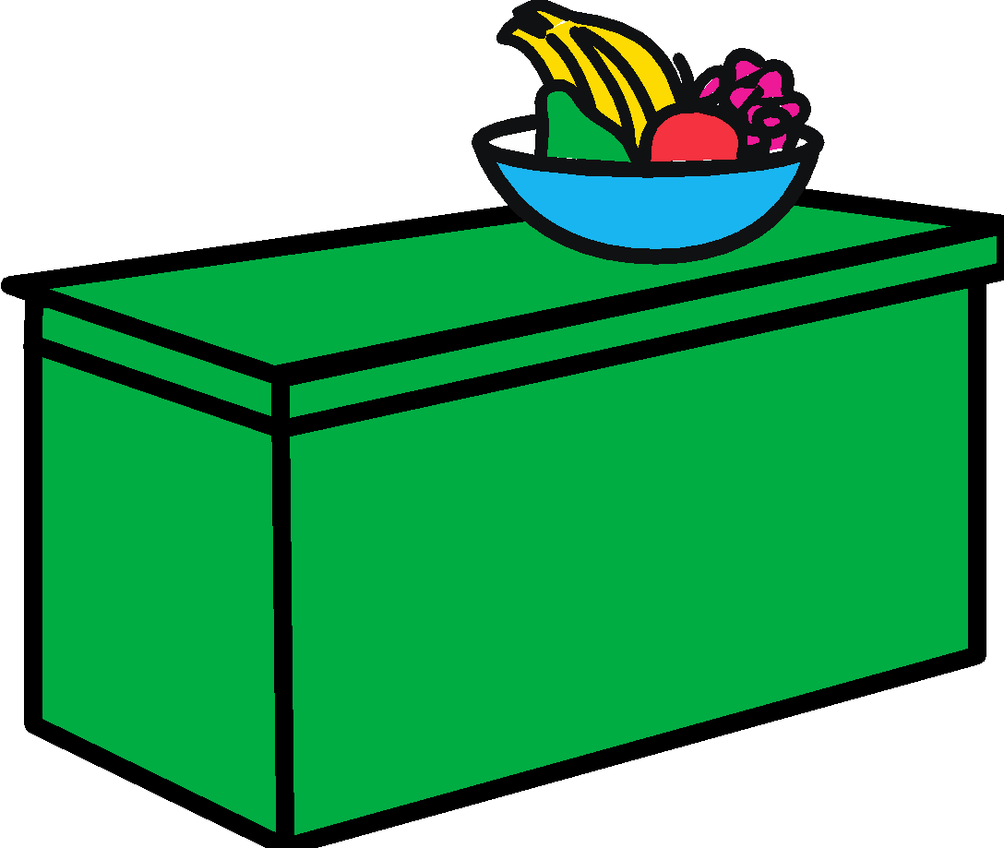

Notes:
After lunch, the twins went to their friend Leo’s house to play.
Leo’s mum offered them a drink. Evie chose a big glass of juice, and Jack had milk.
Why is milk a better choice? (It is better for your teeth.) When is the best time to drink juice? (With a meal.) How much should you have? (Only one small 150ml glass.)

Slide 8

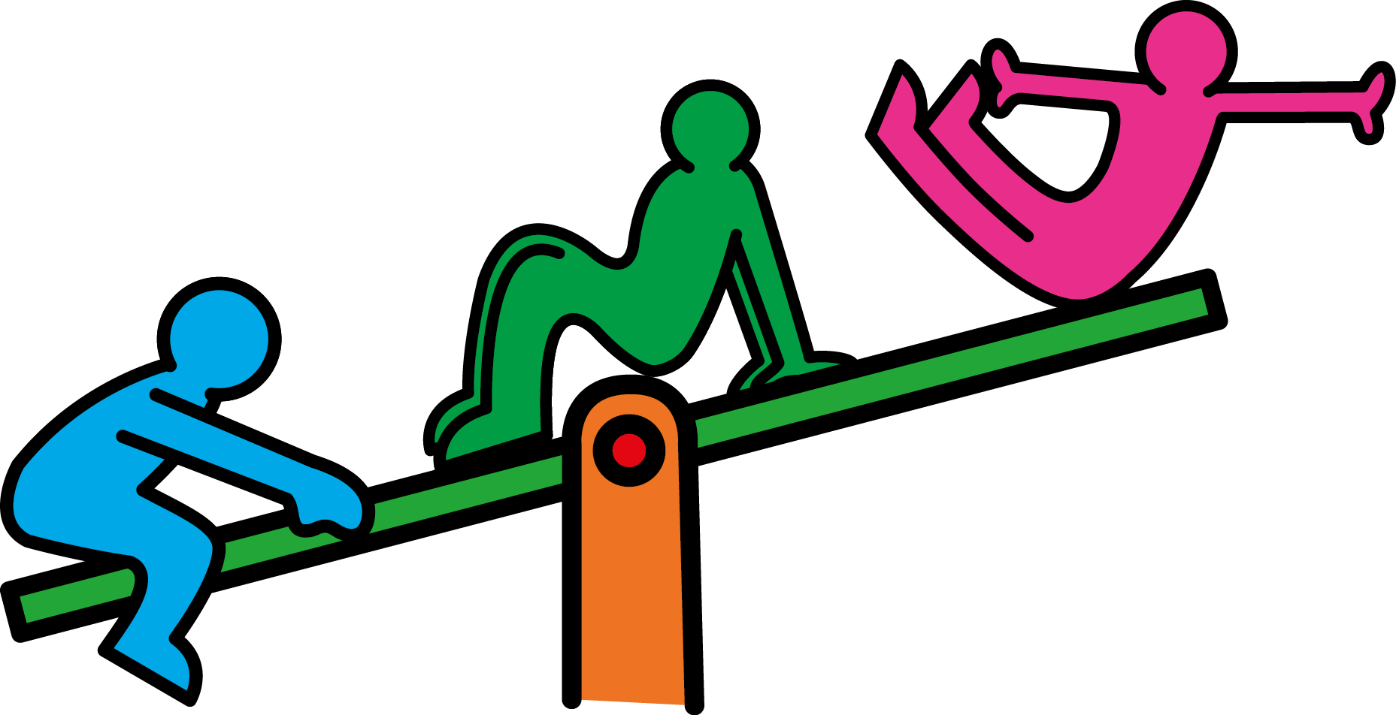
Notes:
Leo’s mum asked if the children wanted to go to the playground, but they decided to play on the tablet instead.
Which activities help keep you fit and healthy? Which don’t?

Slide 9

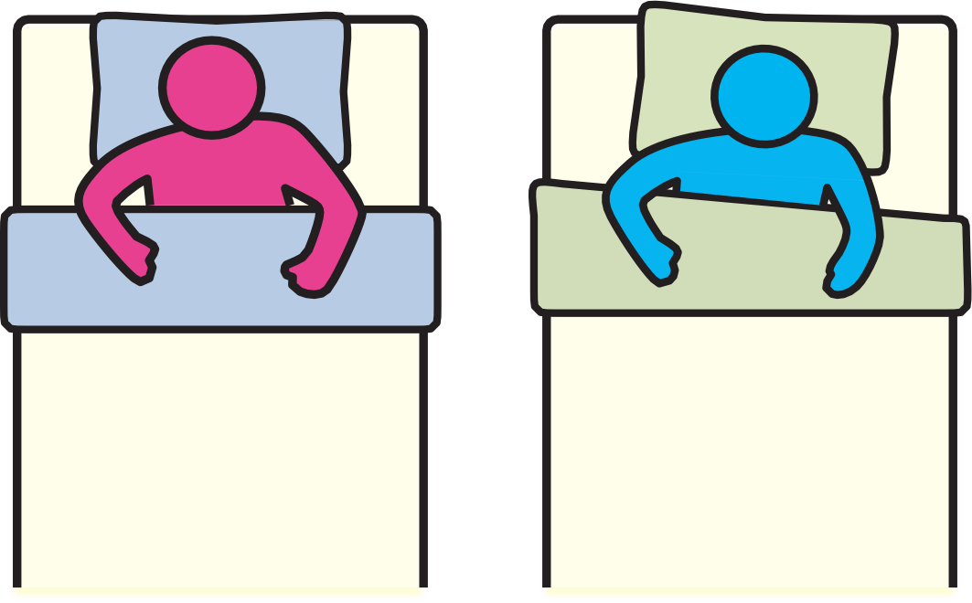
Notes:
At bedtime, the twins snuggled down into their beds.
After mum kissed them goodnight, Evie put her TV on quietly and watched cartoons for an hour. Jack looked at a book for 10 minutes then closed his eyes and fell asleep straight away.
They both dreamed about all the fun things that they were going to do during the holidays.
Who slept for longer if they woke up at the same time?

