Slide 3



Slide 5
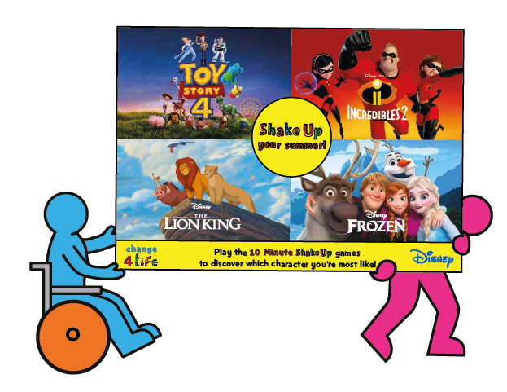

Slide 6





Notes:
Follow-up ideas
- Encourage pupils to reflect on the five senses while they act out their lifting, before challenging them to write a description of lifting something from the point of view of Mr Incredible – what does it feel like when he is using his strength super powers?

Slide 7




Notes:
Follow-up ideas
- Pupils could create a summer senses map, with key words and phrases to record what they can see, hear touch and smell.
- Pupils could write a description of Arendelle in summer from Olaf’s point of view.

Slide 8




Notes:
Note: for their challenge, pupils who use wheelchairs can try to add three strong pushes to their journey.
Follow-up ideas
Pupils could use this as the basis of a drama lesson, building speech into their performance to show how they might interact with other characters along their journey. Finally, pupils could perform to their peers.
Pupils could create a map of the pride lands, using descriptive writing to label the different parts they crossed in their role play.
Pupils could use this activity as the basis for writing a dialogue between Simba and Nala or another character they meet along the way.

Slide 9


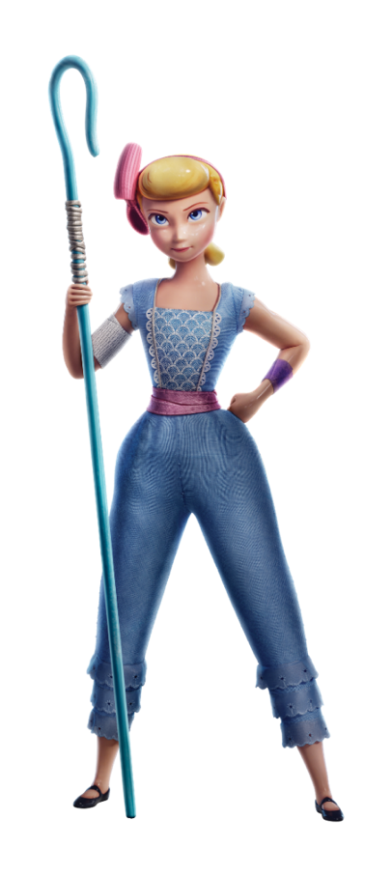

Notes:
Prompts to support pupils
- If pupils are stuck, encourage them to think about rides they might know from the theme park or fun fair (for example, dodgems, a roller coaster, a pirate ship ride or a Ferris wheel). Can they use their bodies to imitate the movement of these rides?
Follow-up ideas
Pupils could create a map or drawing of the Toy Story 4 carnival using description to label the different features.
Pupils could write about their own adventures at a summer carnival.
Pupils could write about their dream carnival ground (if money were no object!). This could be written in a number of ways, for example as a list, a newspaper article reporting on the ground’s opening, or a first-person description of a visitor to the ground.

Slide 10



Notes:
Explain to pupils that the journey doesn’t stop here – there are going to be lots more opportunities to get active throughout the school day and to have more fun with their favourite characters at home.
Pupils can search ‘Change4Life’ to do a fun quiz at home.
Explain that every pupil will be receiving a take-home Shake Up games pack (these packs will be arriving in schools from June), which they can take home to continue the fun over the holiday.
Challenge pupils to complete every Shake Up in their pack, and to teach their moves to their family at home.

