Slide 1
[Insert your school name here]

Slide 3




Slide 5
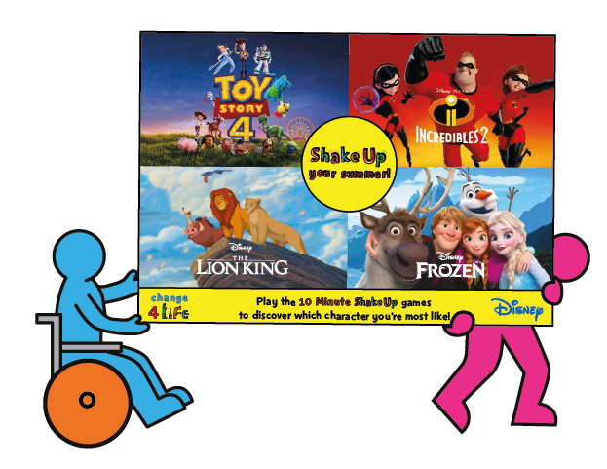

Slide 6



Slide 7





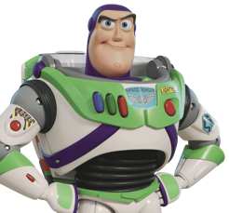

Notes:
Explain the terms or ask pupils for explanations or examples if appropriate:
Agility – being able to change direction quickly without losing balance or falling over
Stamina – keeping going for a long time, getting warm, out of breath and raising your heart rate
Strength – having strong bones and muscles and being able to lift, carry, push and pull objects
Tell pupils that just like the Disney characters, we need agility, stamina and strength in everyday life.

Slide 8
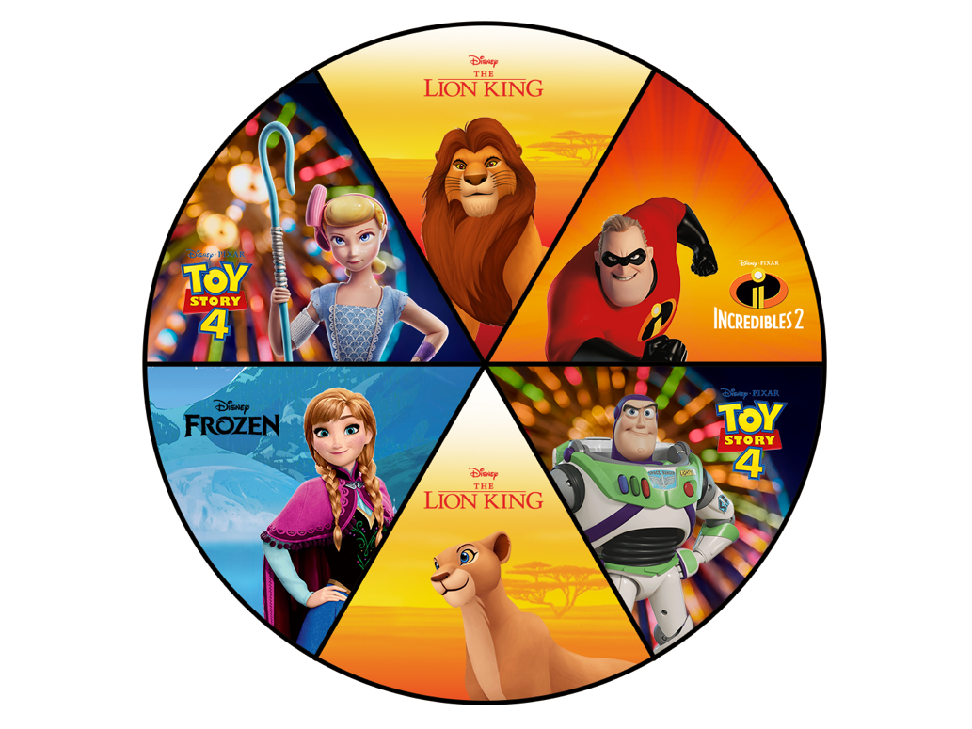


Notes:
Explain to pupils that they will be building their agility, stamina and strength with the Disney characters by learning some different moves.
Challenge pupils to remember the moves – they will be tested on this at the end (see slide 15 for the spinner game).
As they learn the moves, pupils should also think about which is their favourite.

Slide 9
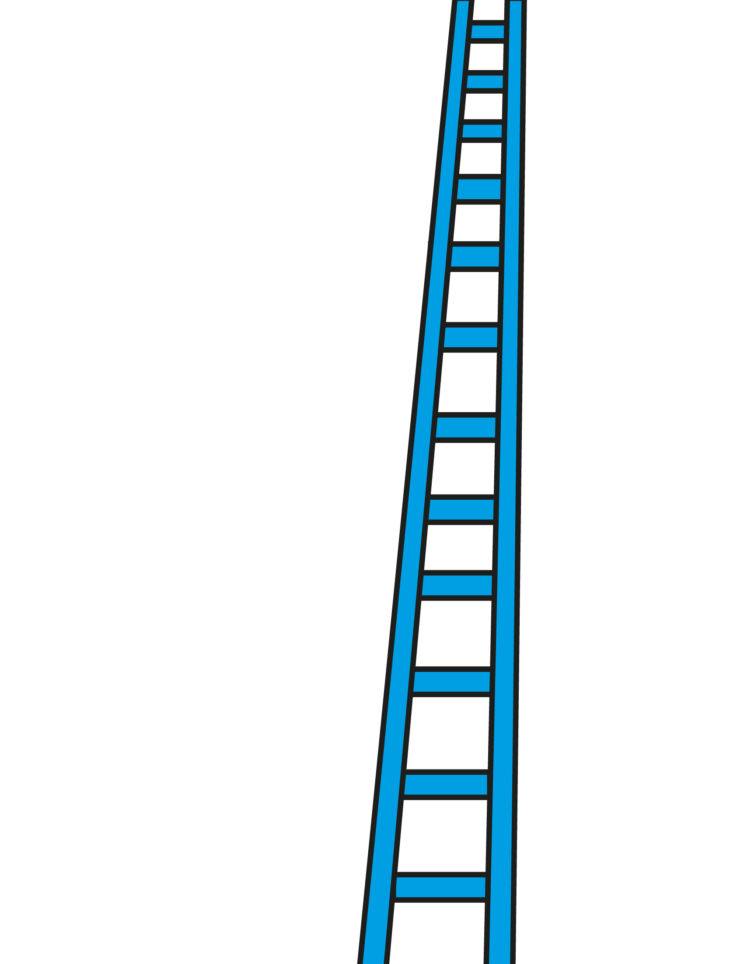


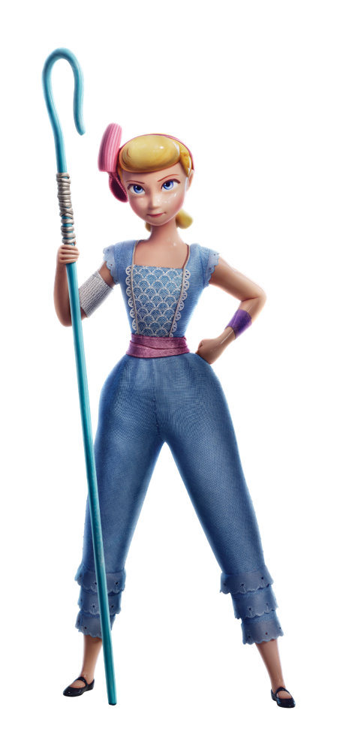

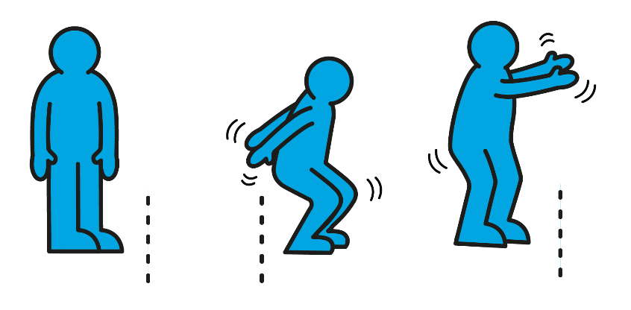
Notes:
Note: with a bit more space at the end of the assembly line, pupils who use wheelchairs can use one push of their wheelchair to jump forwards and one push of their wheelchair to jump backwards.

Slide 10
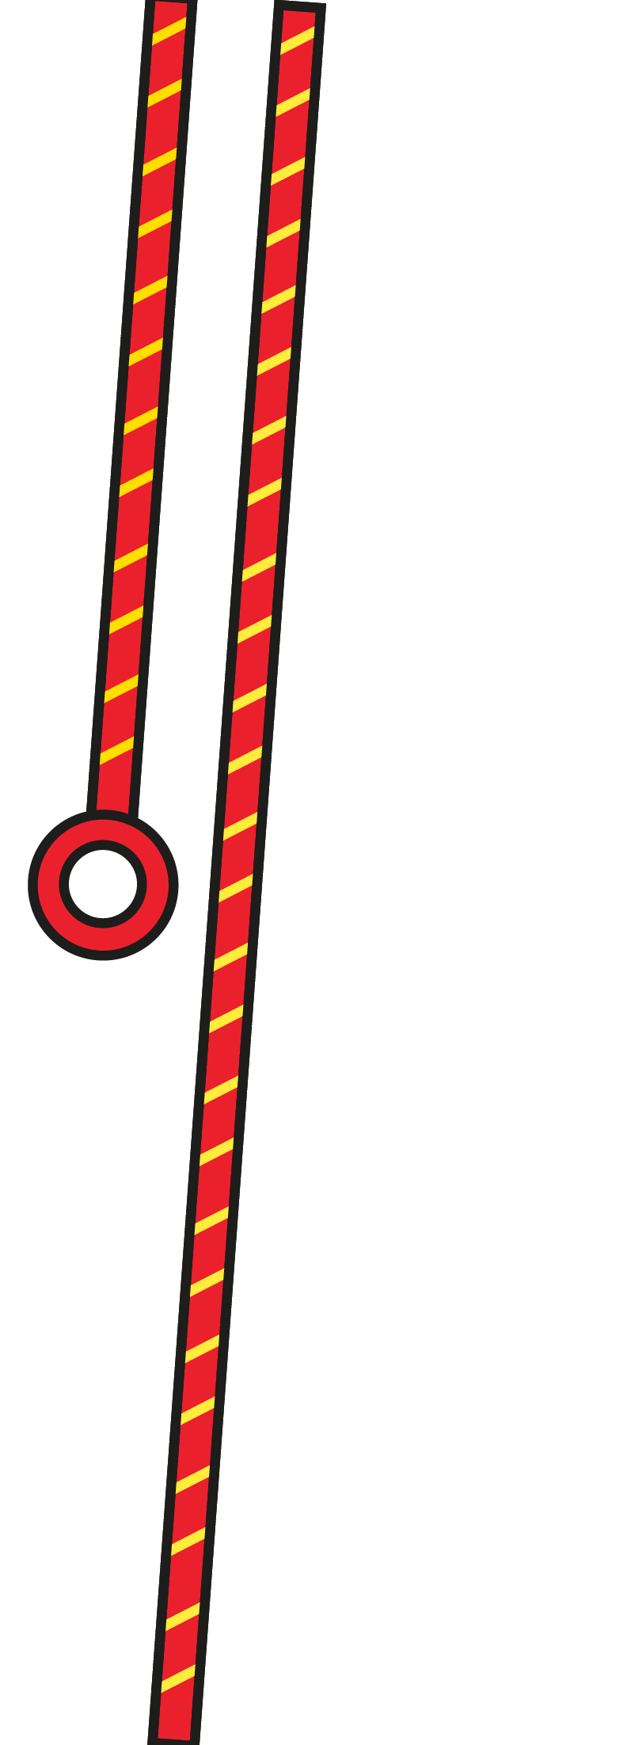





Notes:
Note: pupils doing this move from a seated position can start with their hands on their head (as in image 1) before lowering their lower their elbow to create a side bend. Pupils can repeat this move on either side.

Slide 11


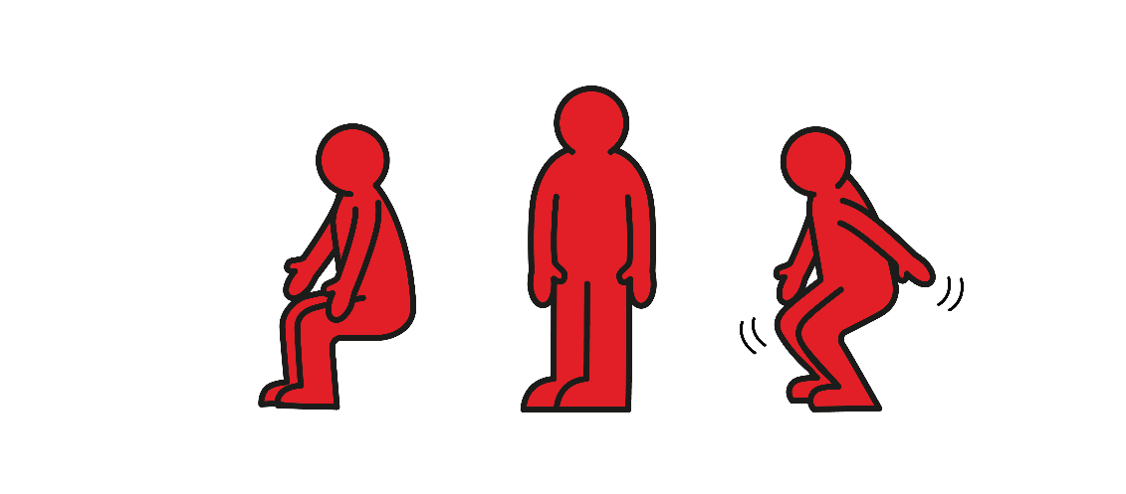
Notes:
Note: pupils who use a wheelchair can place their hands on the armrests of the wheelchair, then carefully take some weight into their arms, pushing themselves up slightly. Pupils can experiment and see how straight they can get their arms. They should slowly lower down until they are fully seated again. (Ensure an adult checks pupils’ arms are directly beneath the shoulders.)

Slide 12



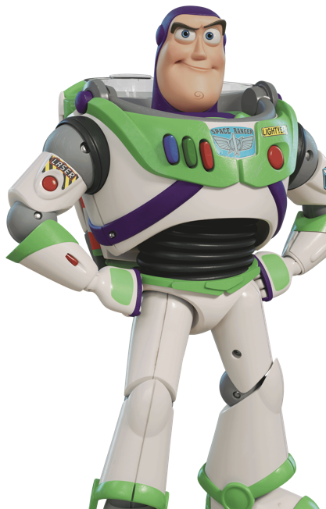

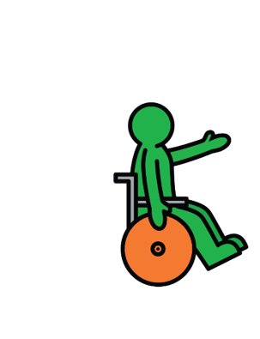
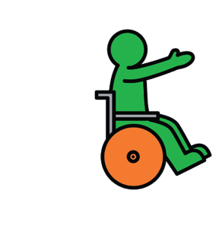

Slide 13




Notes:
Note: with a bit more space at the end of the assembly line, pupils who use wheelchairs can do two short forward pushes of their wheelchair, followed by two short backward pushes to return to the starting position. They should repeat this move.

Slide 14



Notes:
Note: with a bit more space at the end of the assembly line, pupils who use wheelchairs can use one push forwards and one push backwards as a jump. They can add in a clap or trick between each push.

Slide 15

Notes:
Click to spin the character wheel and see if pupils can remember the move for each character.
Pupils should continue to repeat the move until the spinner lands on another character – this is a great way to build their stamina.
You may wish to spin the wheel faster and faster each time to increase the challenge.

Slide 16
Notes:
Ask pupils to pick the move they most enjoyed.

Slide 17



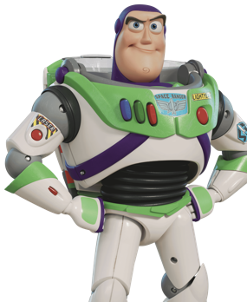
Notes:
Use this slide to help pupils think about how they could get more active, both inside and outside school.

Slide 18




Notes:
Use this slide to help pupils think about how they could get more active, both inside and outside school.

Slide 19




Notes:
Use this slide to help pupils think about how they could get more active, both inside and outside school.

Slide 20



Can you do all the Shake Up games?
Notes:
Explain to pupils that the journey doesn’t stop here – there are going to be lots more opportunities to get active throughout the school day and to have more fun with their favourite characters at home.
Pupils can search ‘Change4Life’ to do a fun quiz at home.
Explain that every pupil will be receiving a take-home Shake Up games pack (these packs will be arriving in schools from June), which they can take home to continue the fun over the holiday.
Challenge pupils to complete every Shake Up in their pack, and to teach their moves to their family at home.

Slide 21











