Slide 1
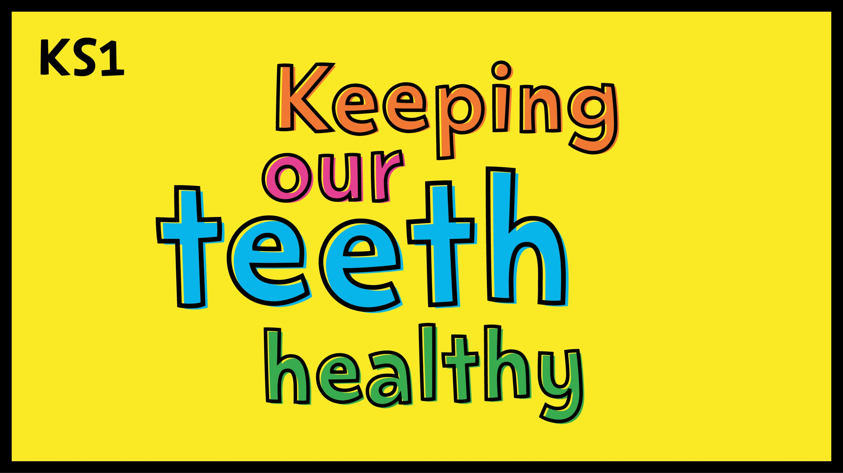

Notes:
Please note that this presentation includes quiz questions and the response slides (‘Oops, try again! or ‘That’s right!) will show when an answer is clicked on. The next ‘Background information for teachers’ slide is hidden and will not show in presentation mode.

Slide 2
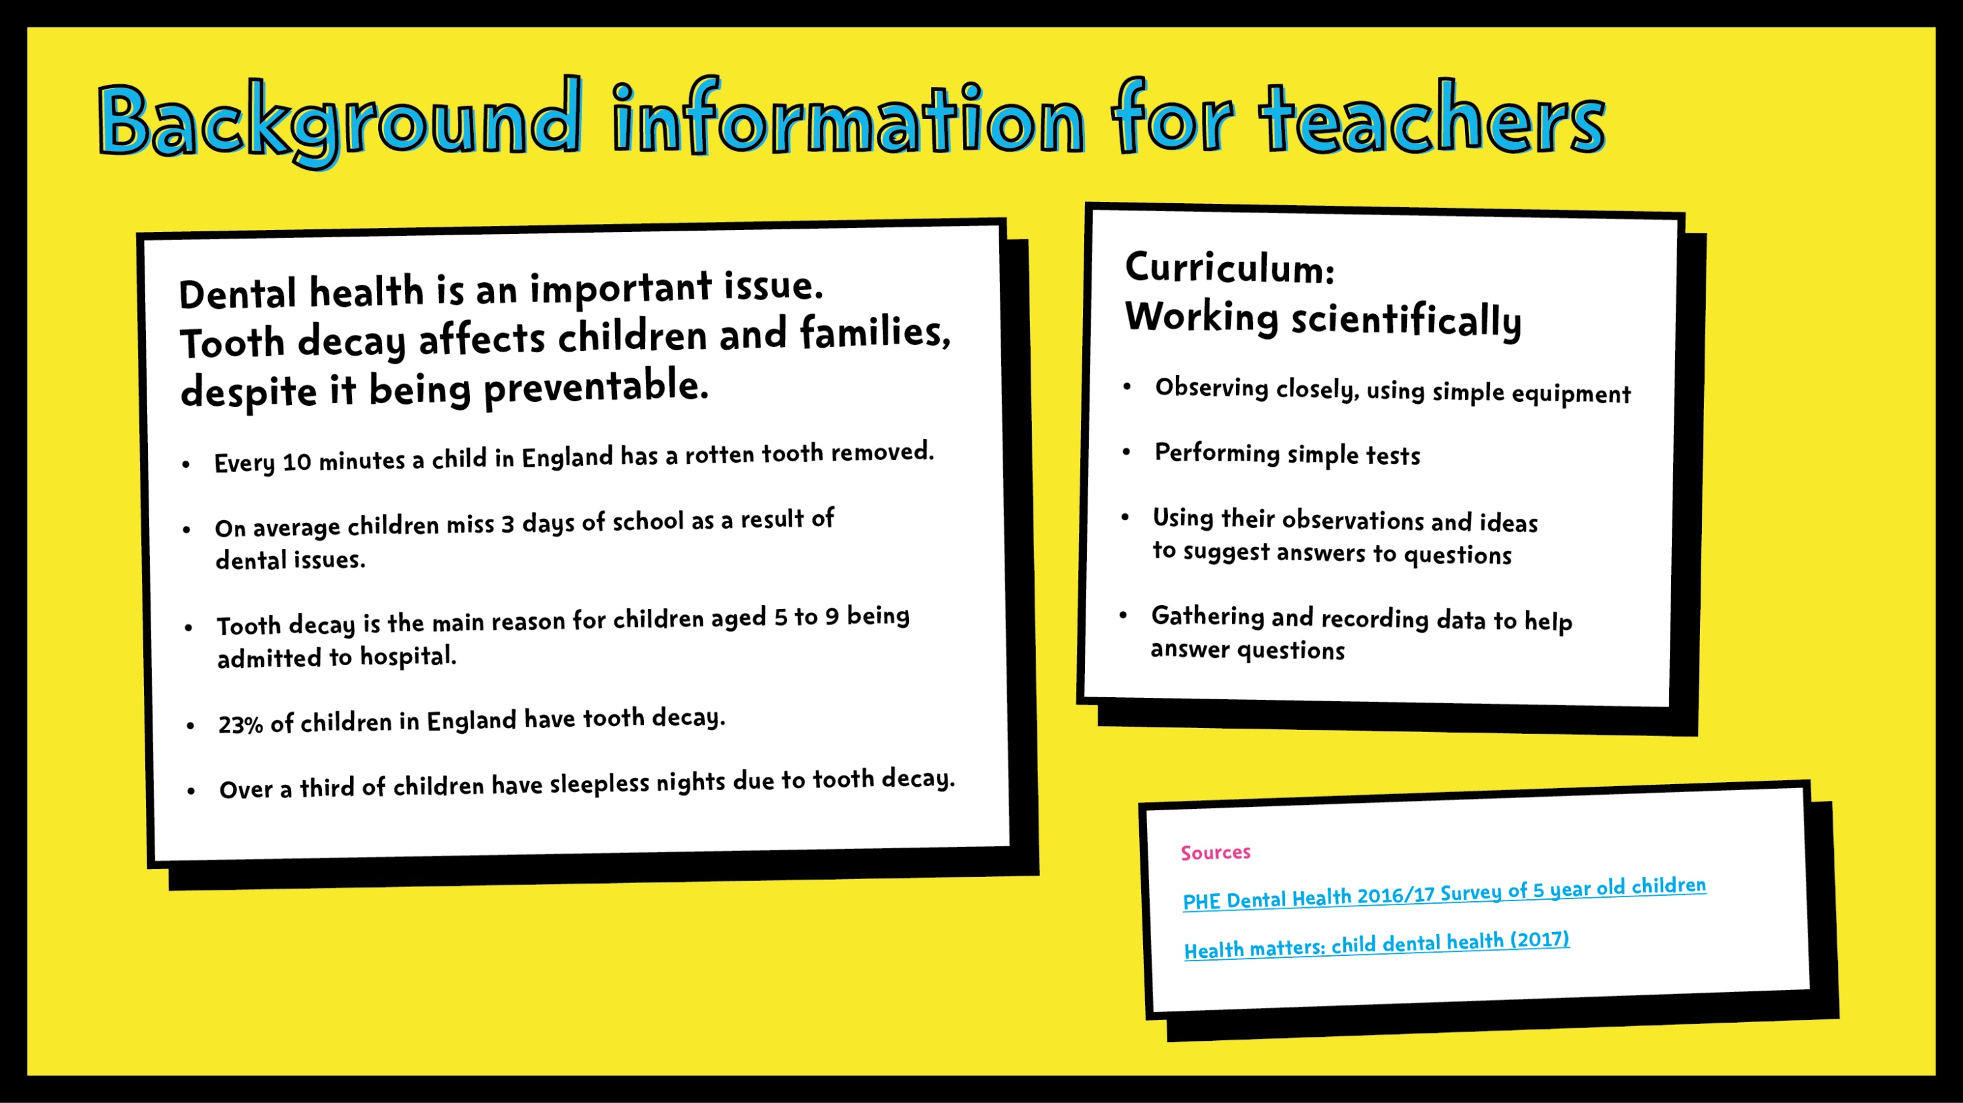

Slide 3
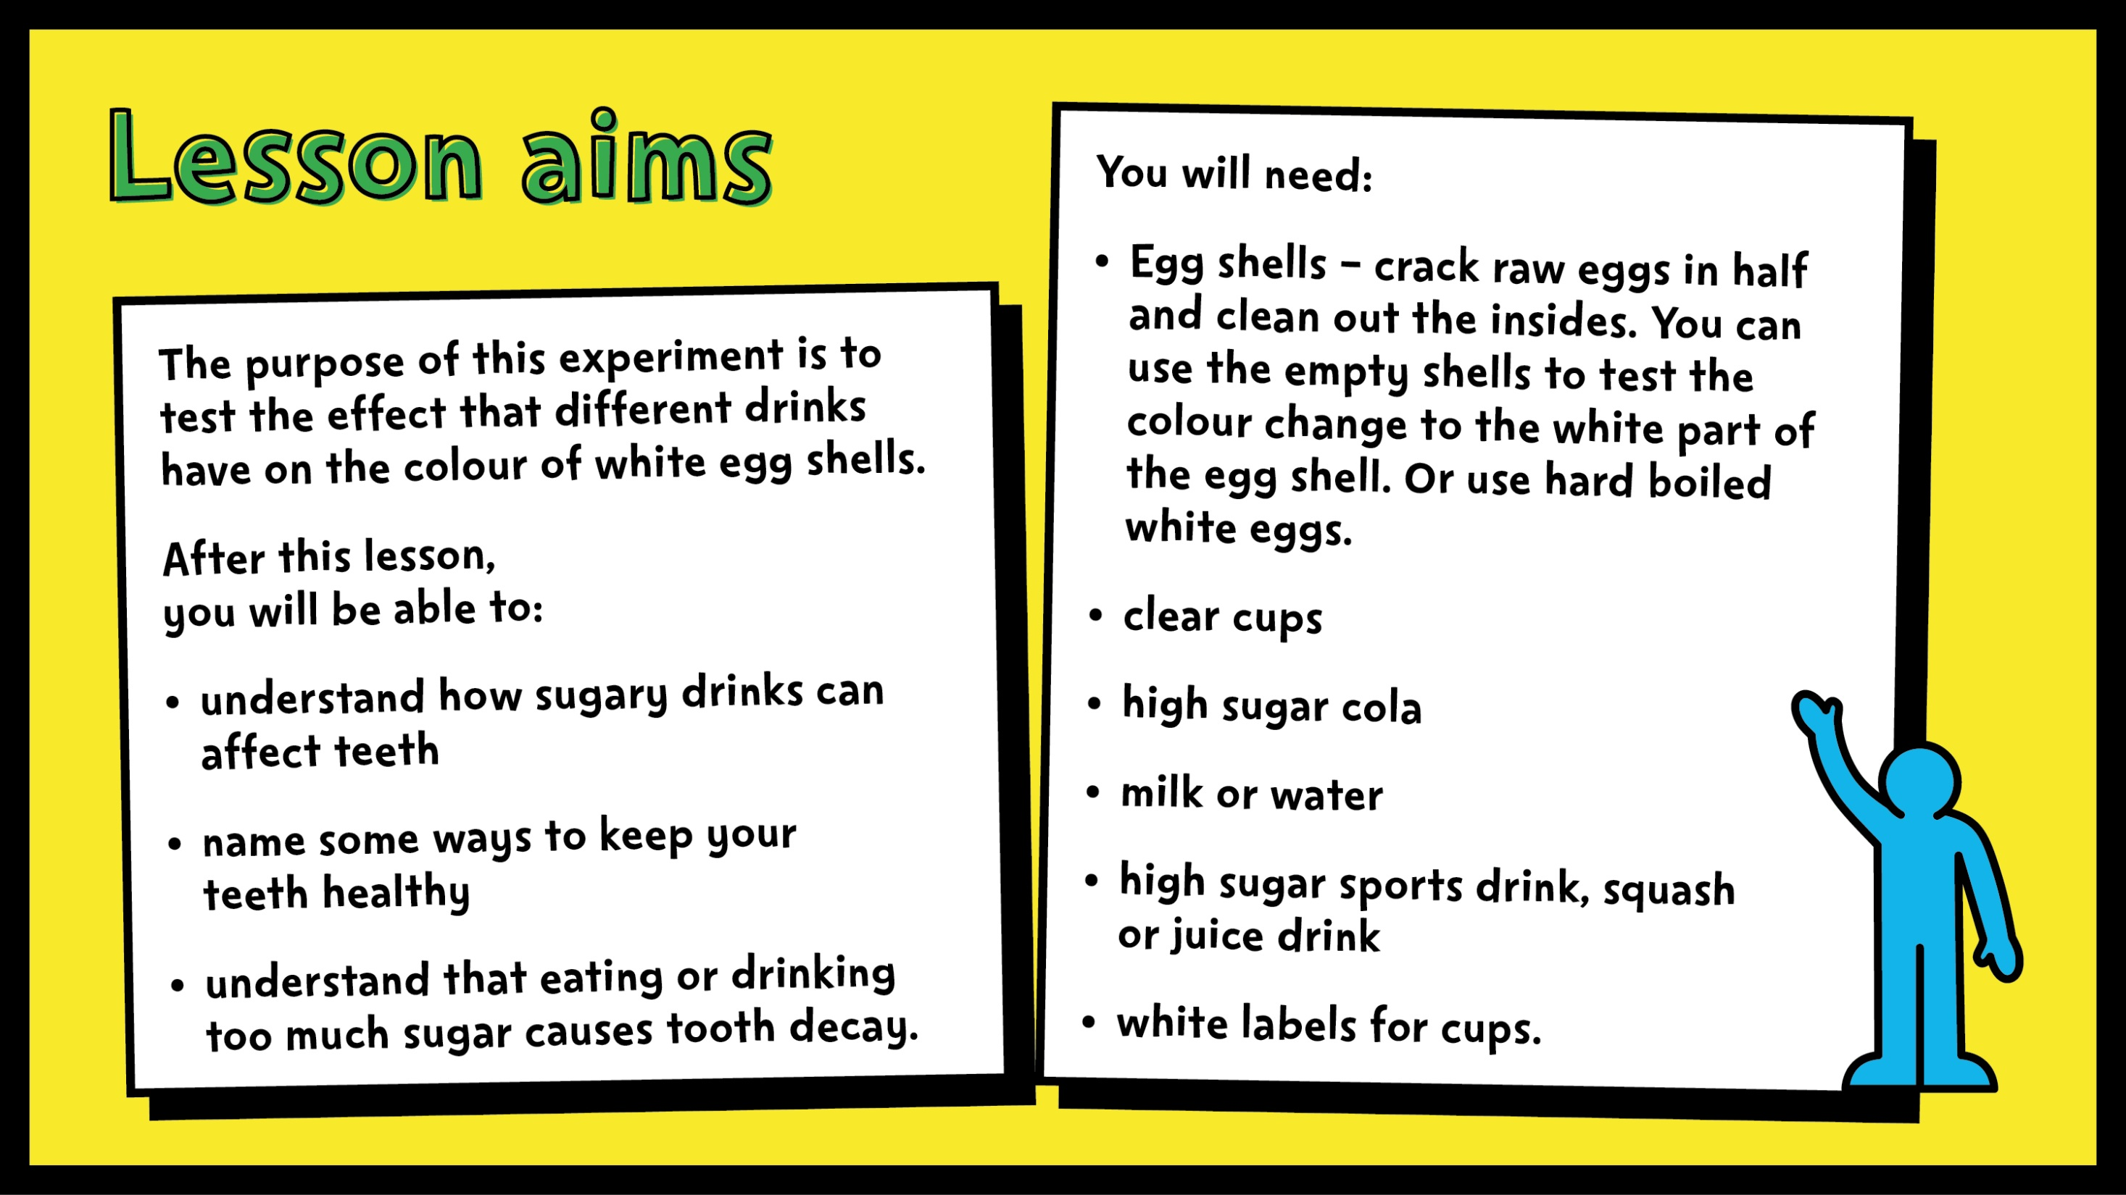

Slide 4
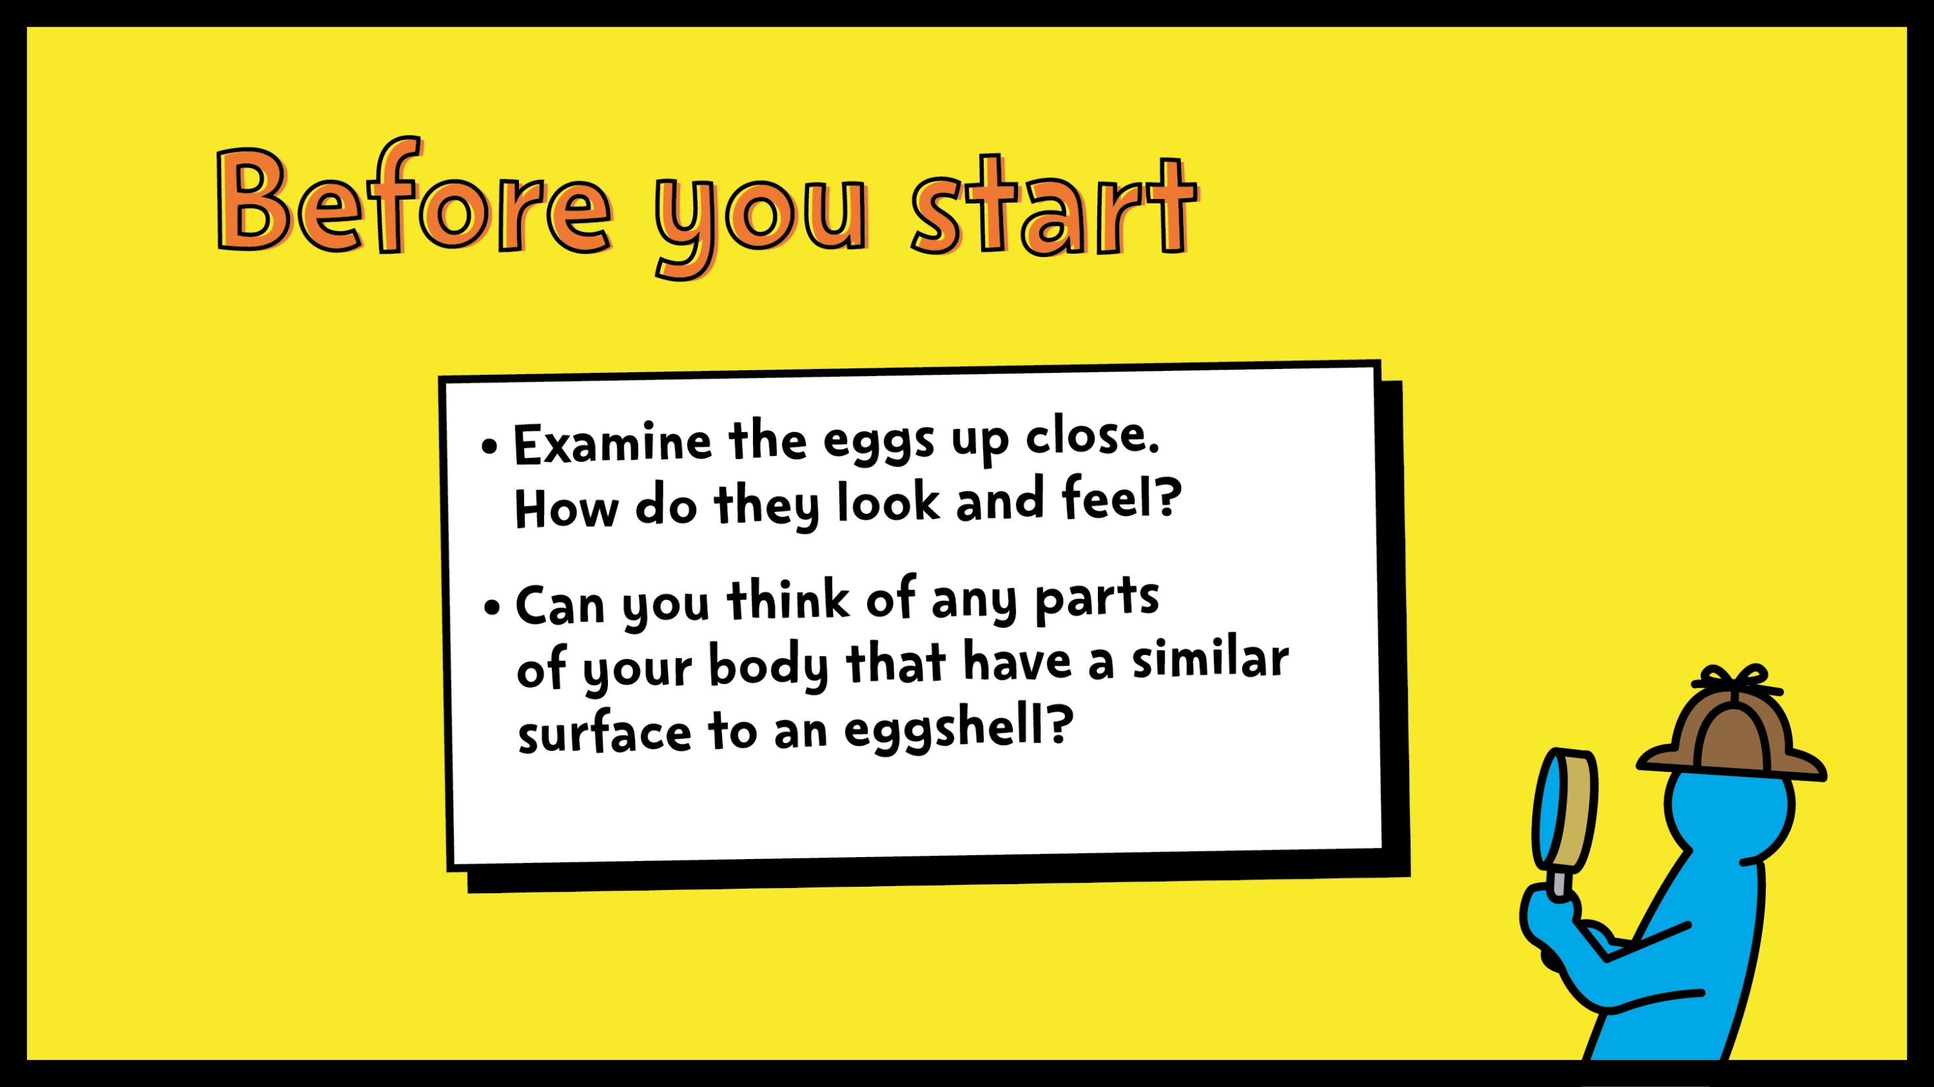
Notes:
Ask pupils to look at the eggs up close, and (gently) touch them. They should be able to identify that the egg shells have a are similar to teeth.

Slide 5
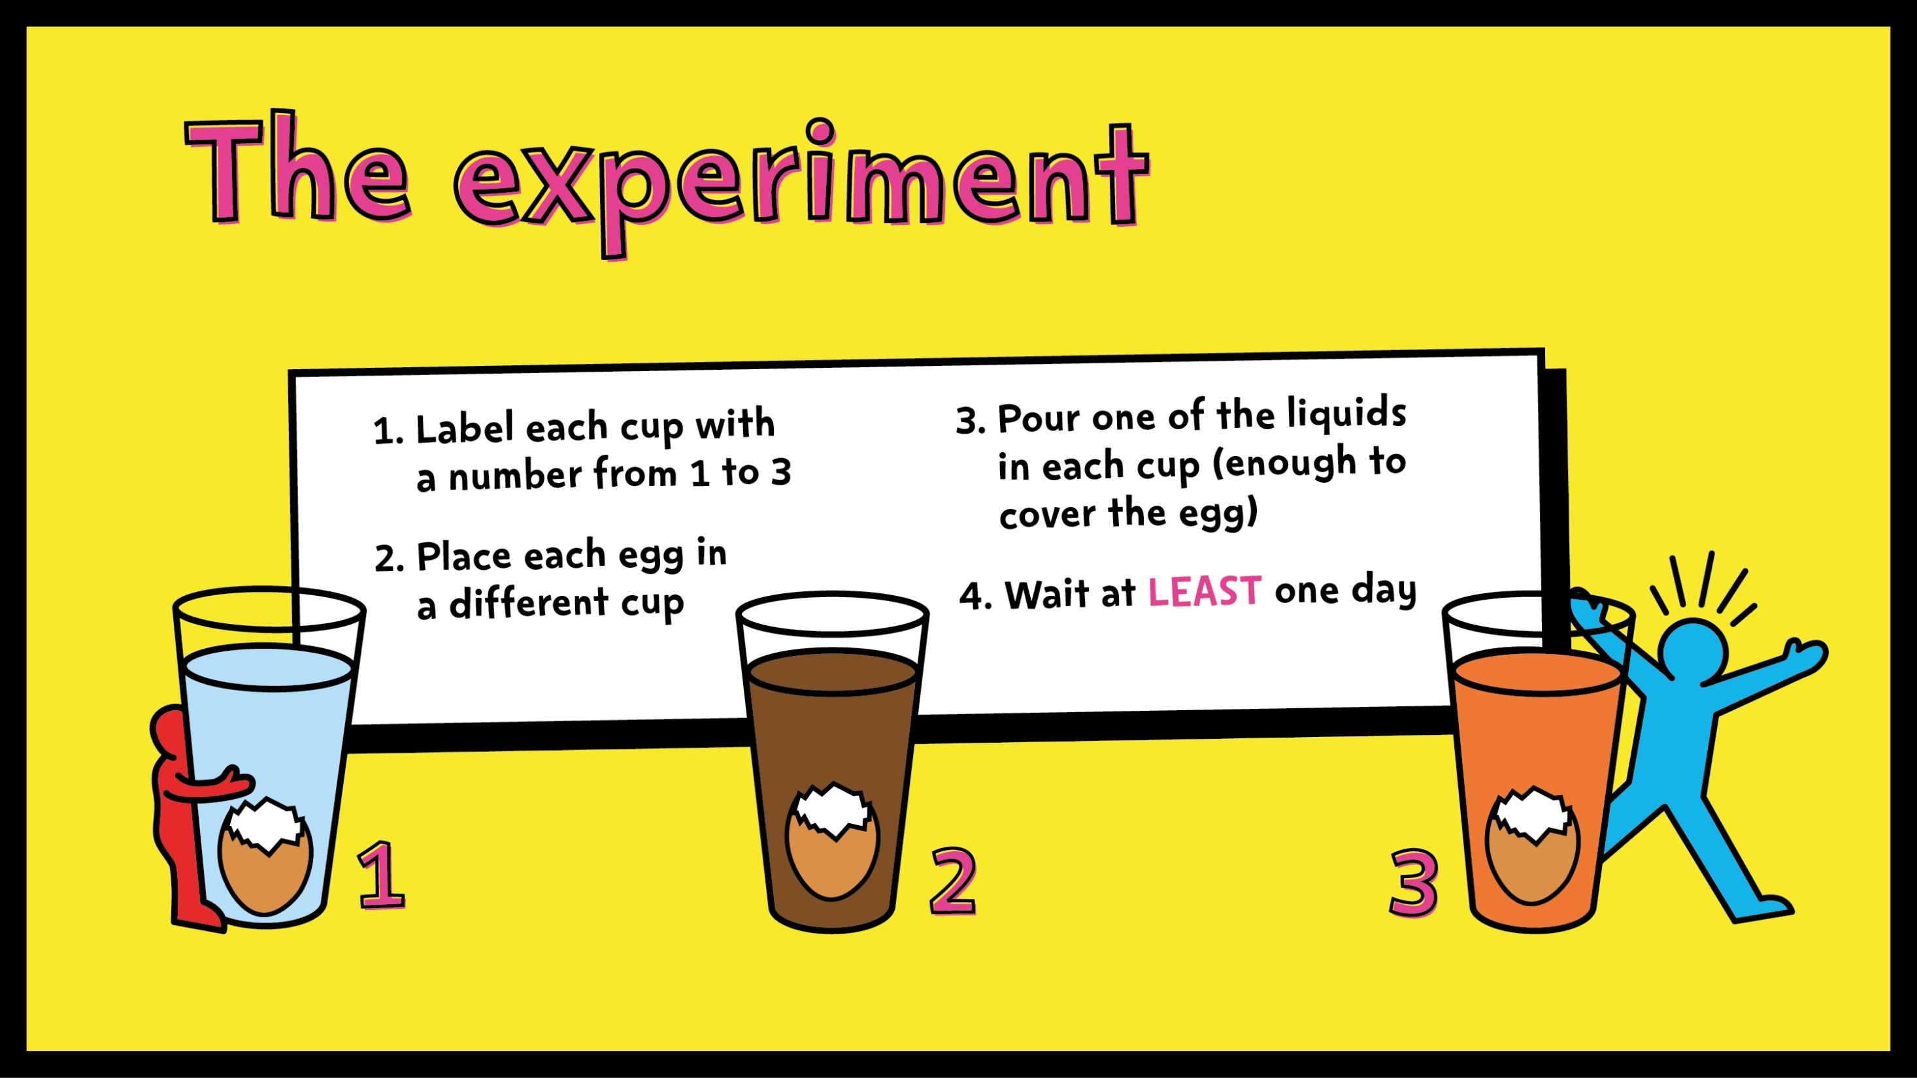
Notes:
Assist pupils in setting up the experiment as described on the slide.

Slide 6
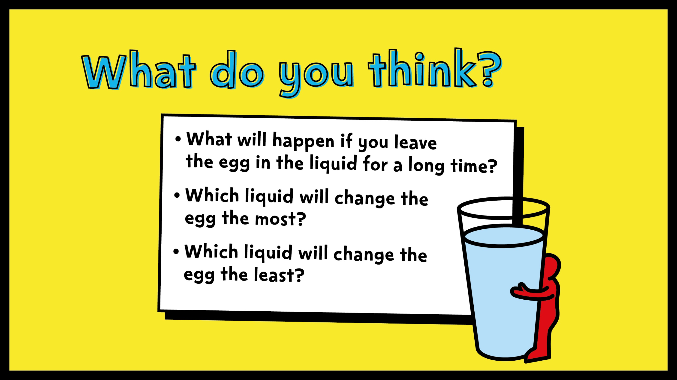
Notes:
Ask pupils to think about the questions on the slide. What do they think will happen to each of the eggs? Why?
Answers should include that the egg will change colour, become sticky, get covered in build-up etc.

Slide 7
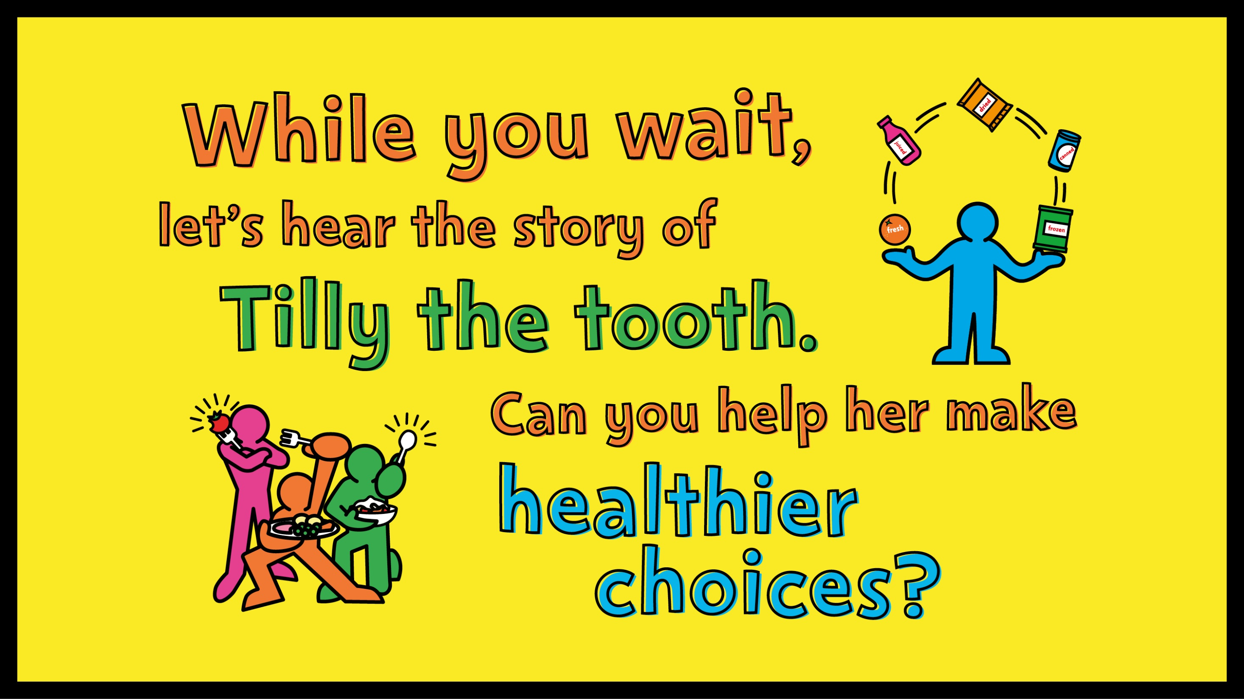

Slide 8
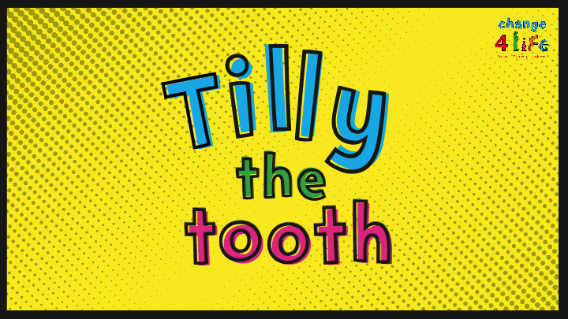
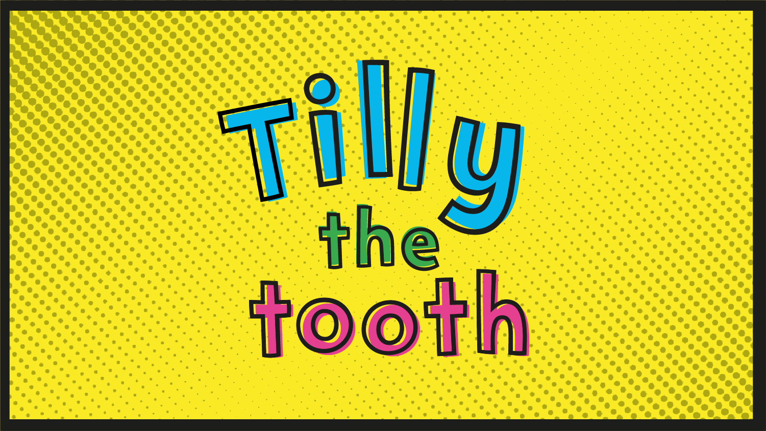
Notes:
Read pupils the story of Tilly the tooth. They will have the chance to answer some questions to help Tilly stay healthy and strong.

Slide 9

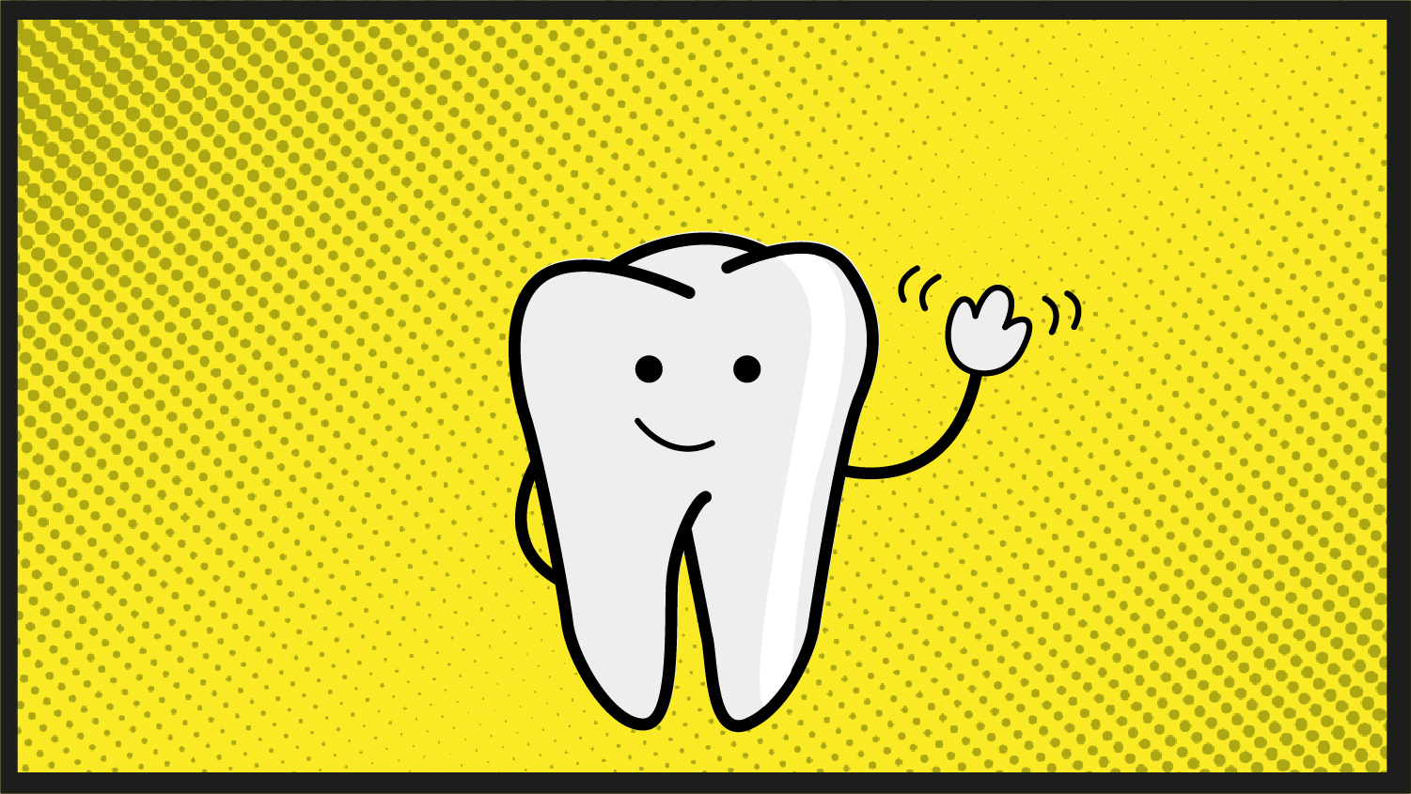

Slide 10
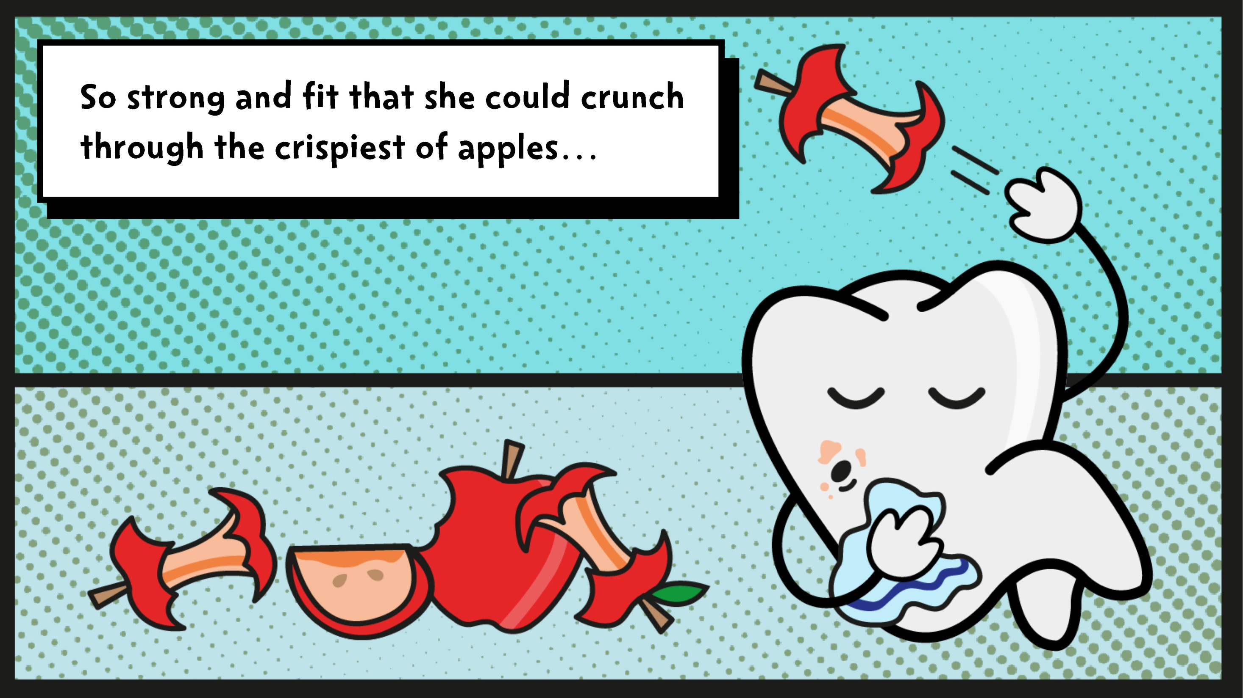

Slide 11
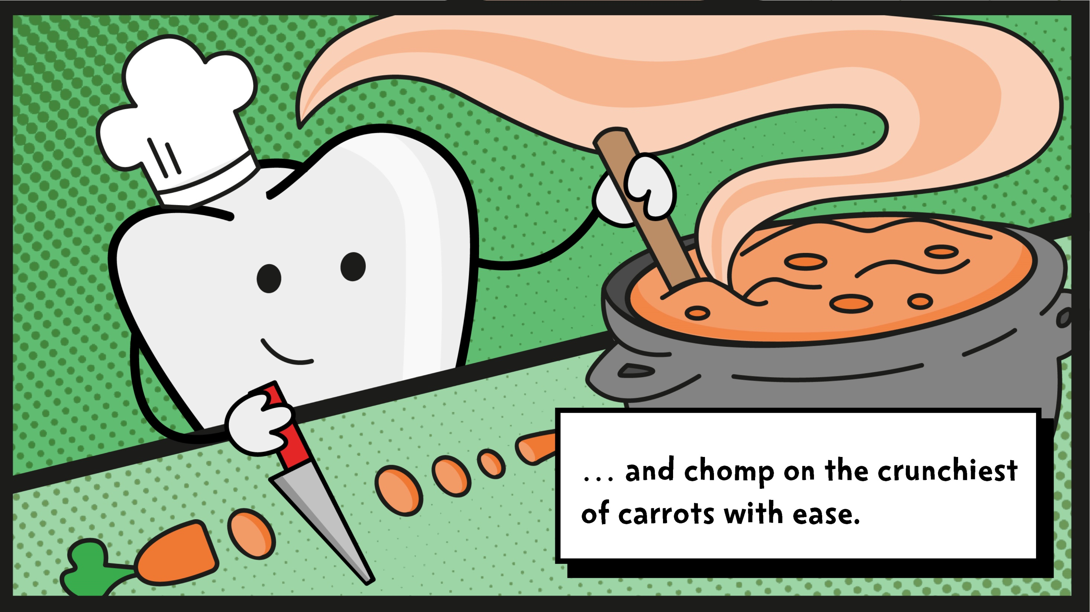

Slide 12
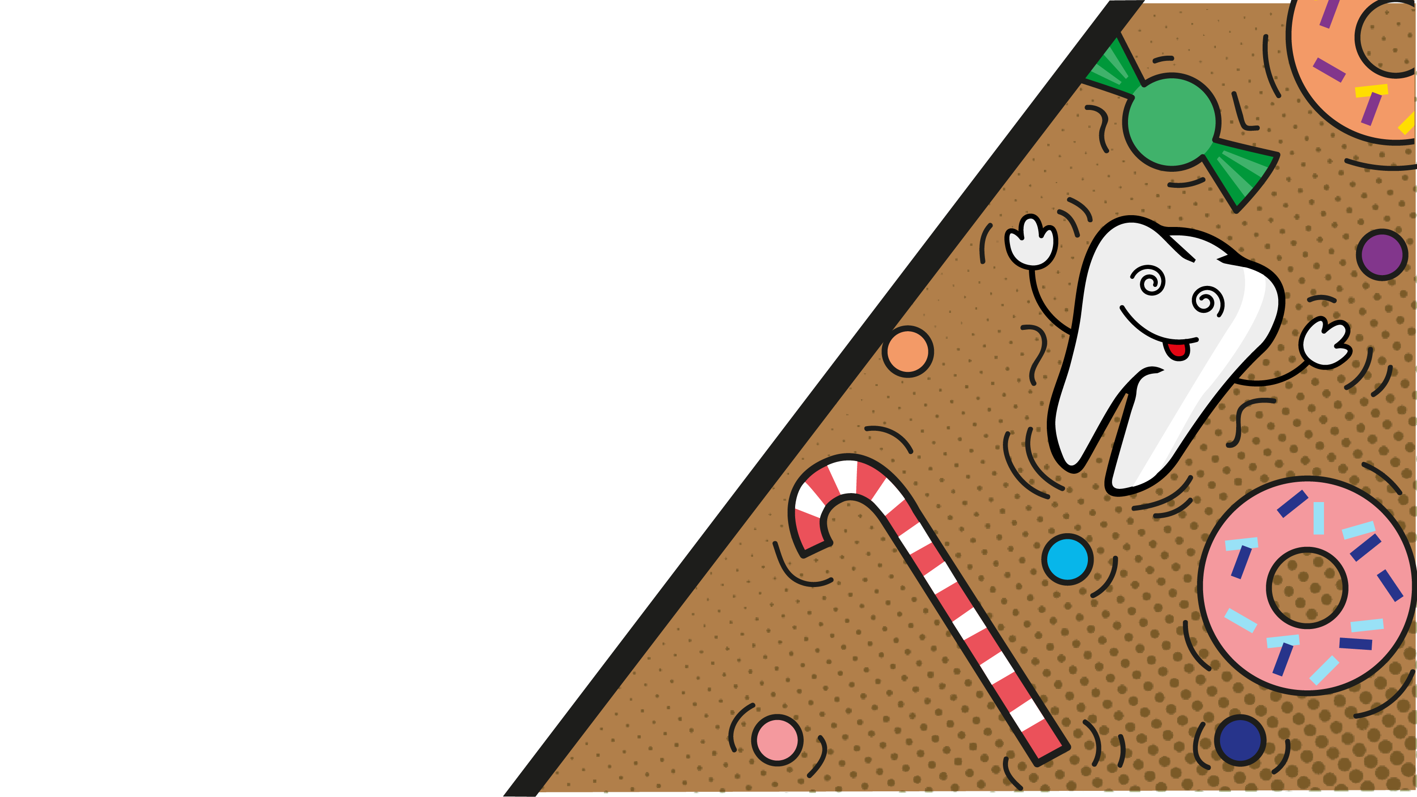
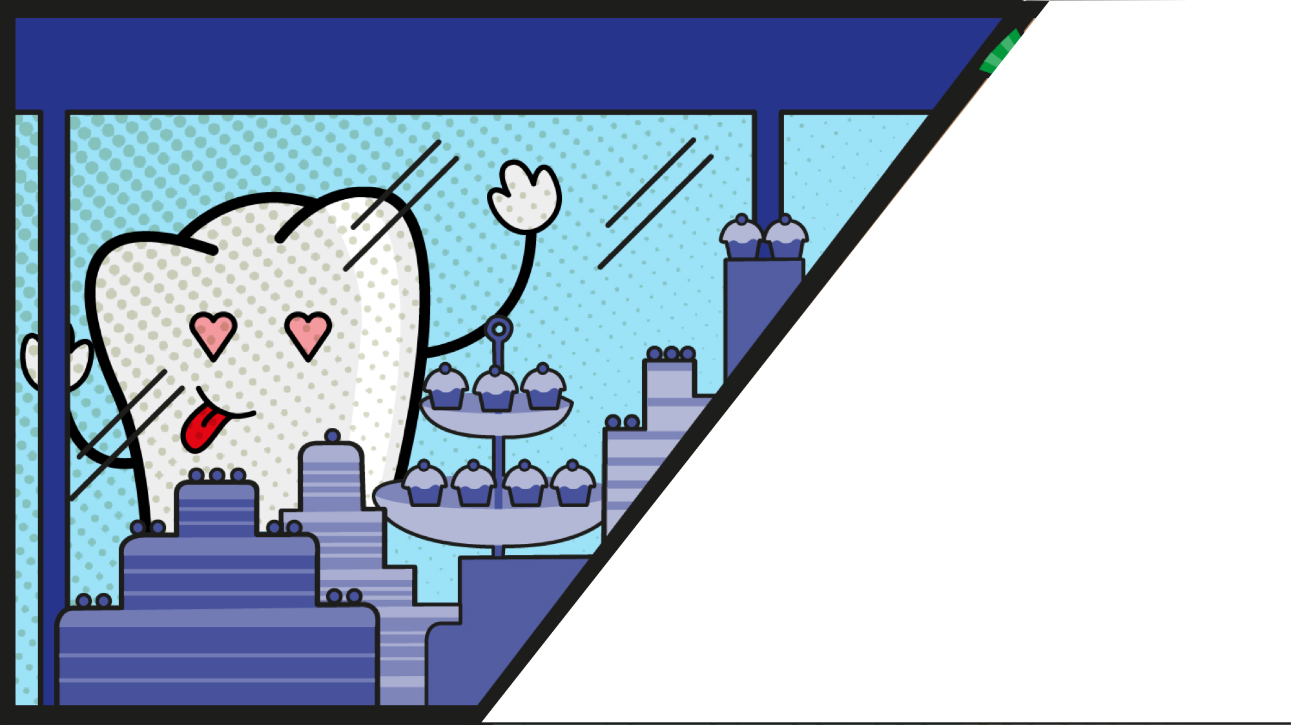

Slide 13
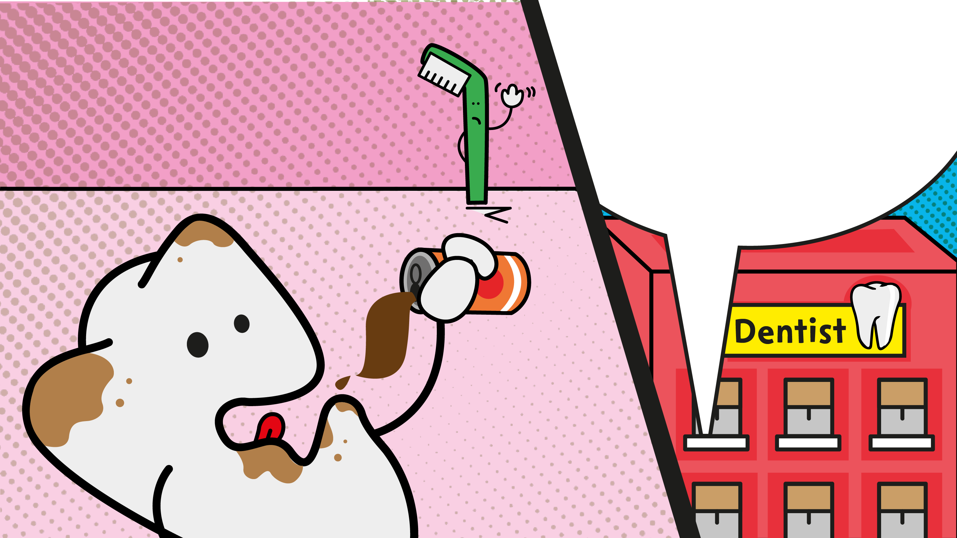

Slide 14

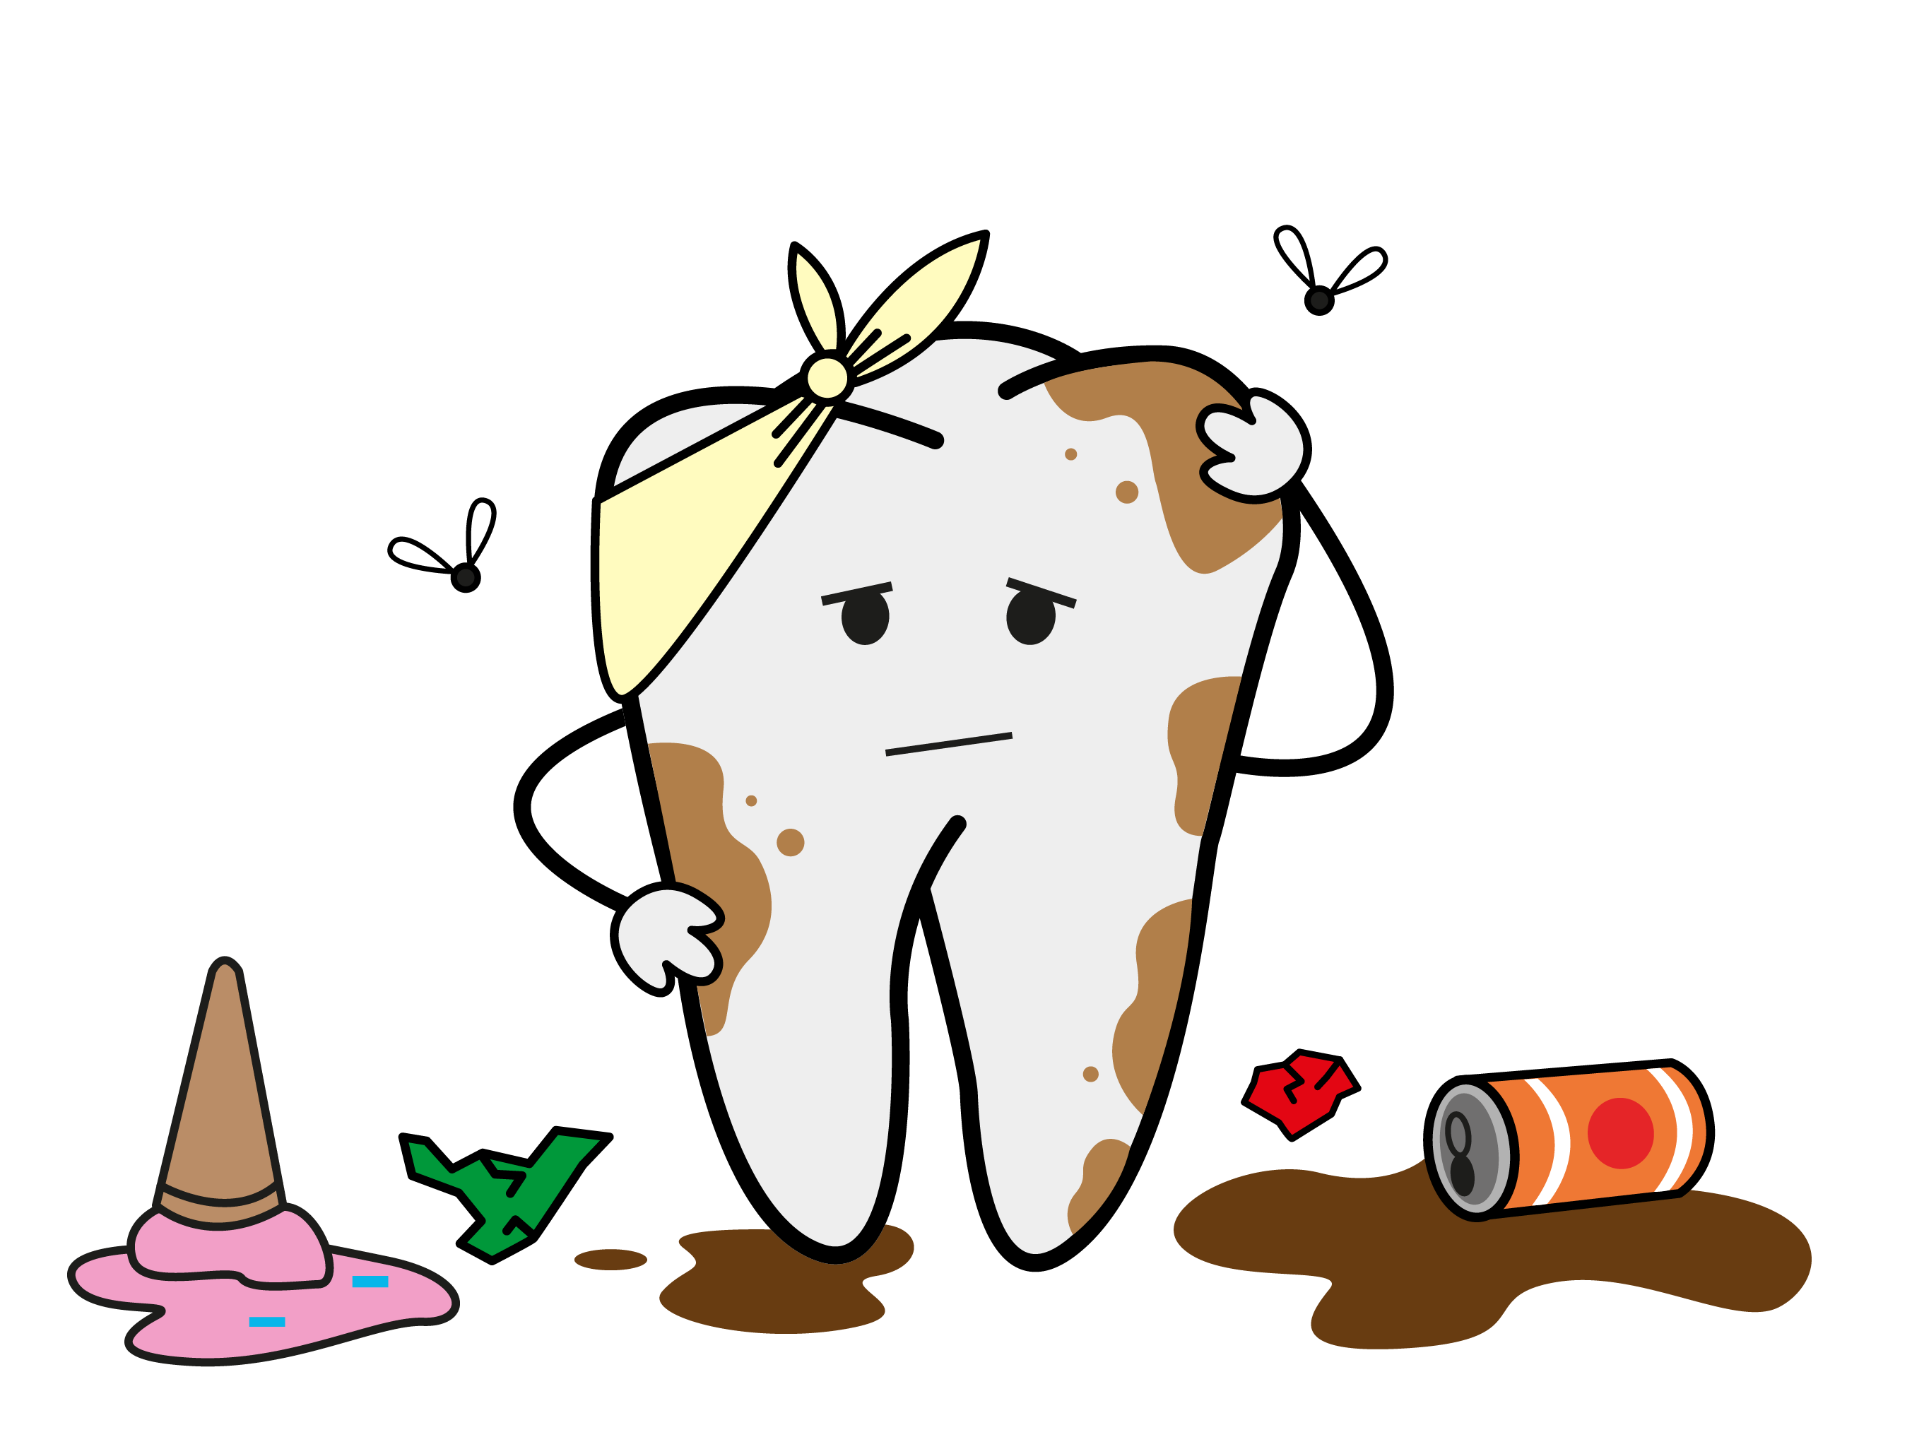

Slide 15
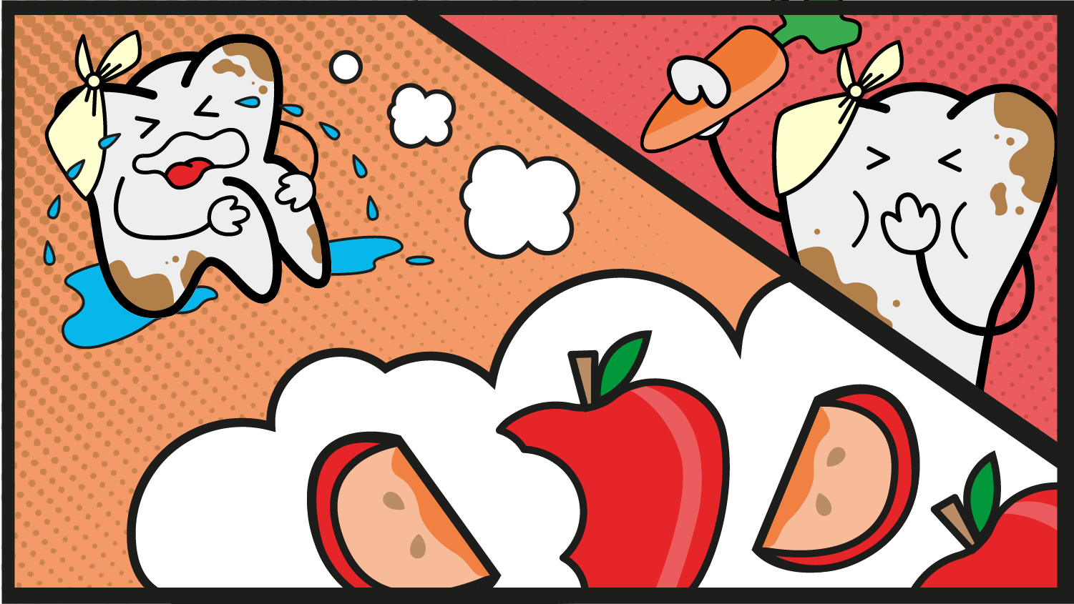

Slide 16
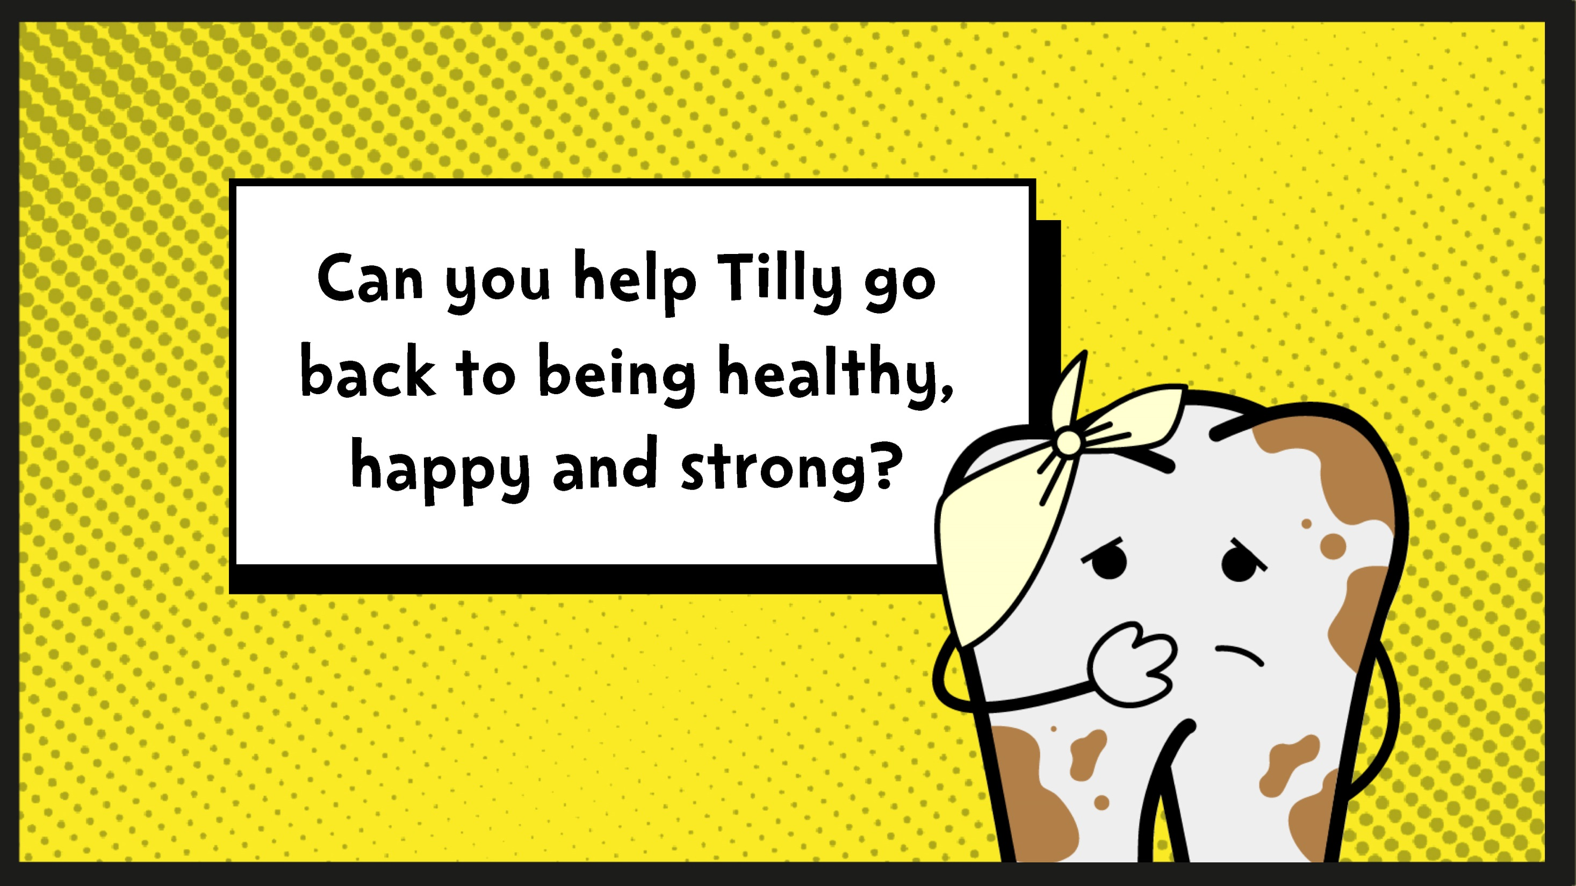

Slide 17
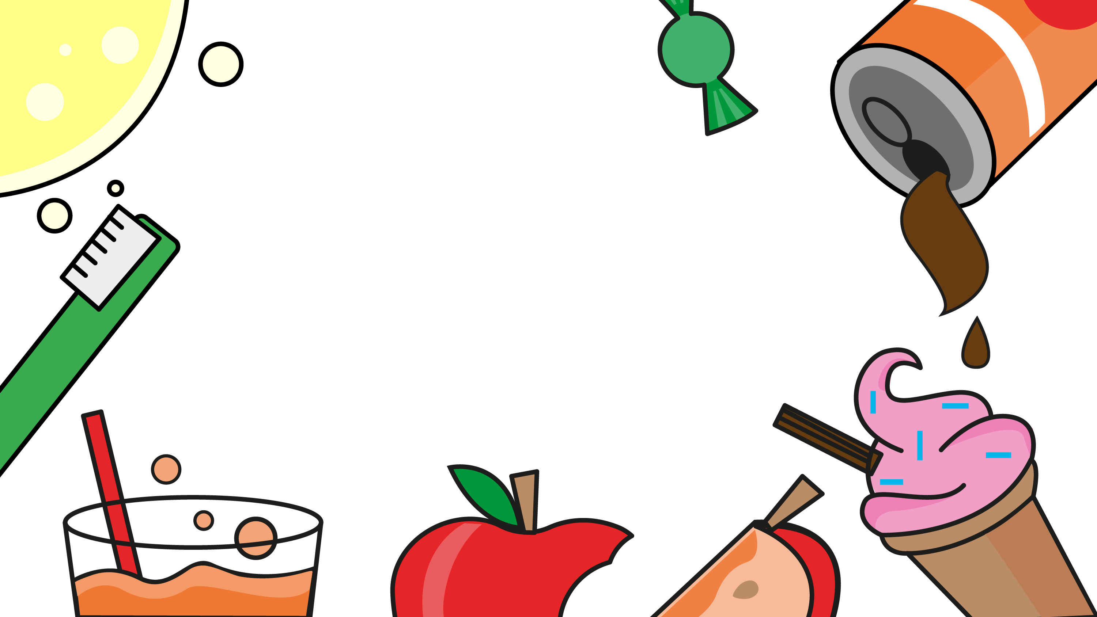
Notes:
Answer: B
Many breakfast cereals contain lots of sugar. The best choices for keeping teeth healthy are low-sugar foods like wheat biscuit cereal.

Slide 18
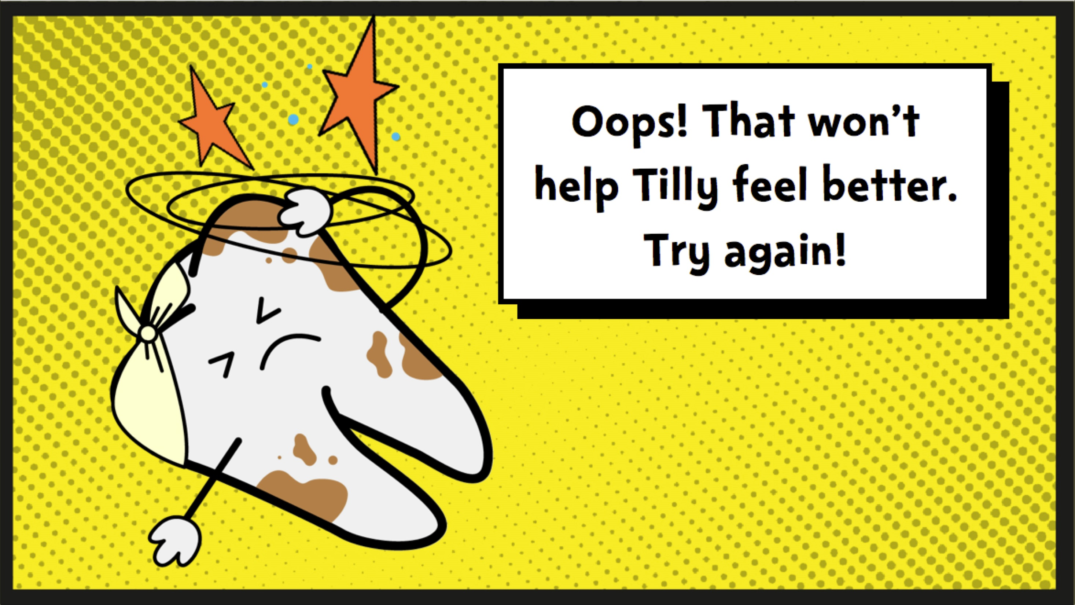

Slide 19
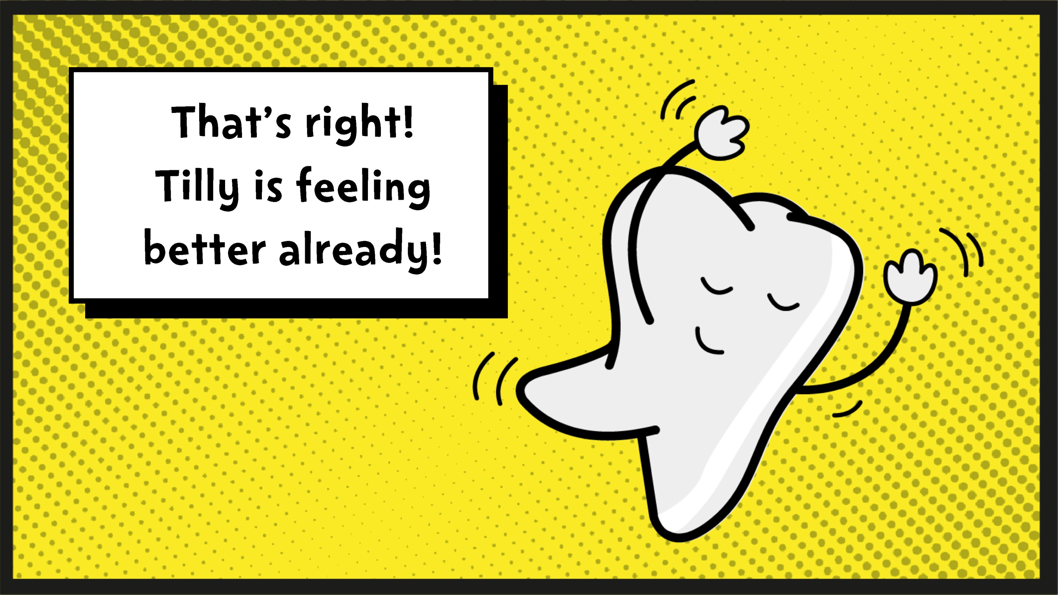

Slide 20
Notes:
Answer: C
Fruit and veg are always a great choice for a snack!

Slide 23
Notes:
Answer: A
Cake and ice cream both contain lots of sugar. Plain yoghurt with fresh fruit is a better choice.

Slide 26
Notes:
Answer: C
Water and semi-skimmed milk are both a great choice. Sports drinks and juice drinks can be very high in sugar.

Slide 29
Notes:
Answer: B
We should all brush twice a day, right before bed and one other time during the day.

Slide 32
Notes:
Answer: C
Use a pea-sized amount of fluoride toothpaste to help keep teeth healthy.

Slide 35
Notes:
Answer: A
After brushing, we should spit out the toothpaste but not rinse with water (or cola!)

Slide 38
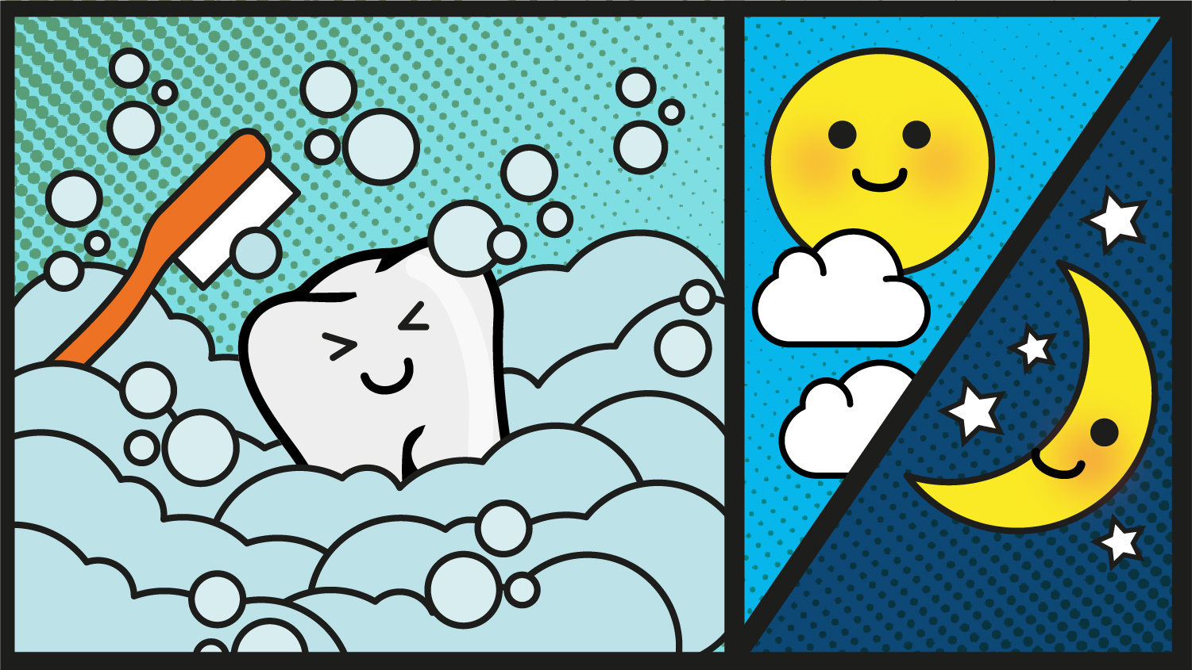

Slide 39
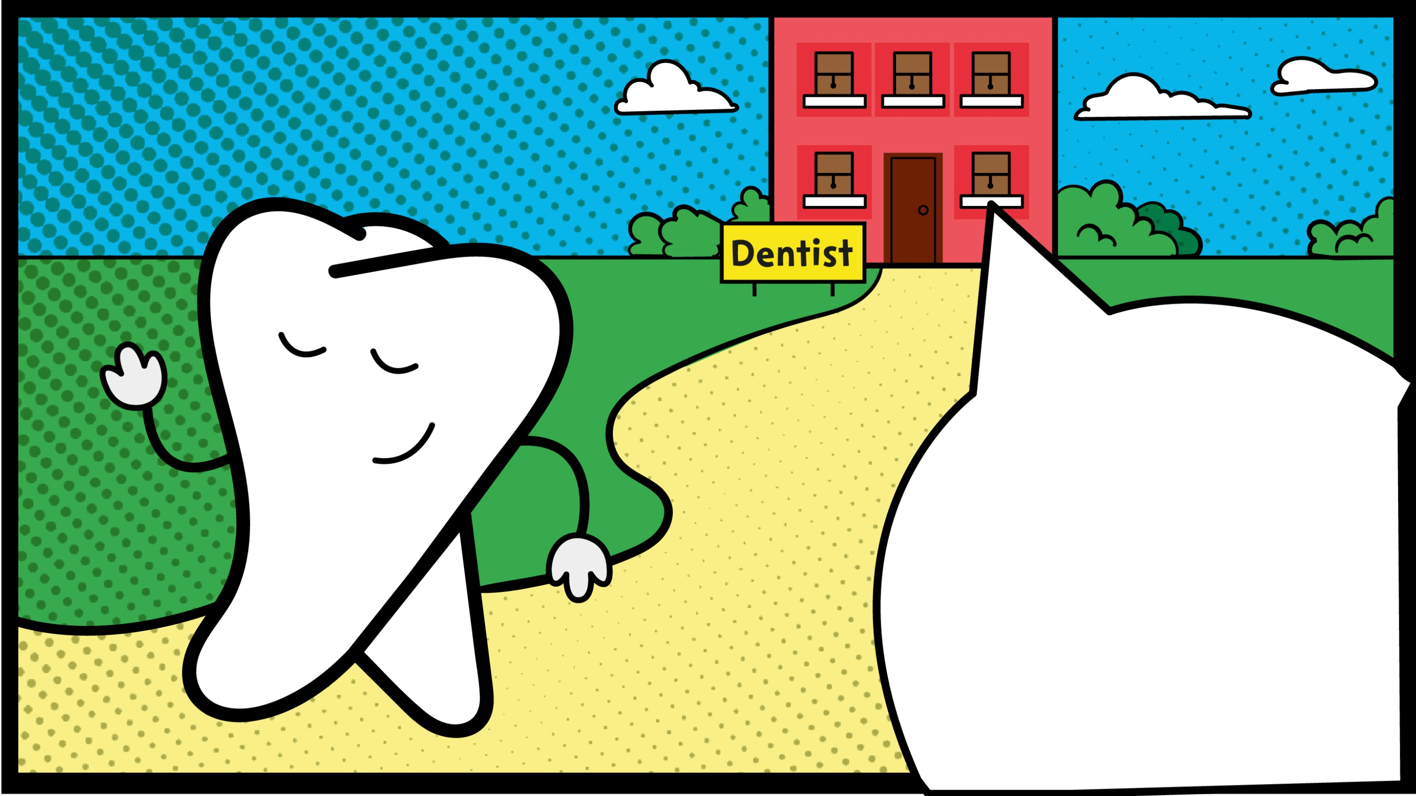

Slide 40
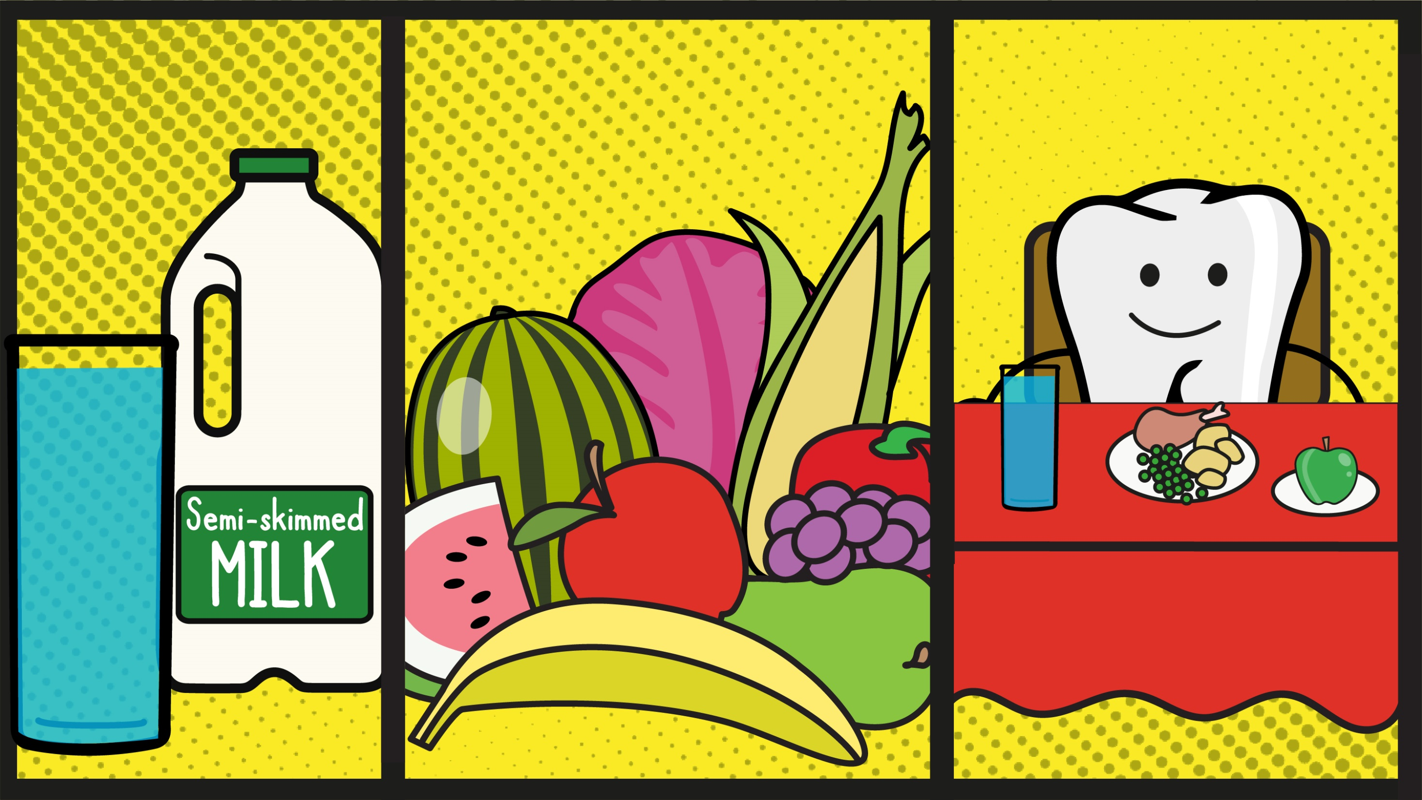

Slide 41
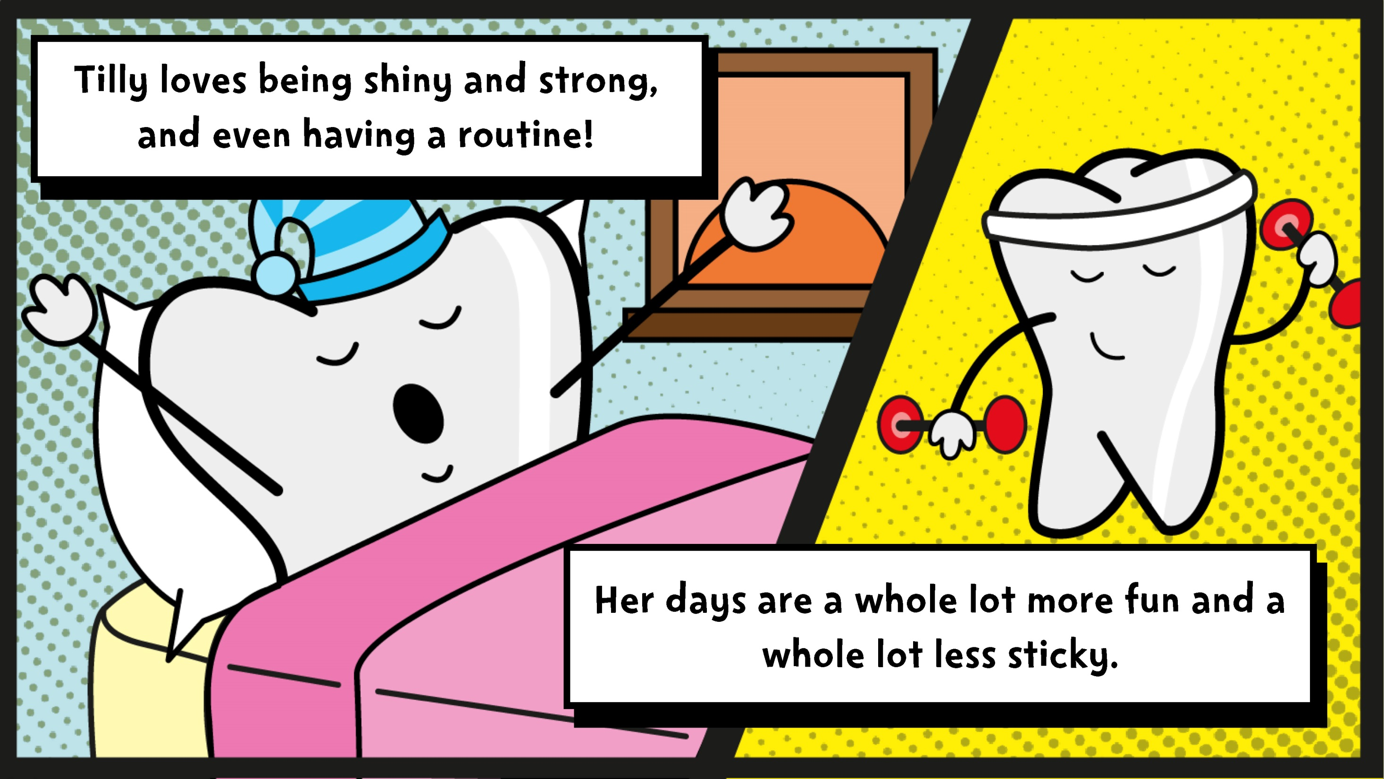

Slide 42
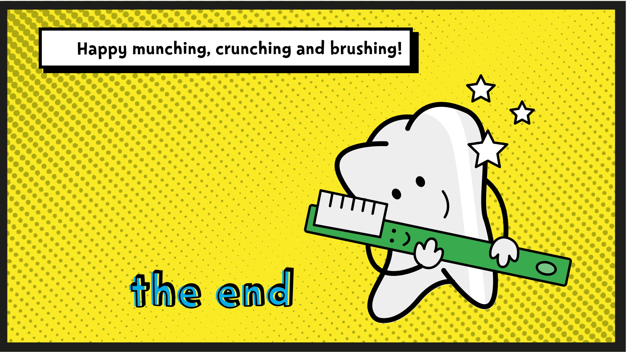

Slide 43
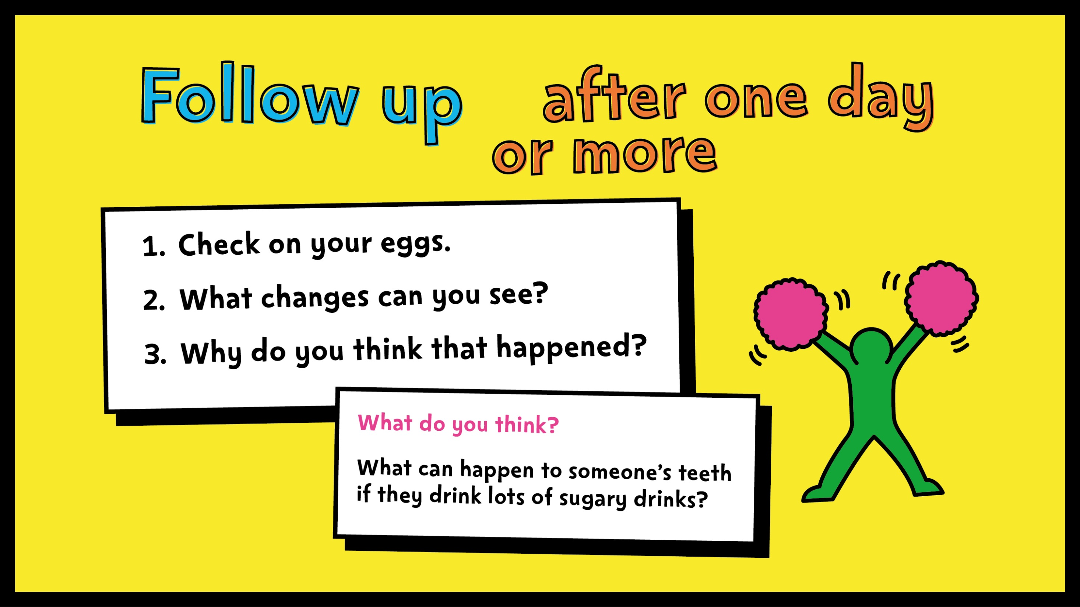
Notes:
After the eggs have stayed in the liquids long enough to change colour, ask pupils to examine them. What changes can they see and what do they think caused the change?
Ask them what they think can happen to our teeth if we drink lots of sugary drinks like the ones they tested.
Optional
If you’ve used a boiled egg, ask pupils what they think will happen if they (gently!) brush their egg with toothpaste and a toothbrush?

Slide 44
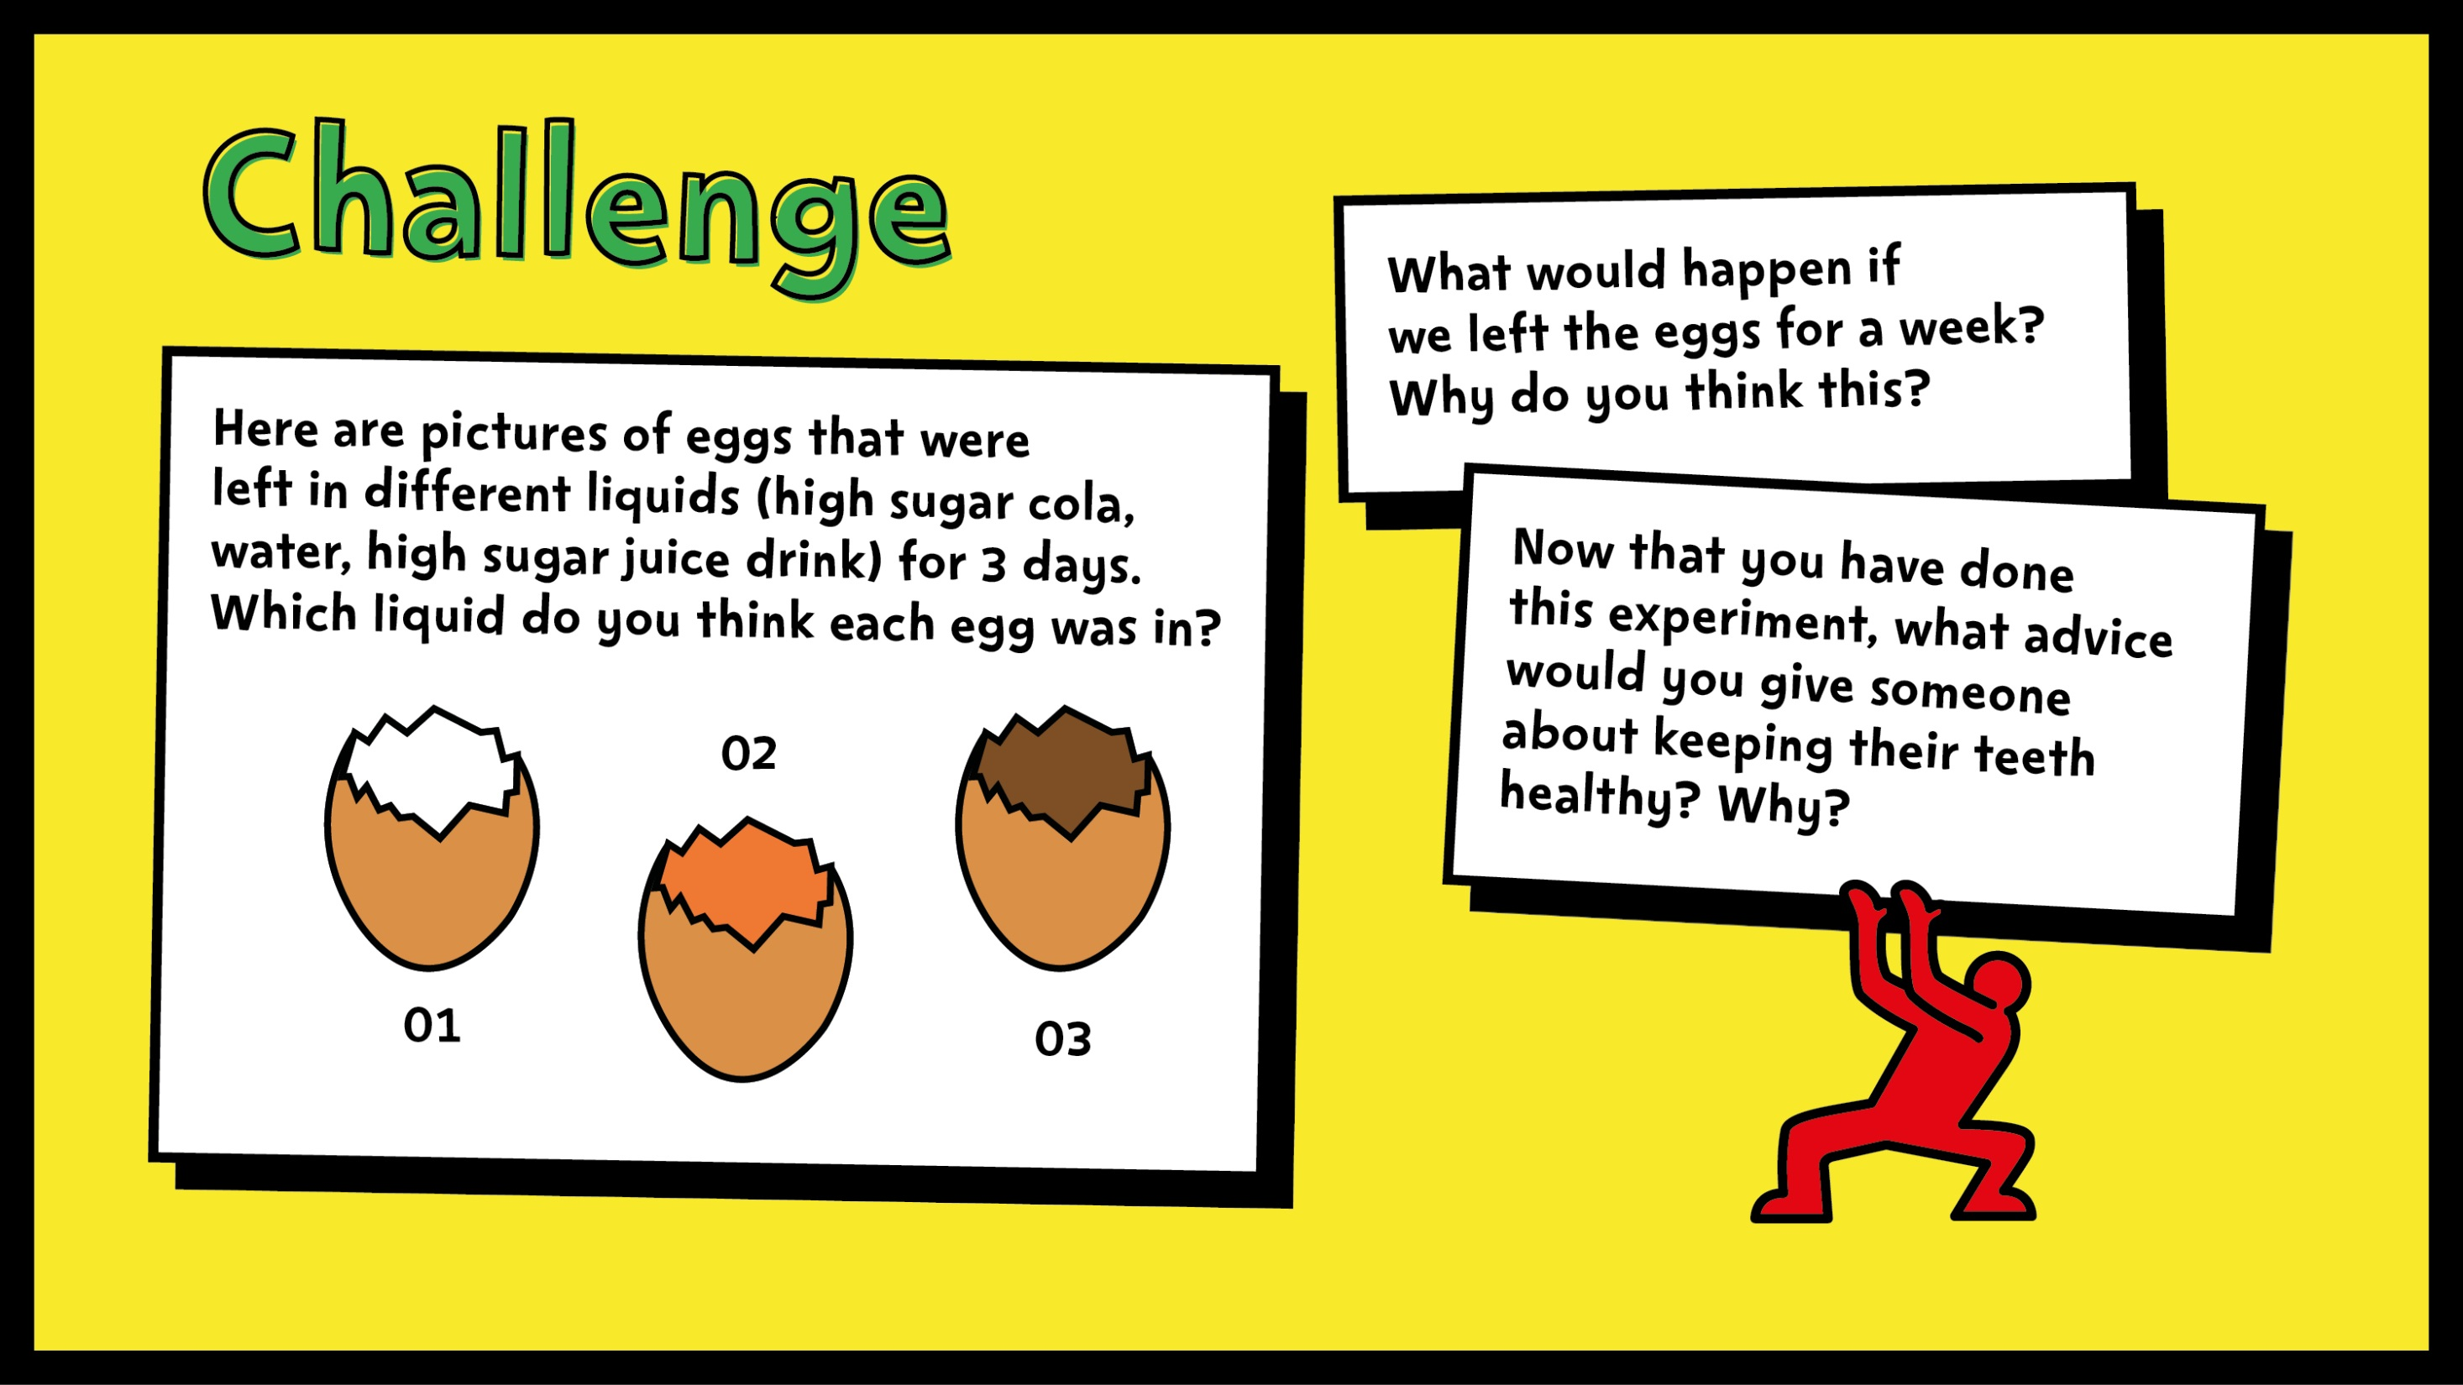
Notes:
For an extra challenge, ask pupils to share their ideas about the questions on the slide.
Ask them what kind of advice they can give to others about keeping their teeth healthy. Answers should include:
eat and drink less sugary foods
brush your teeth twice a day (at night, right before bed, and at one other time)
use a pea-sized amount of fluoride toothpaste
spit, don’t rinse!
visit your dentist regularly.

