Slide 1


Notes:
Please note that this presentation includes quiz questions and the response slides (‘Oops, try again! or ‘That’s right!) will show when an answer is clicked on. The next ‘Background information for teachers’ slide is hidden and will not show in presentation mode.

Slide 2
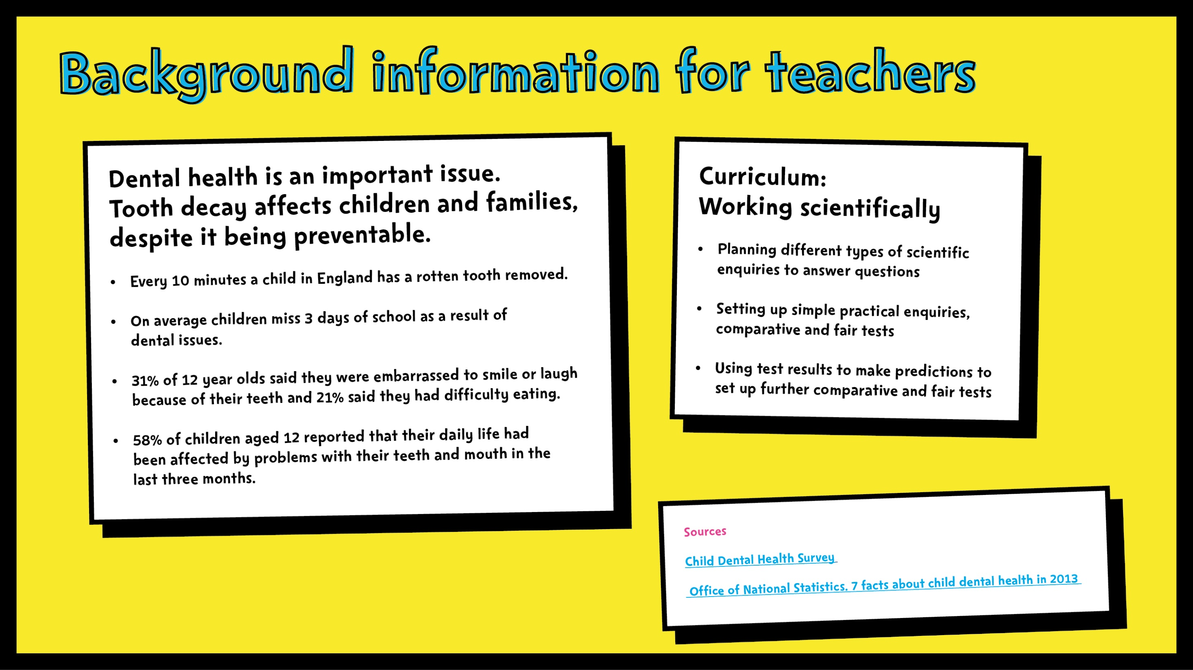

Slide 3
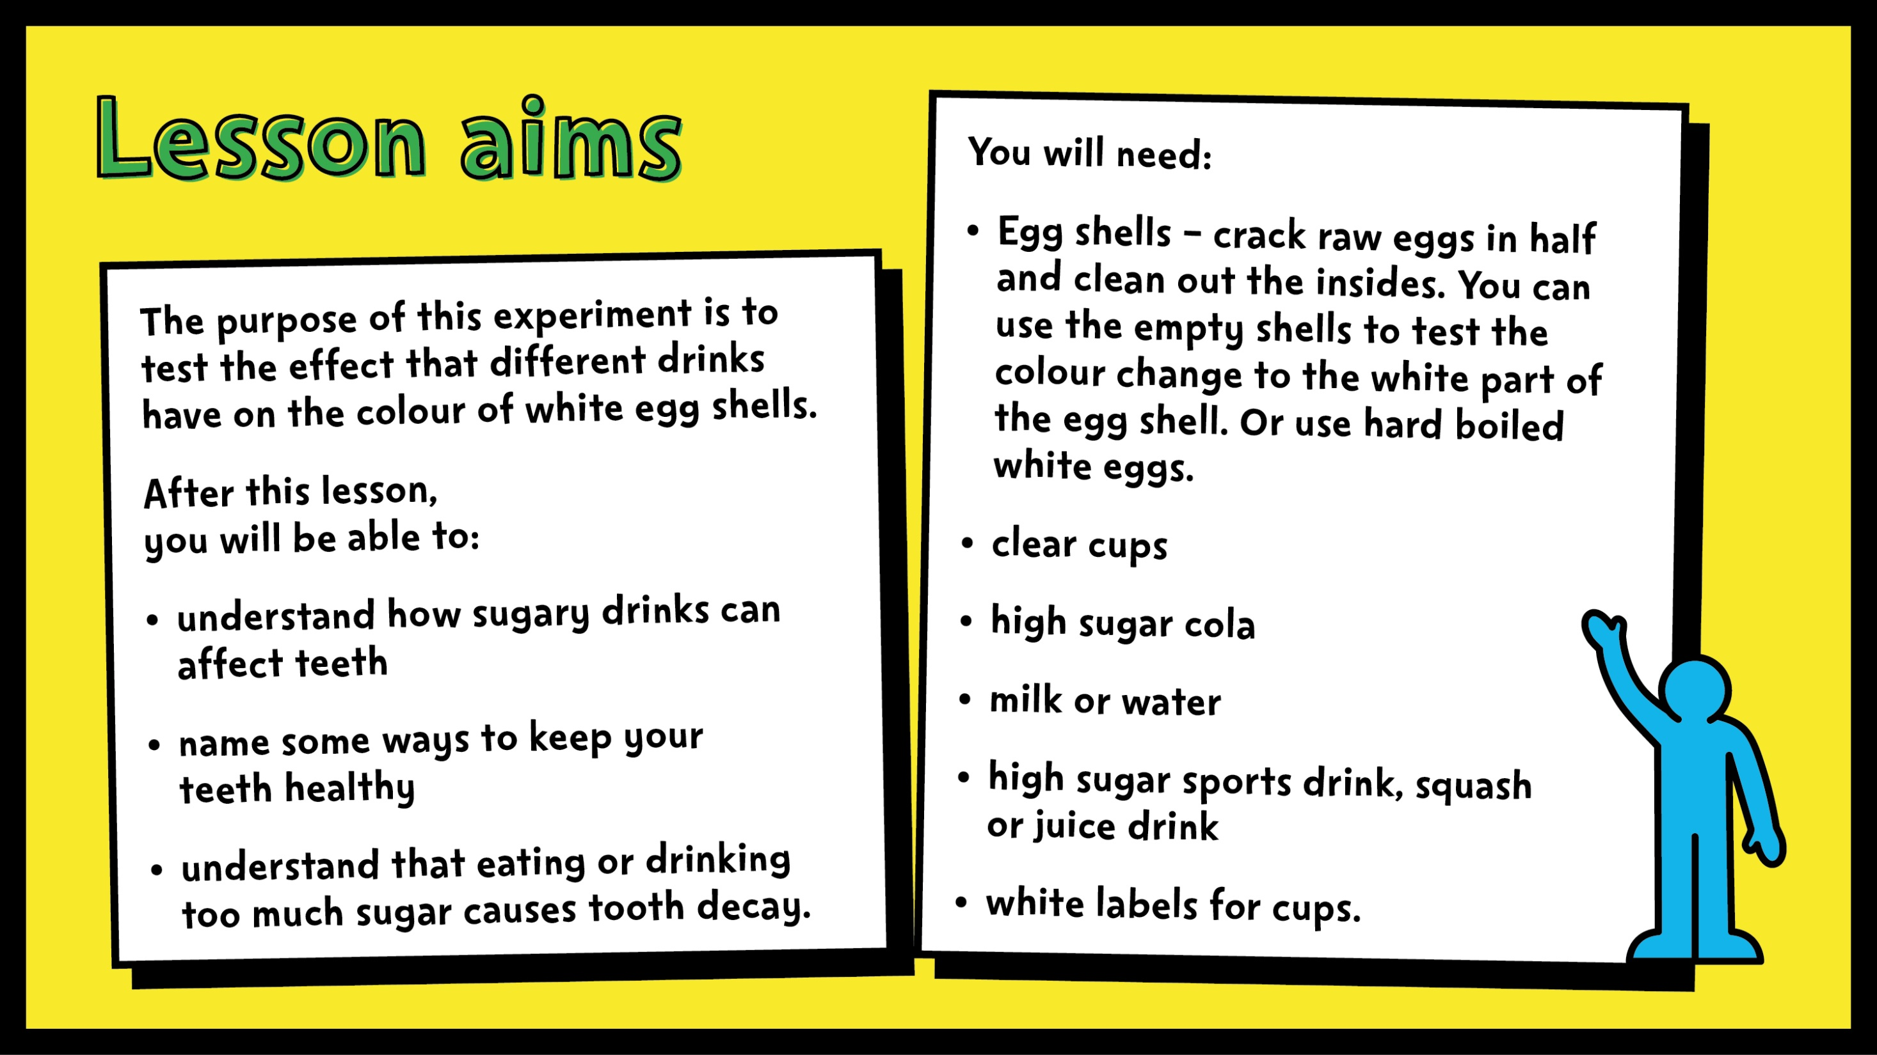

Slide 4
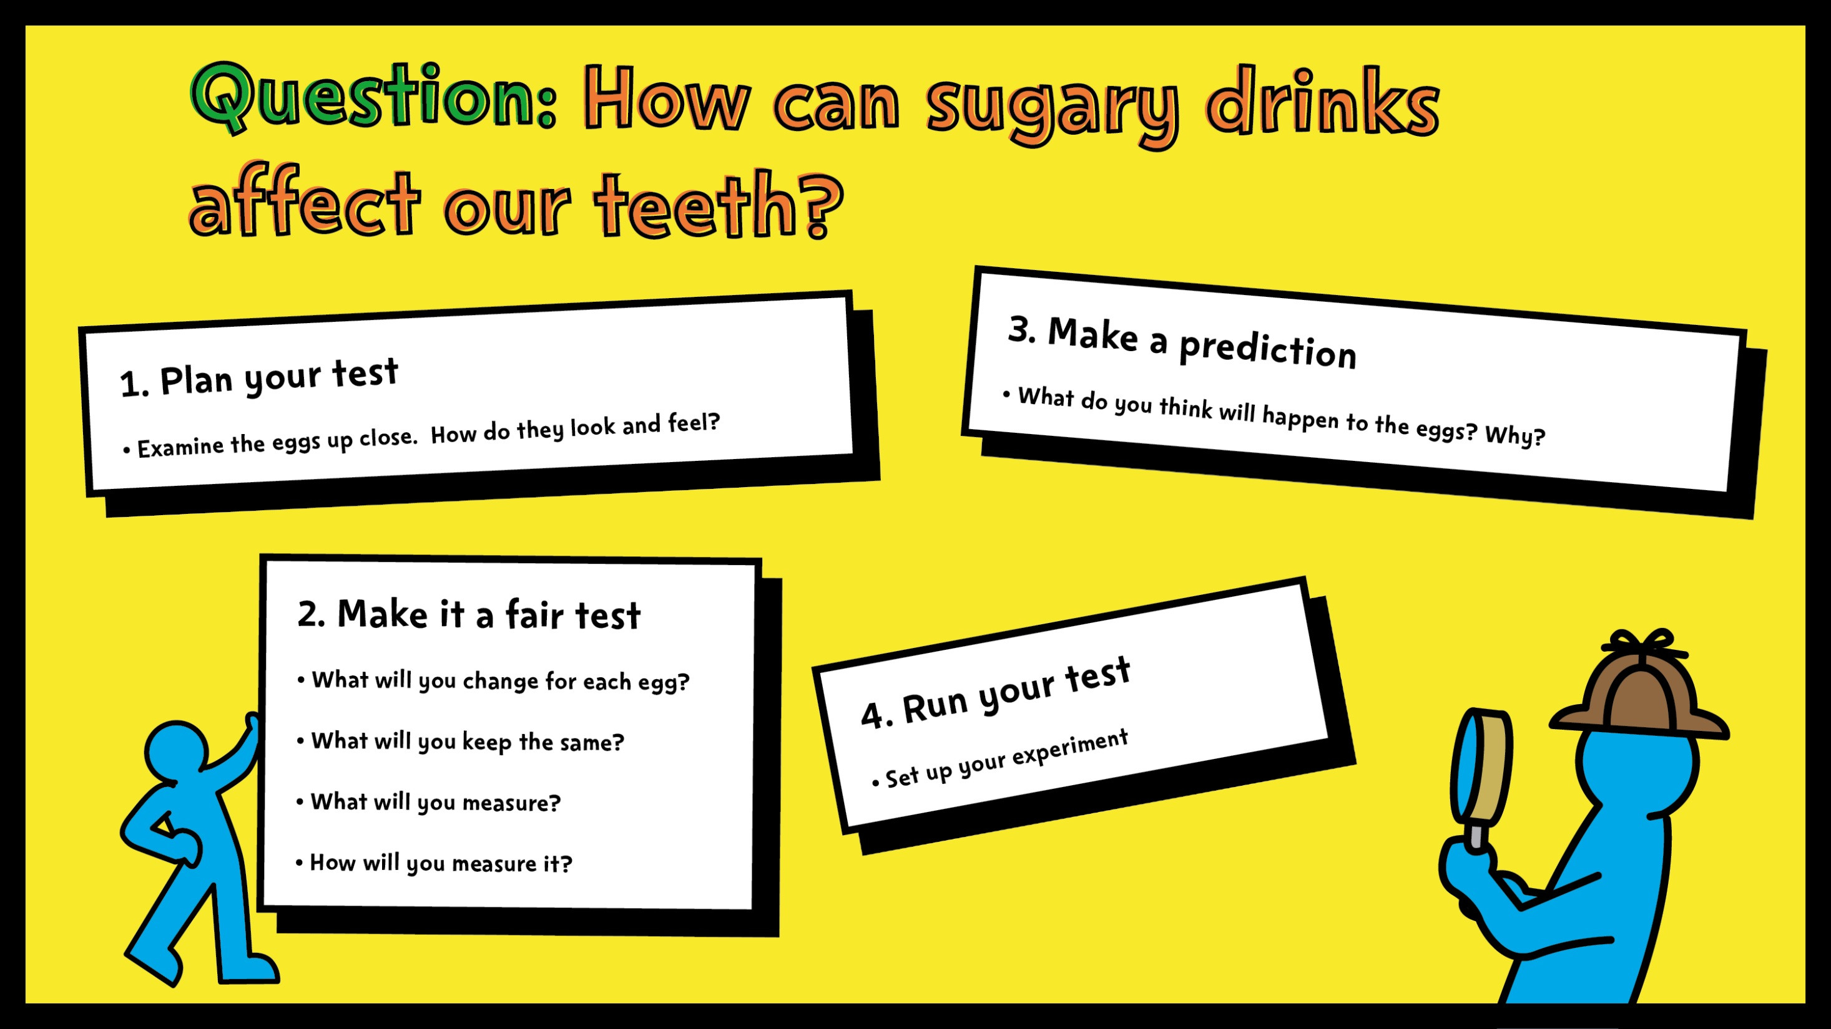
Notes:
Give pupils all equipment and explain that they need to plan an experiment to test the affect of different liquids, including sugary drinks like cola, on teeth.
Plan your test
Ask students to think about how they can set up their test. What will they need? How will they arrange it?
Make it a fair test
What will you keep the same for each egg? Amount of liquid, length of time they stay in the liquid
What will you change? Different liquid in each cup (one should be water)
What will you measure? Amount/rate of discolouration
How will you measure it? Compare to white egg / arrange in order of light to dark etc.
Make a prediction
What do you think will happen to each egg? Why?
Answers should include that the egg will change colour, become sticky, get covered in build-up etc.
Run your test
Allow pupils to set up their test according to their plan.

Slide 5
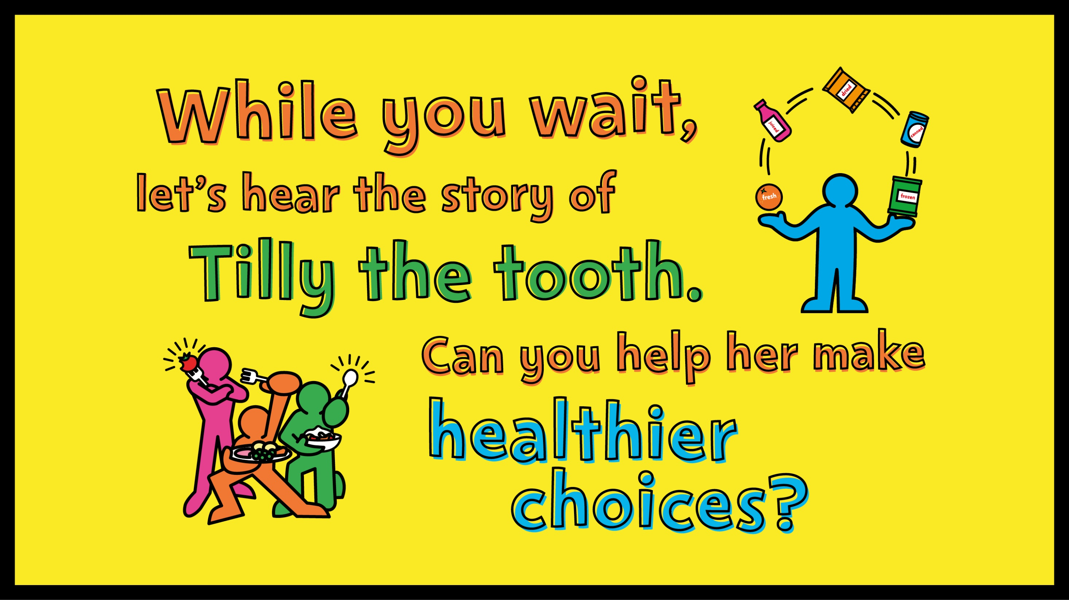

Slide 6

Notes:
Read pupils the story of Tilly the tooth. They will have the chance to answer some questions to help Tilly stay healthy and strong.

Slide 7
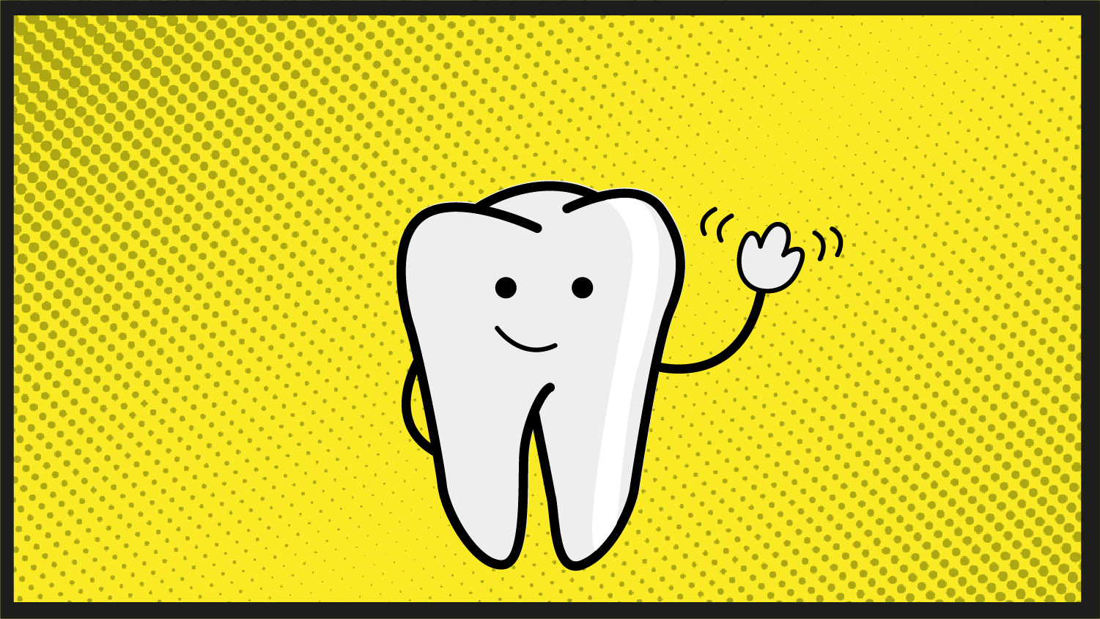

Slide 8
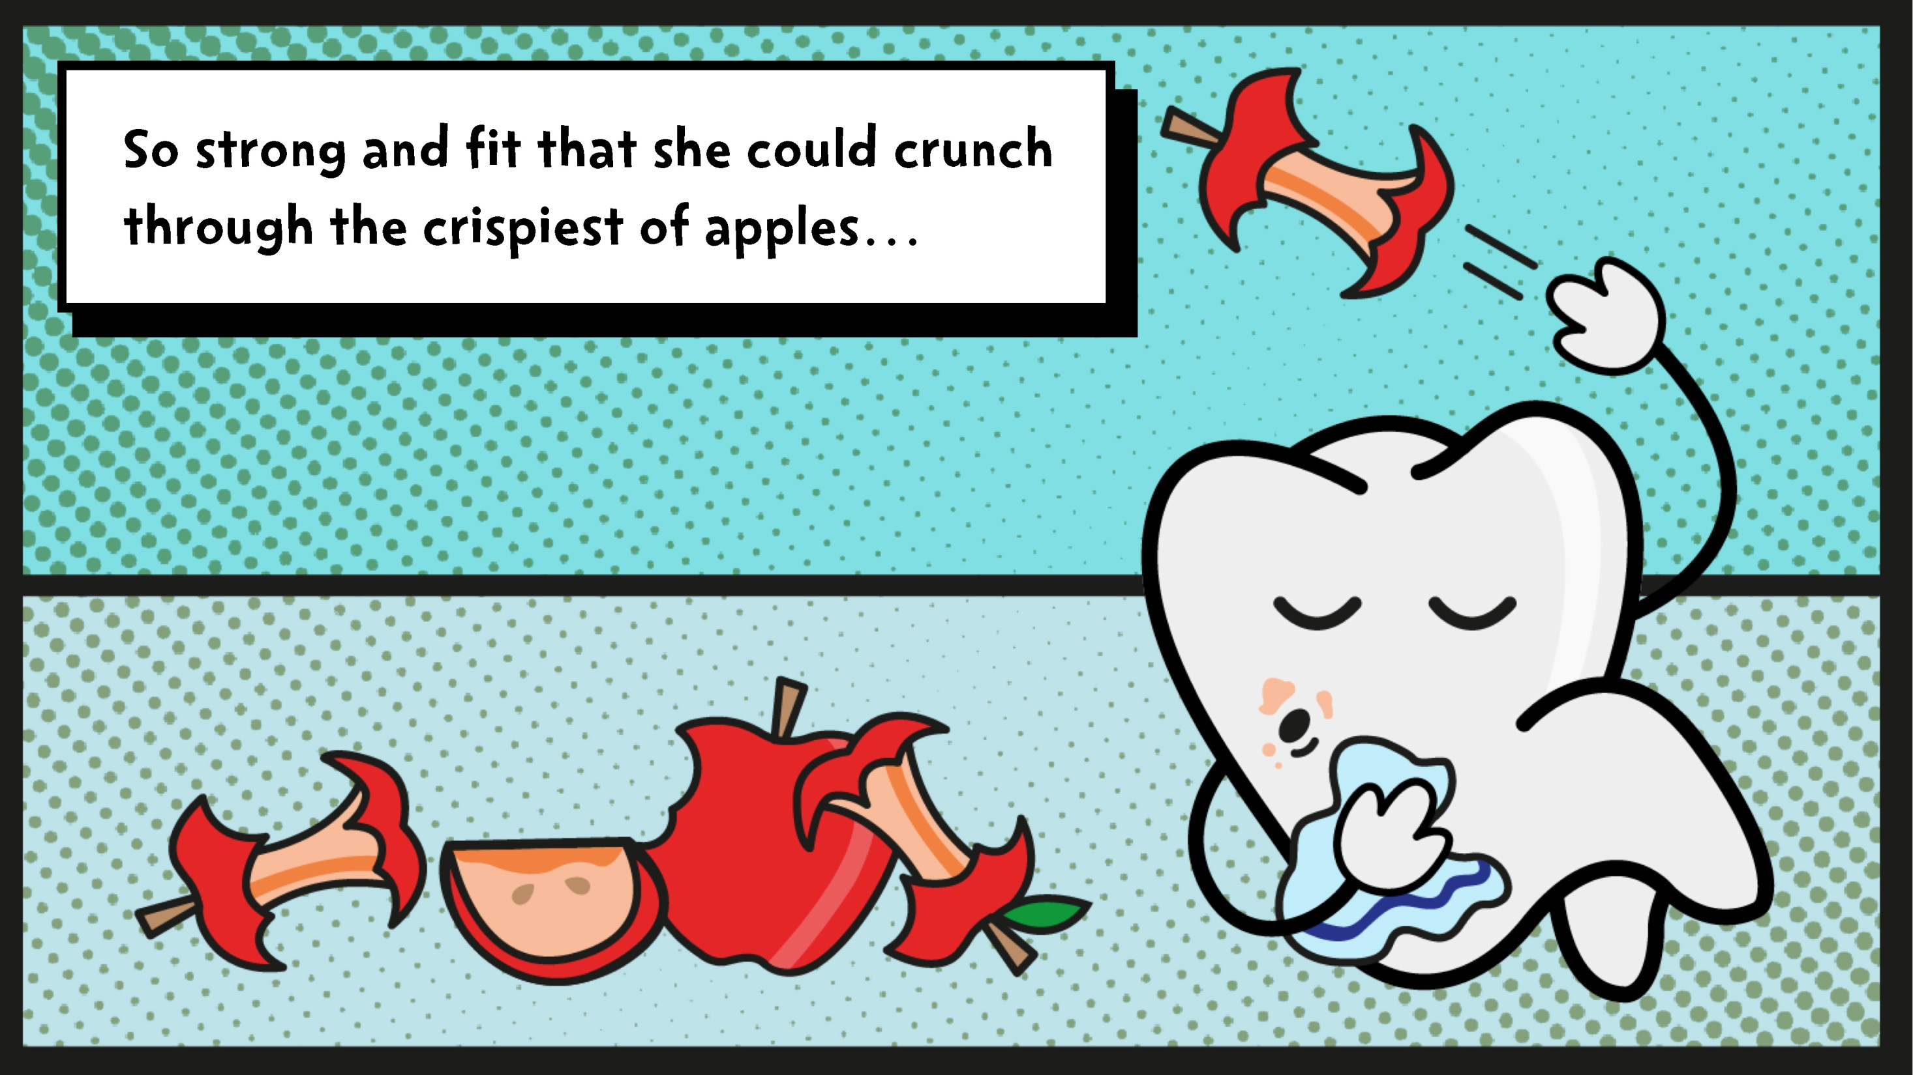

Slide 9
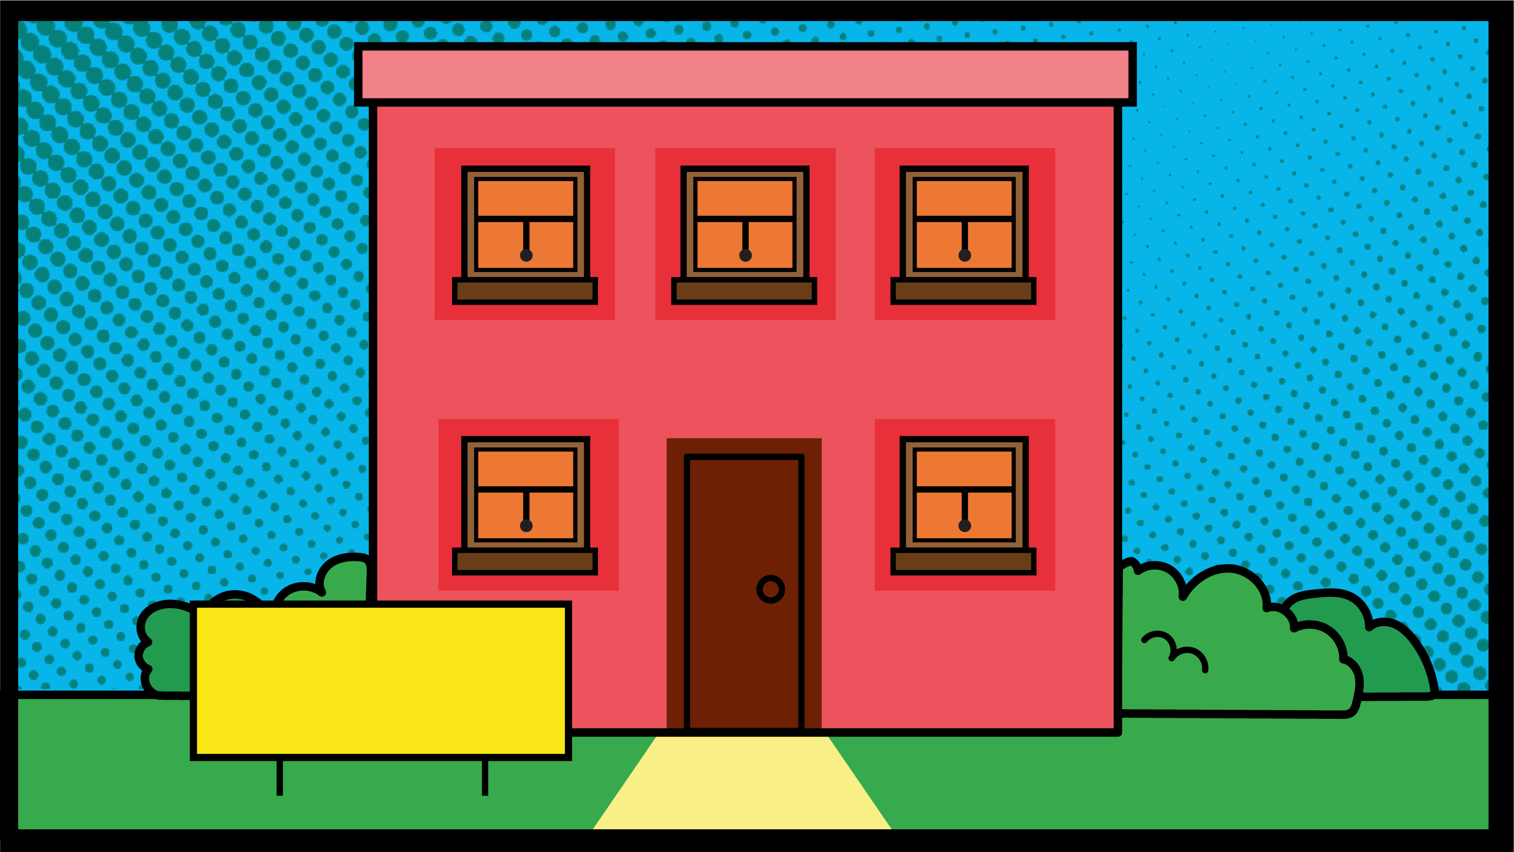

Slide 10

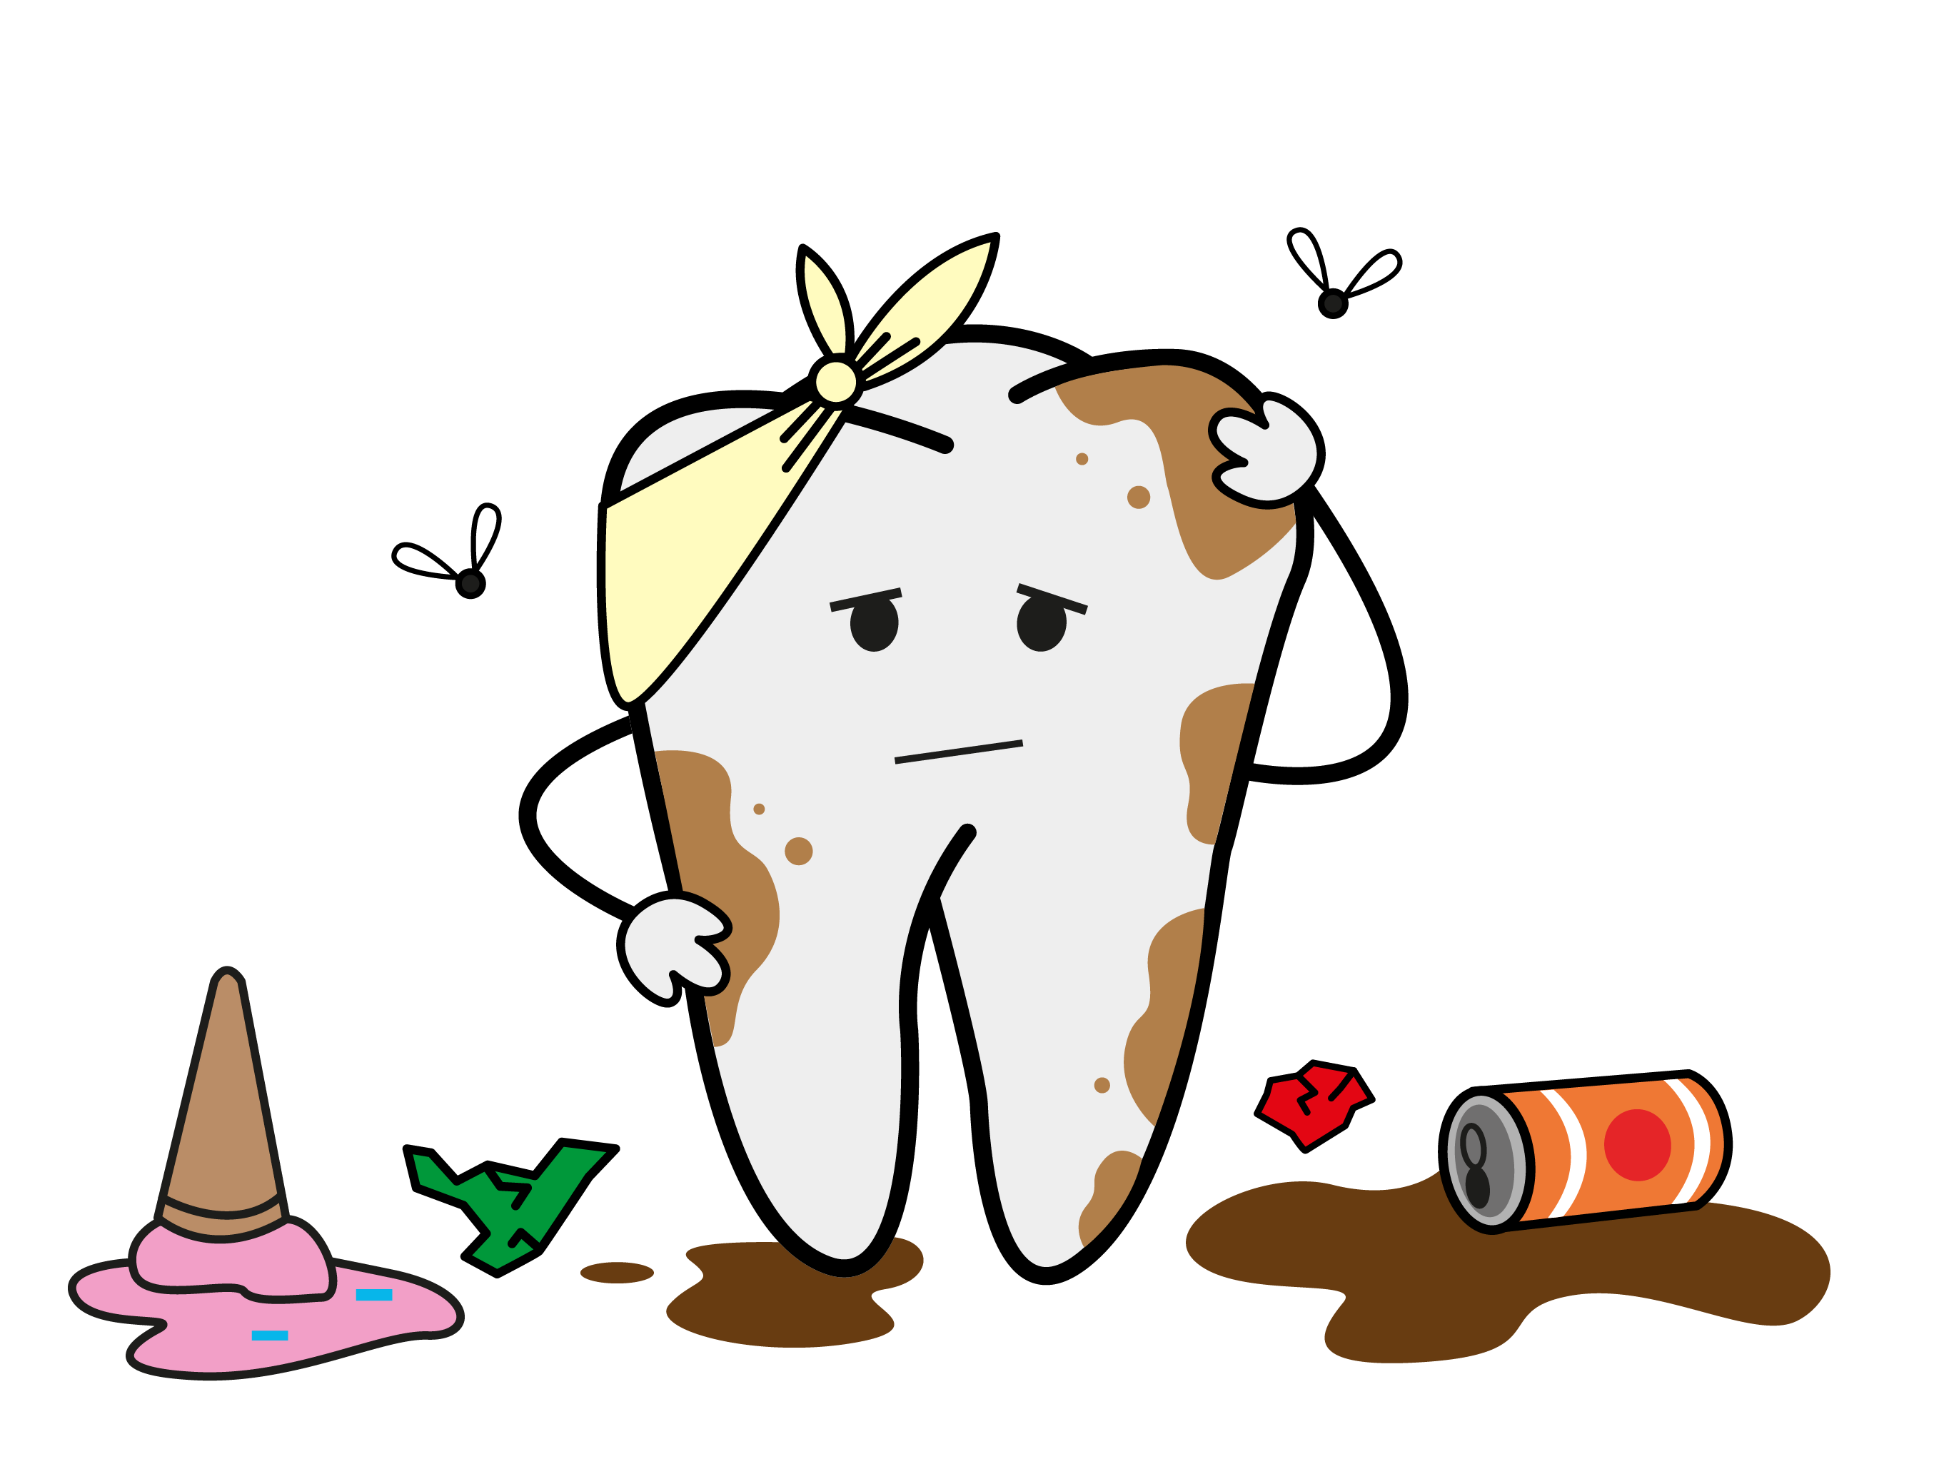
Notes:
After pupils give their guesses, explain that she is covered in a sticky build-up and is in pain, especially when chewing.
Then explain that it’s time to dig deeper and find out how you can help her.

Slide 11

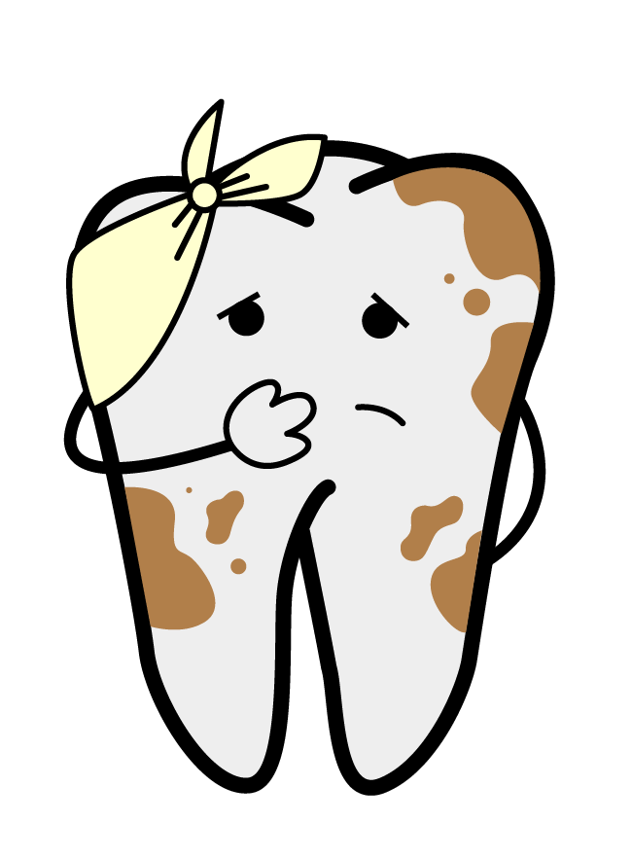
Notes:
Ask pupils to choose what they’d like to ask Tilly about first.

Slide 12
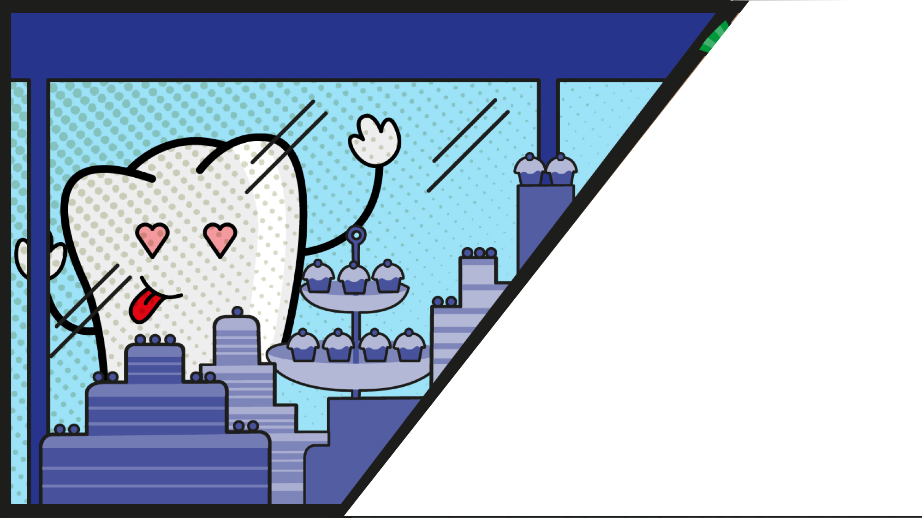
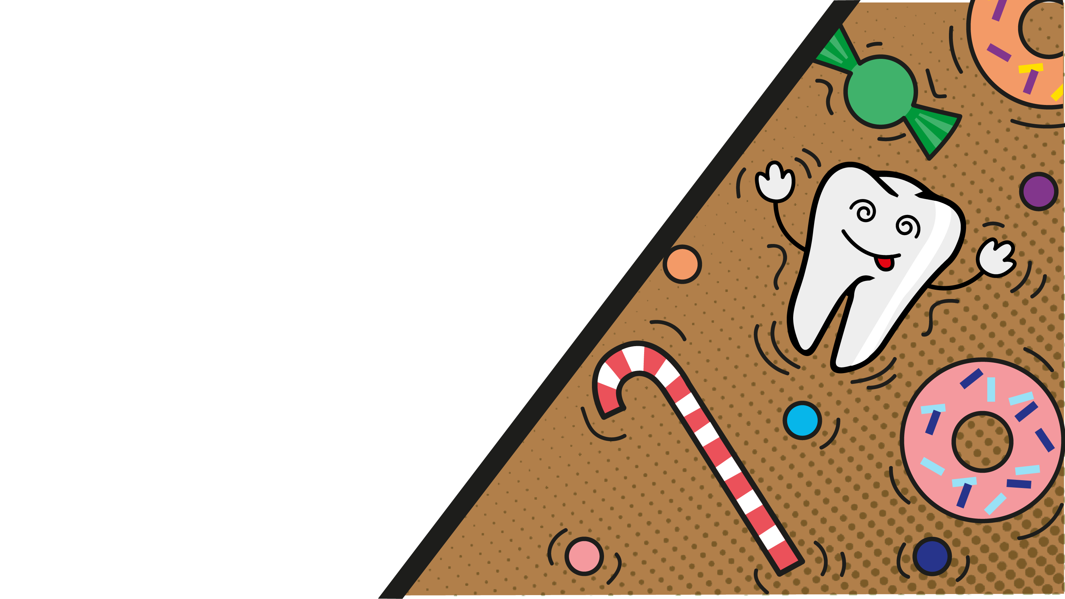
Notes:
Pupils should tell Tilly to eat and drink less sugar. The following slides will give more examples for them to test their knowledge.

Slide 13
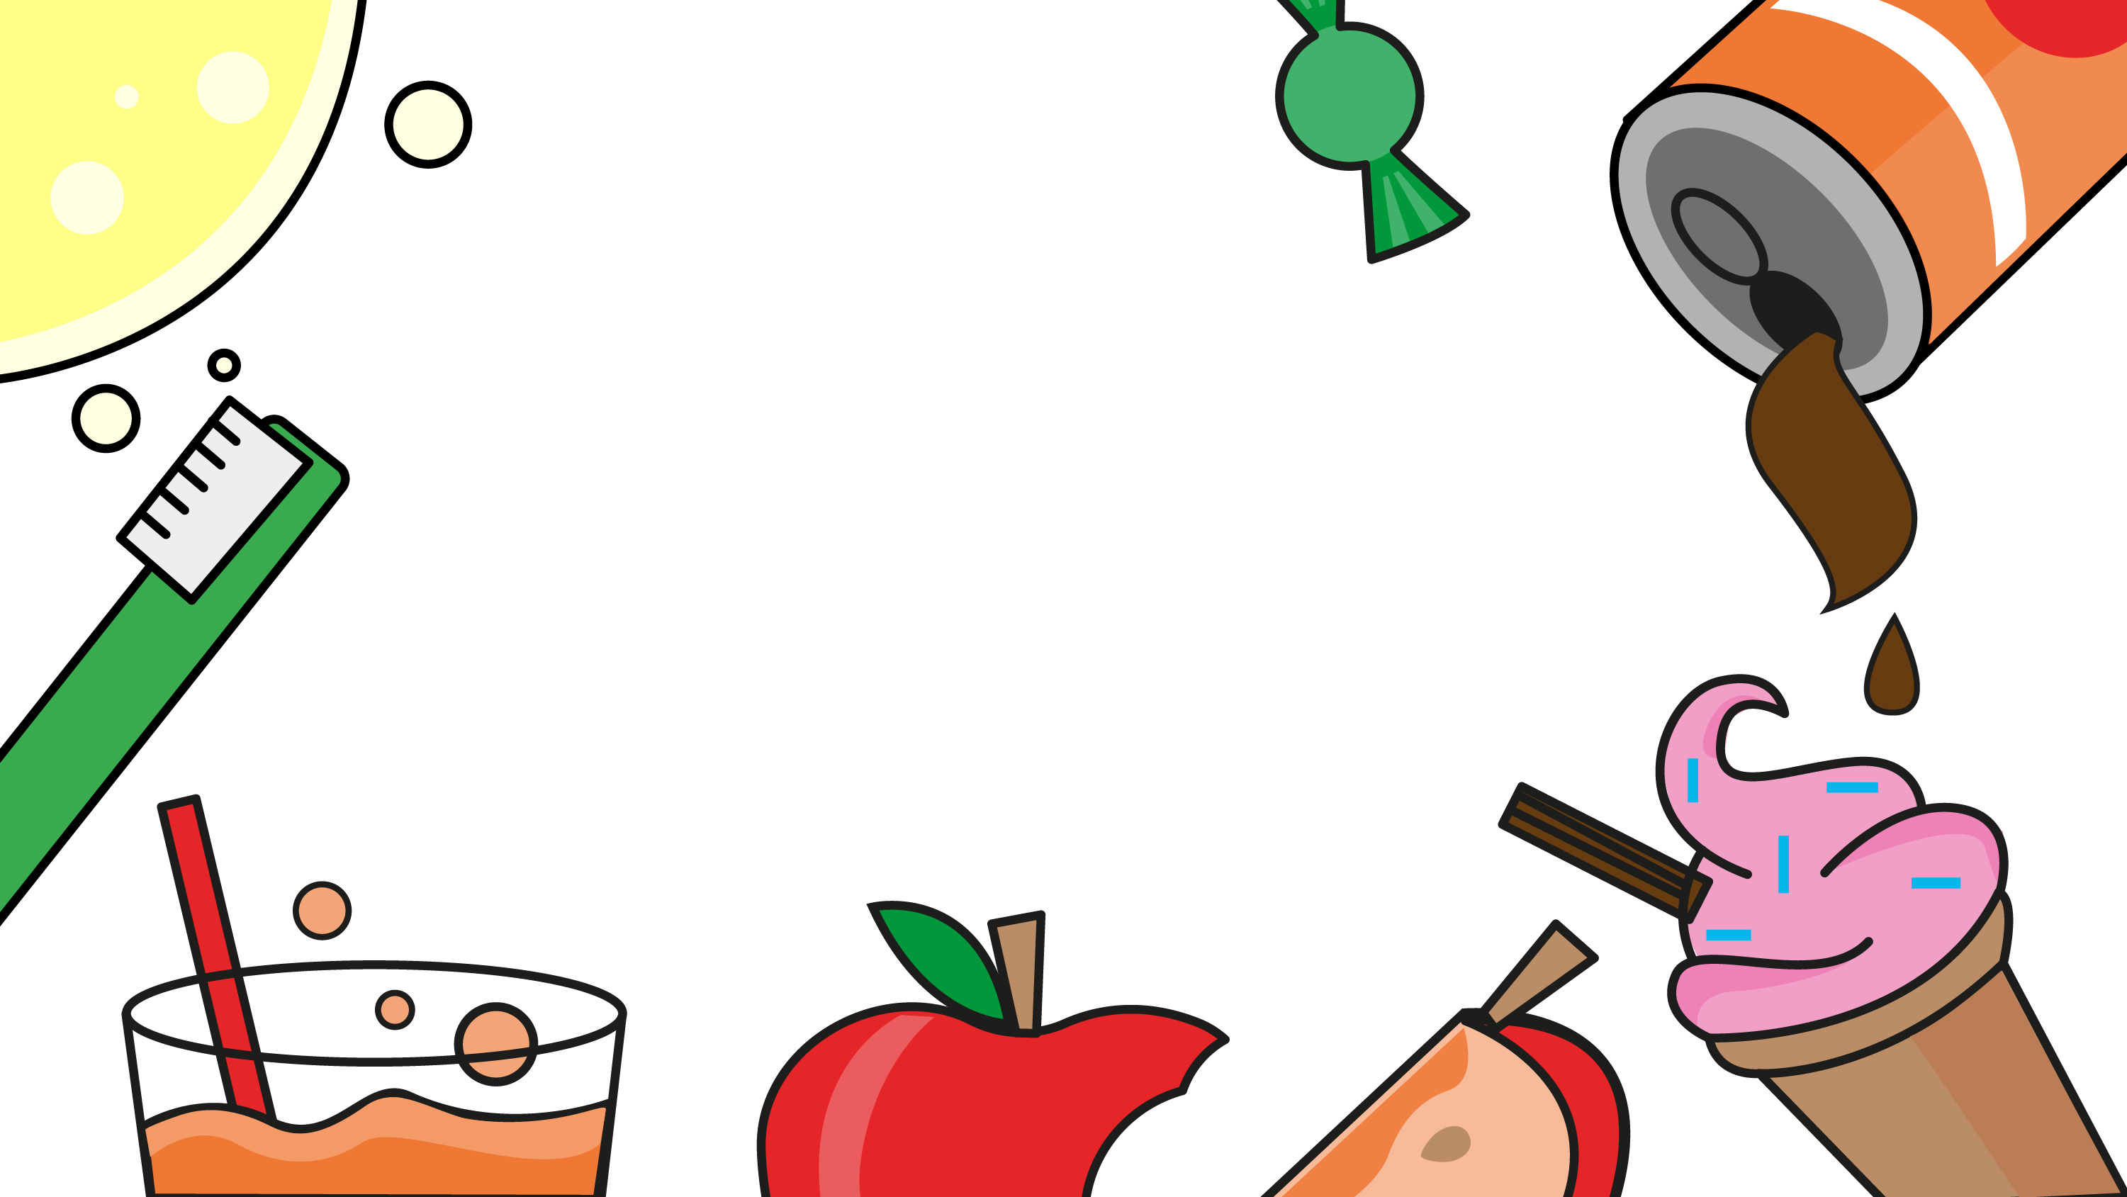
Notes:
Answer: B
Many breakfast cereals contain lots of sugar. The best choices for keeping teeth healthy are low-sugar foods like wheat biscuit cereal.
Ask pupils to choose which option in each group is the lowest in sugar, and best choice for a food or drink for Tilly.
Ask them to suggest other less sugary foods and drinks that they like.
High in sugar:
cake, biscuits, morning goods (croissants, pain au chocolat, etc.), spreads (including jams, chocolate spread, etc.), ice cream, lollies, confectionary, puddings.
Healthier choices:
fresh or tinned fruit salad
chopped veg and lower fat hummus
plain rice cakes
crackers
malt loaf
lower fat cheese
a small low-fat, lower sugar yoghurt
sugar free jelly
crumpet
bread or toast
water and lower fat milks.

Slide 14
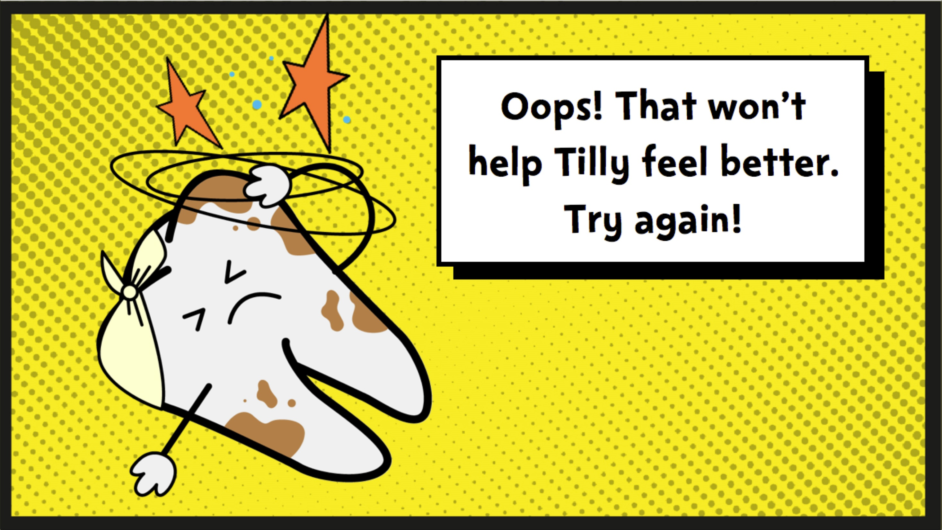

Slide 15
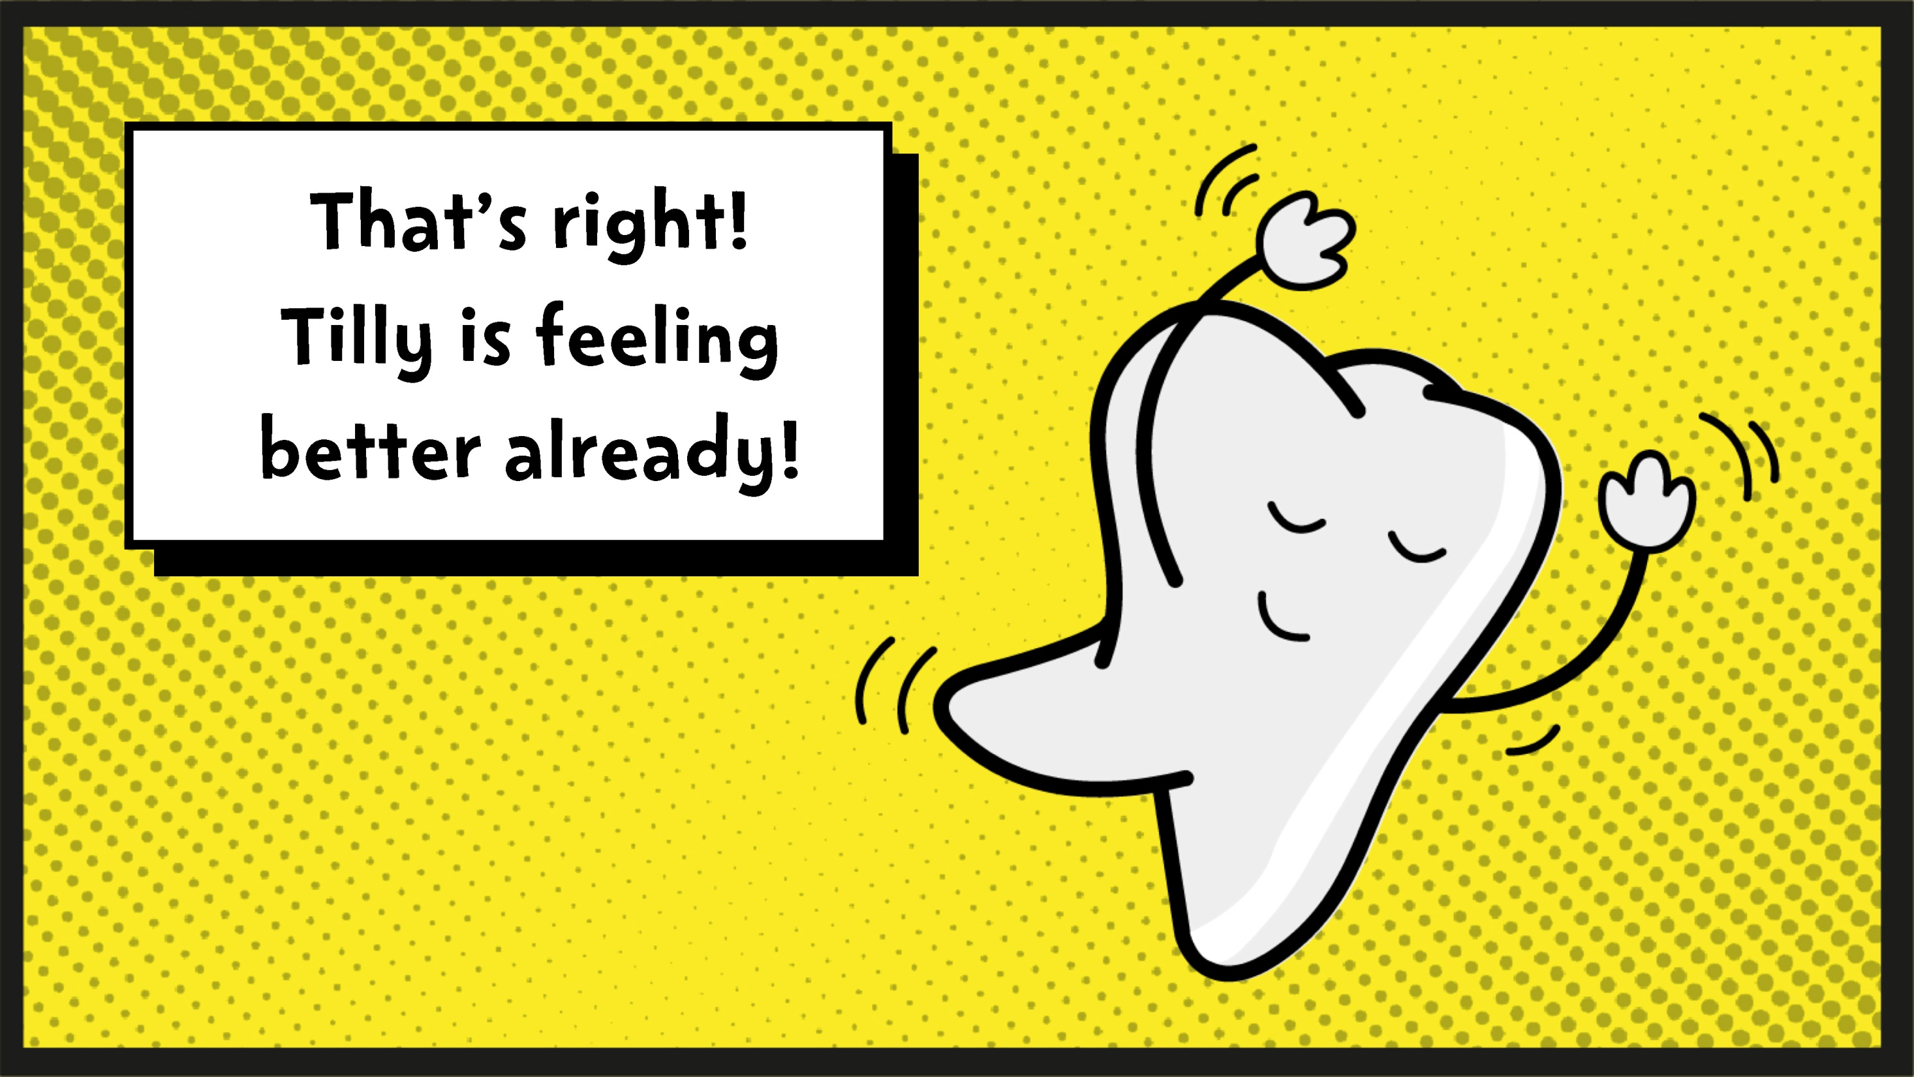

Slide 16
Notes:
Answer: C
Fruit and veg are always a great choice for a snack!

Slide 19
Notes:
Answer: A
Cake and ice cream with chocolate both contain lots of sugar. Plain yoghurt with fresh fruit is a better choice.

Slide 22
Notes:
Answer: C
Water and semi-skimmed milk are both a great choice. Sports drinks and juice drinks can be very high in sugar.

Slide 26
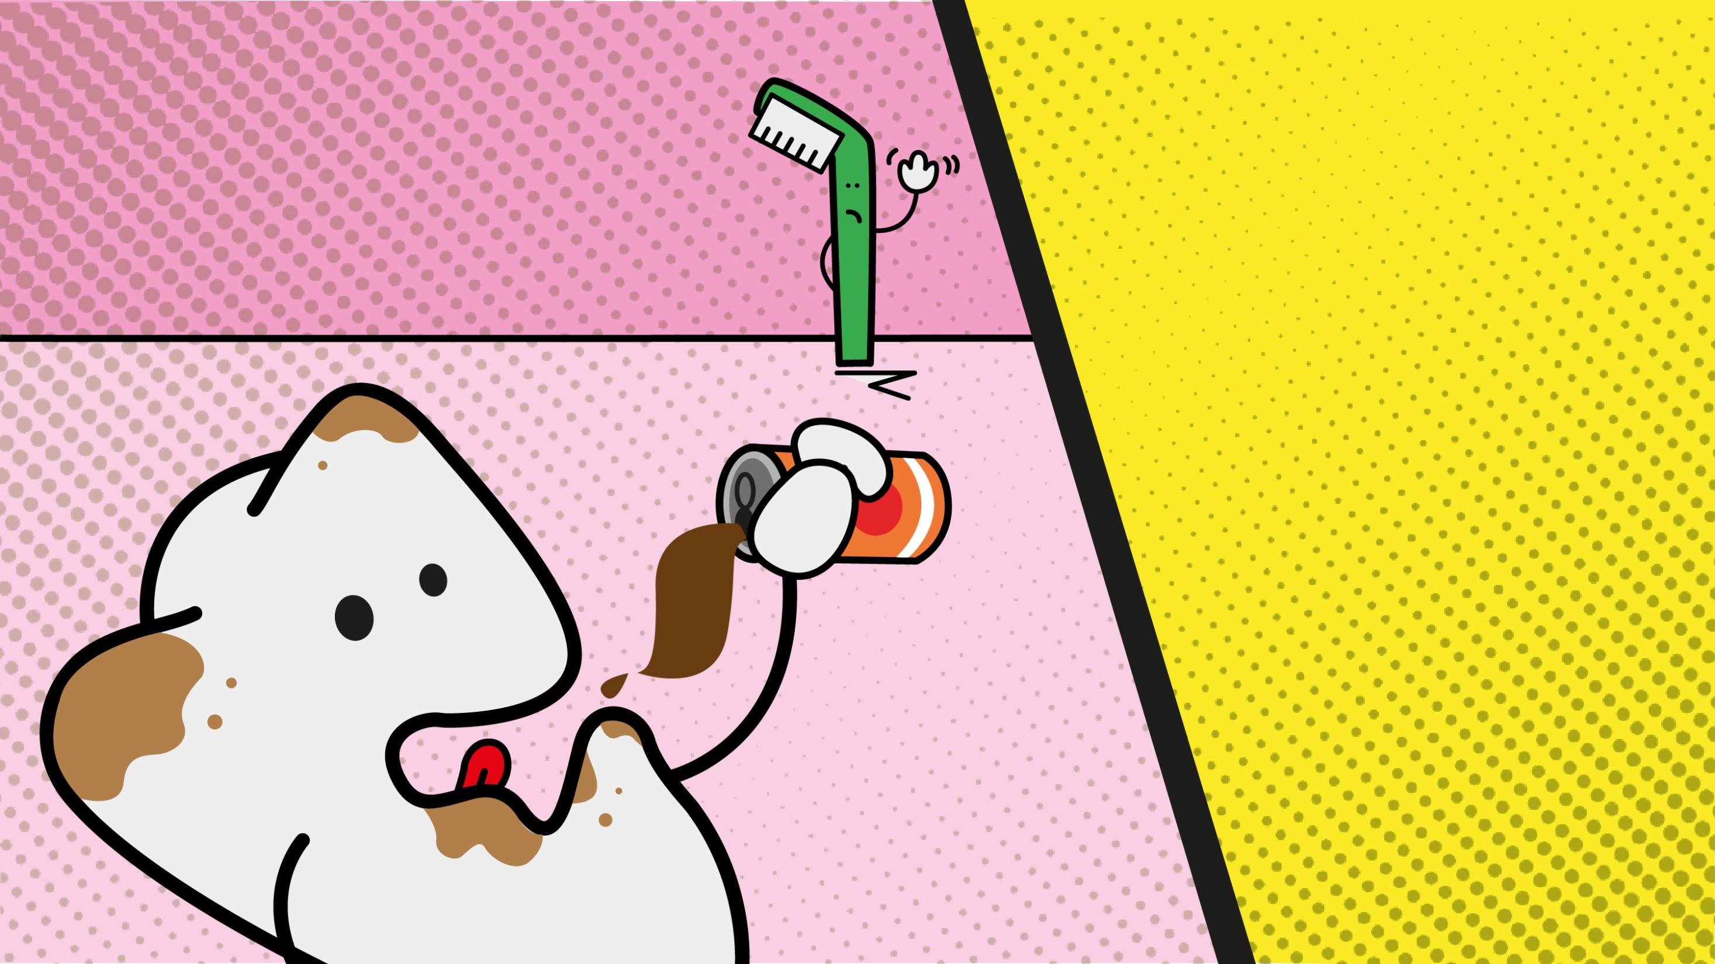
Notes:
Answer: B
After pupils have correctly answered the question, ask: How could you help her remember to brush twice a day?

Slide 27
Notes:
Answer: C
Use a pea-sized amount of fluoride toothpaste to help keep teeth healthy.

Slide 28
Notes:
Answer: A
After brushing, we should spit out the toothpaste but not rinse (or swallow!)

Slide 30
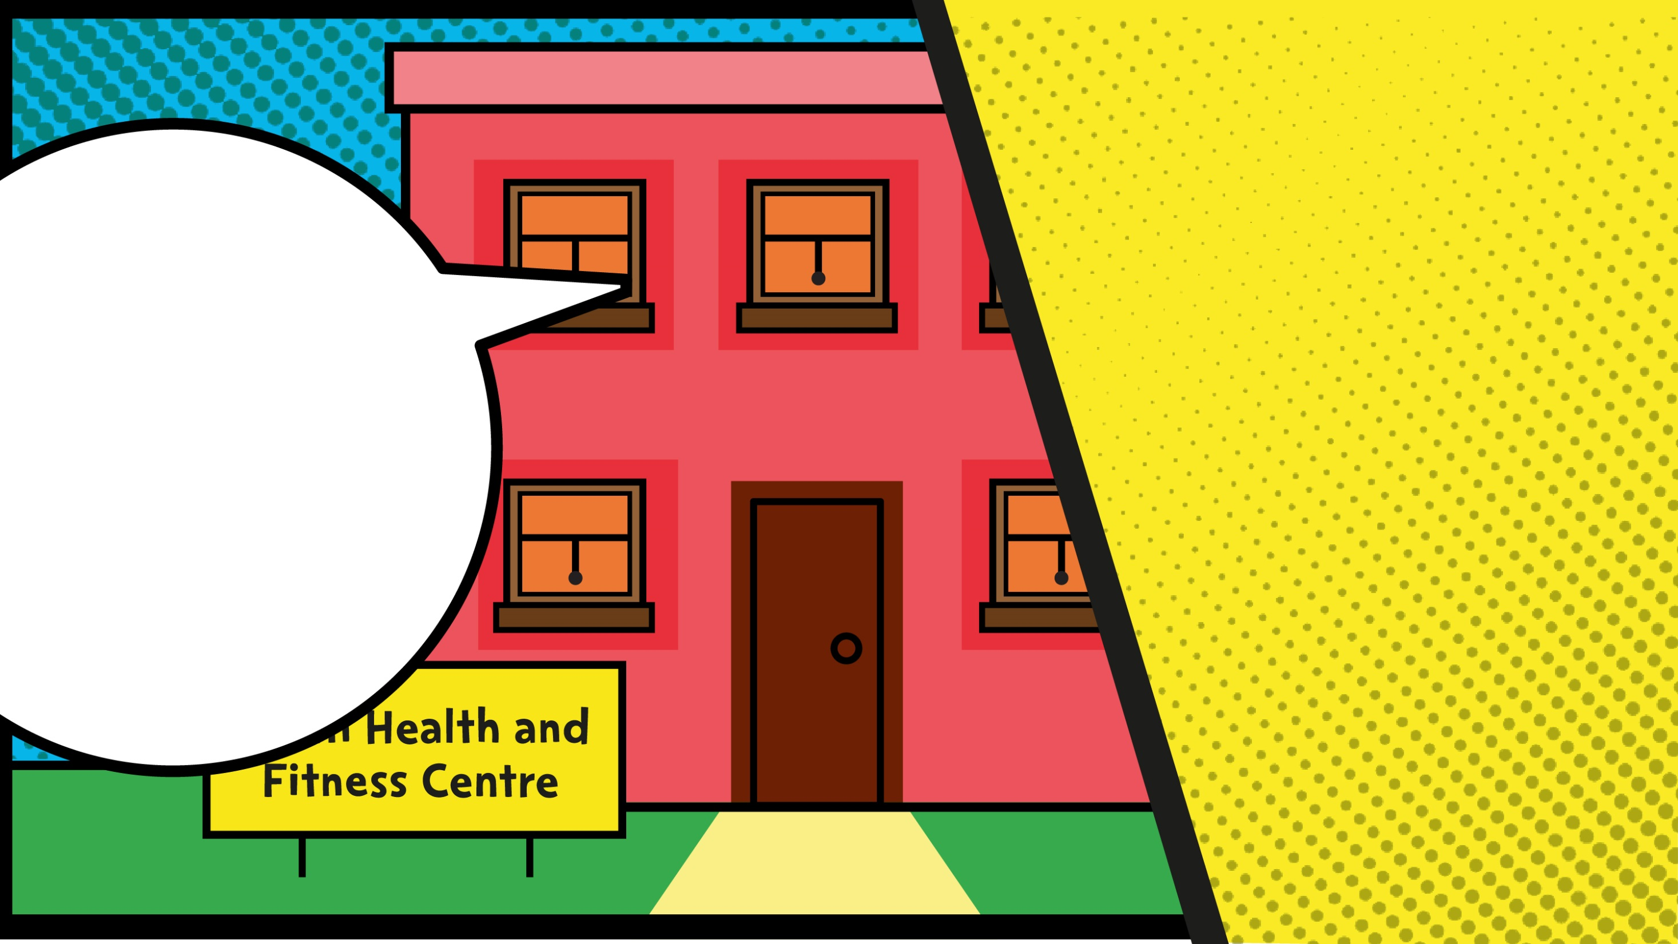
Notes:
Answer: C
Ask pupils why it might be a problem that Tilly hasn’t seen the dentist in years.
Ask them how often someone should go to the dentist (They should go at least once a year, but should listen to their dentist to see what is recommended for them.)
https://www.nhs.uk/live-well/healthy-body/dental-check-ups/

Slide 32

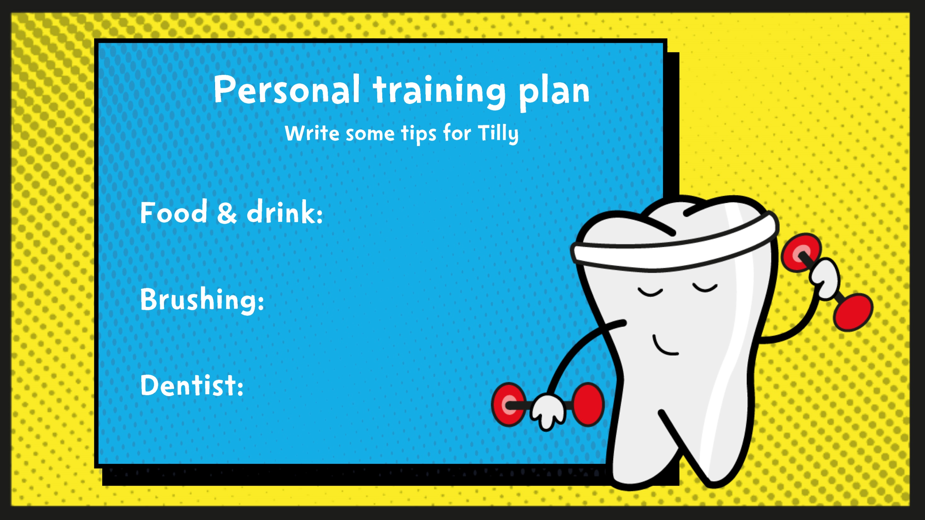
Notes:
Ask pupils to write or discuss some top tips to help Tilly get back in shape before her next visit.
Avoid sugary food and drinks. Remember they should be eaten less often and only at mealtimes.
Brush twice a day
Visit the dentist regularly

Slide 33
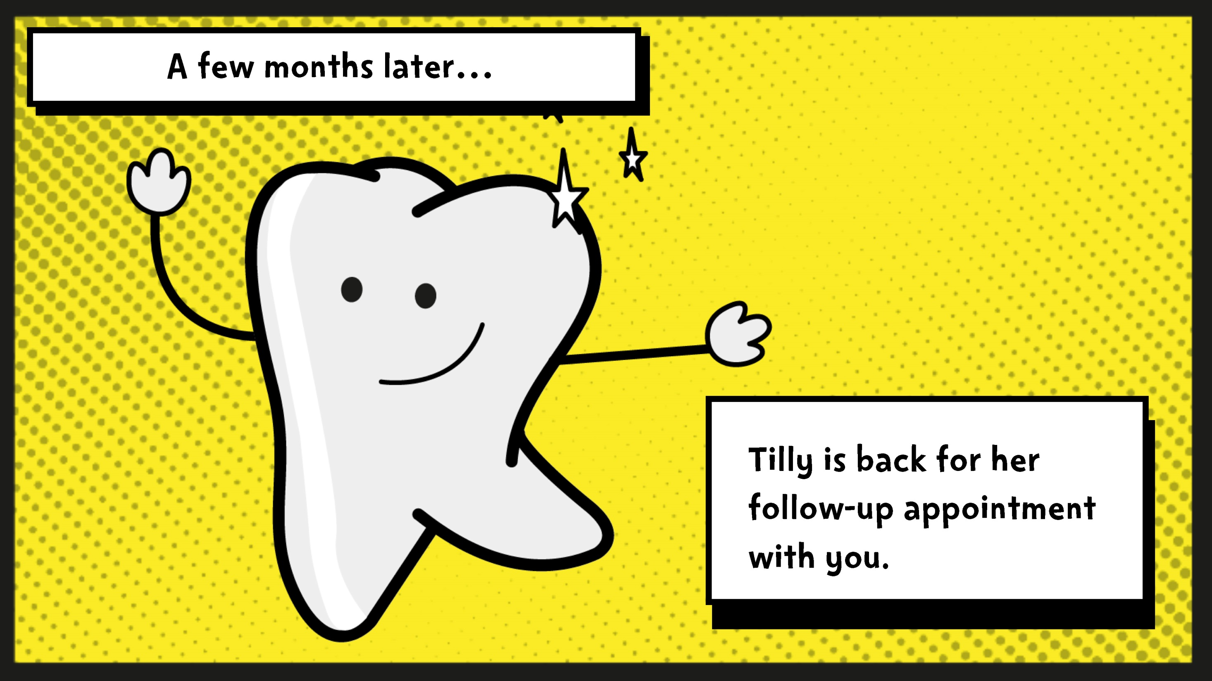

Slide 34
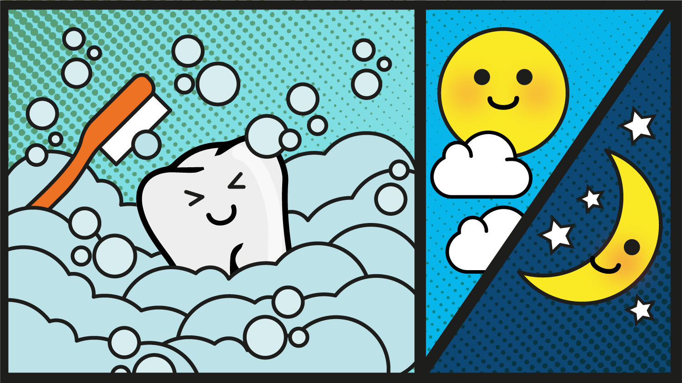

Slide 35
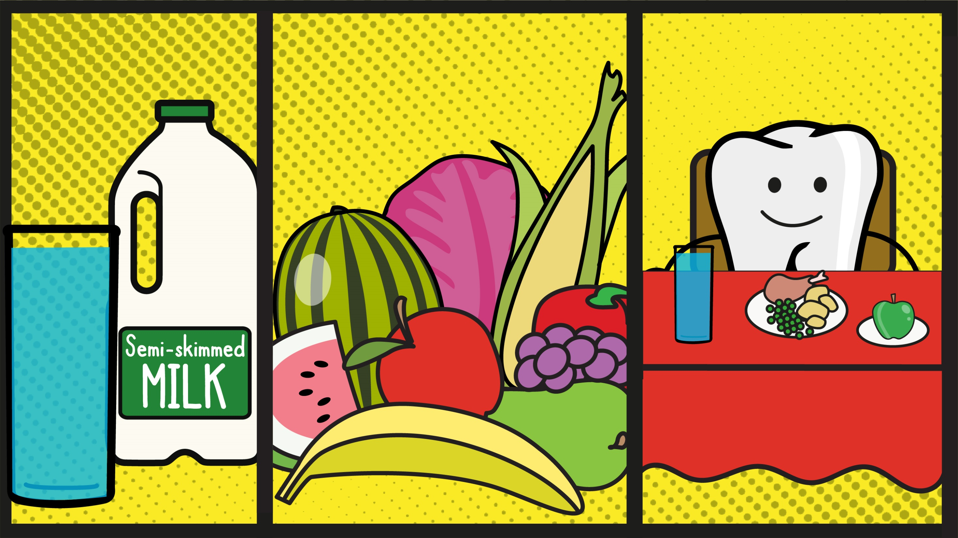

Slide 36
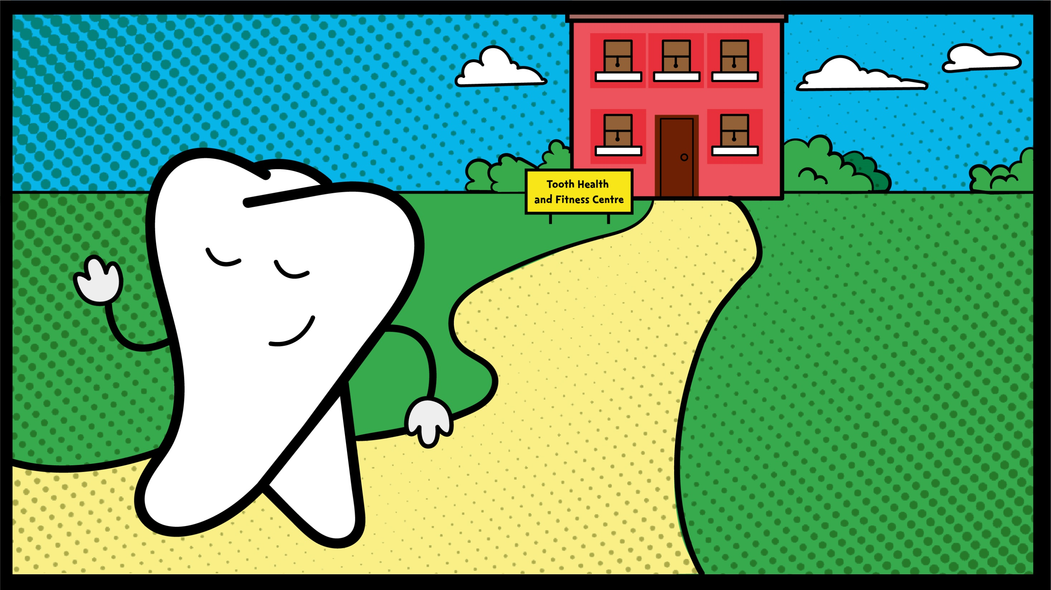

Slide 37
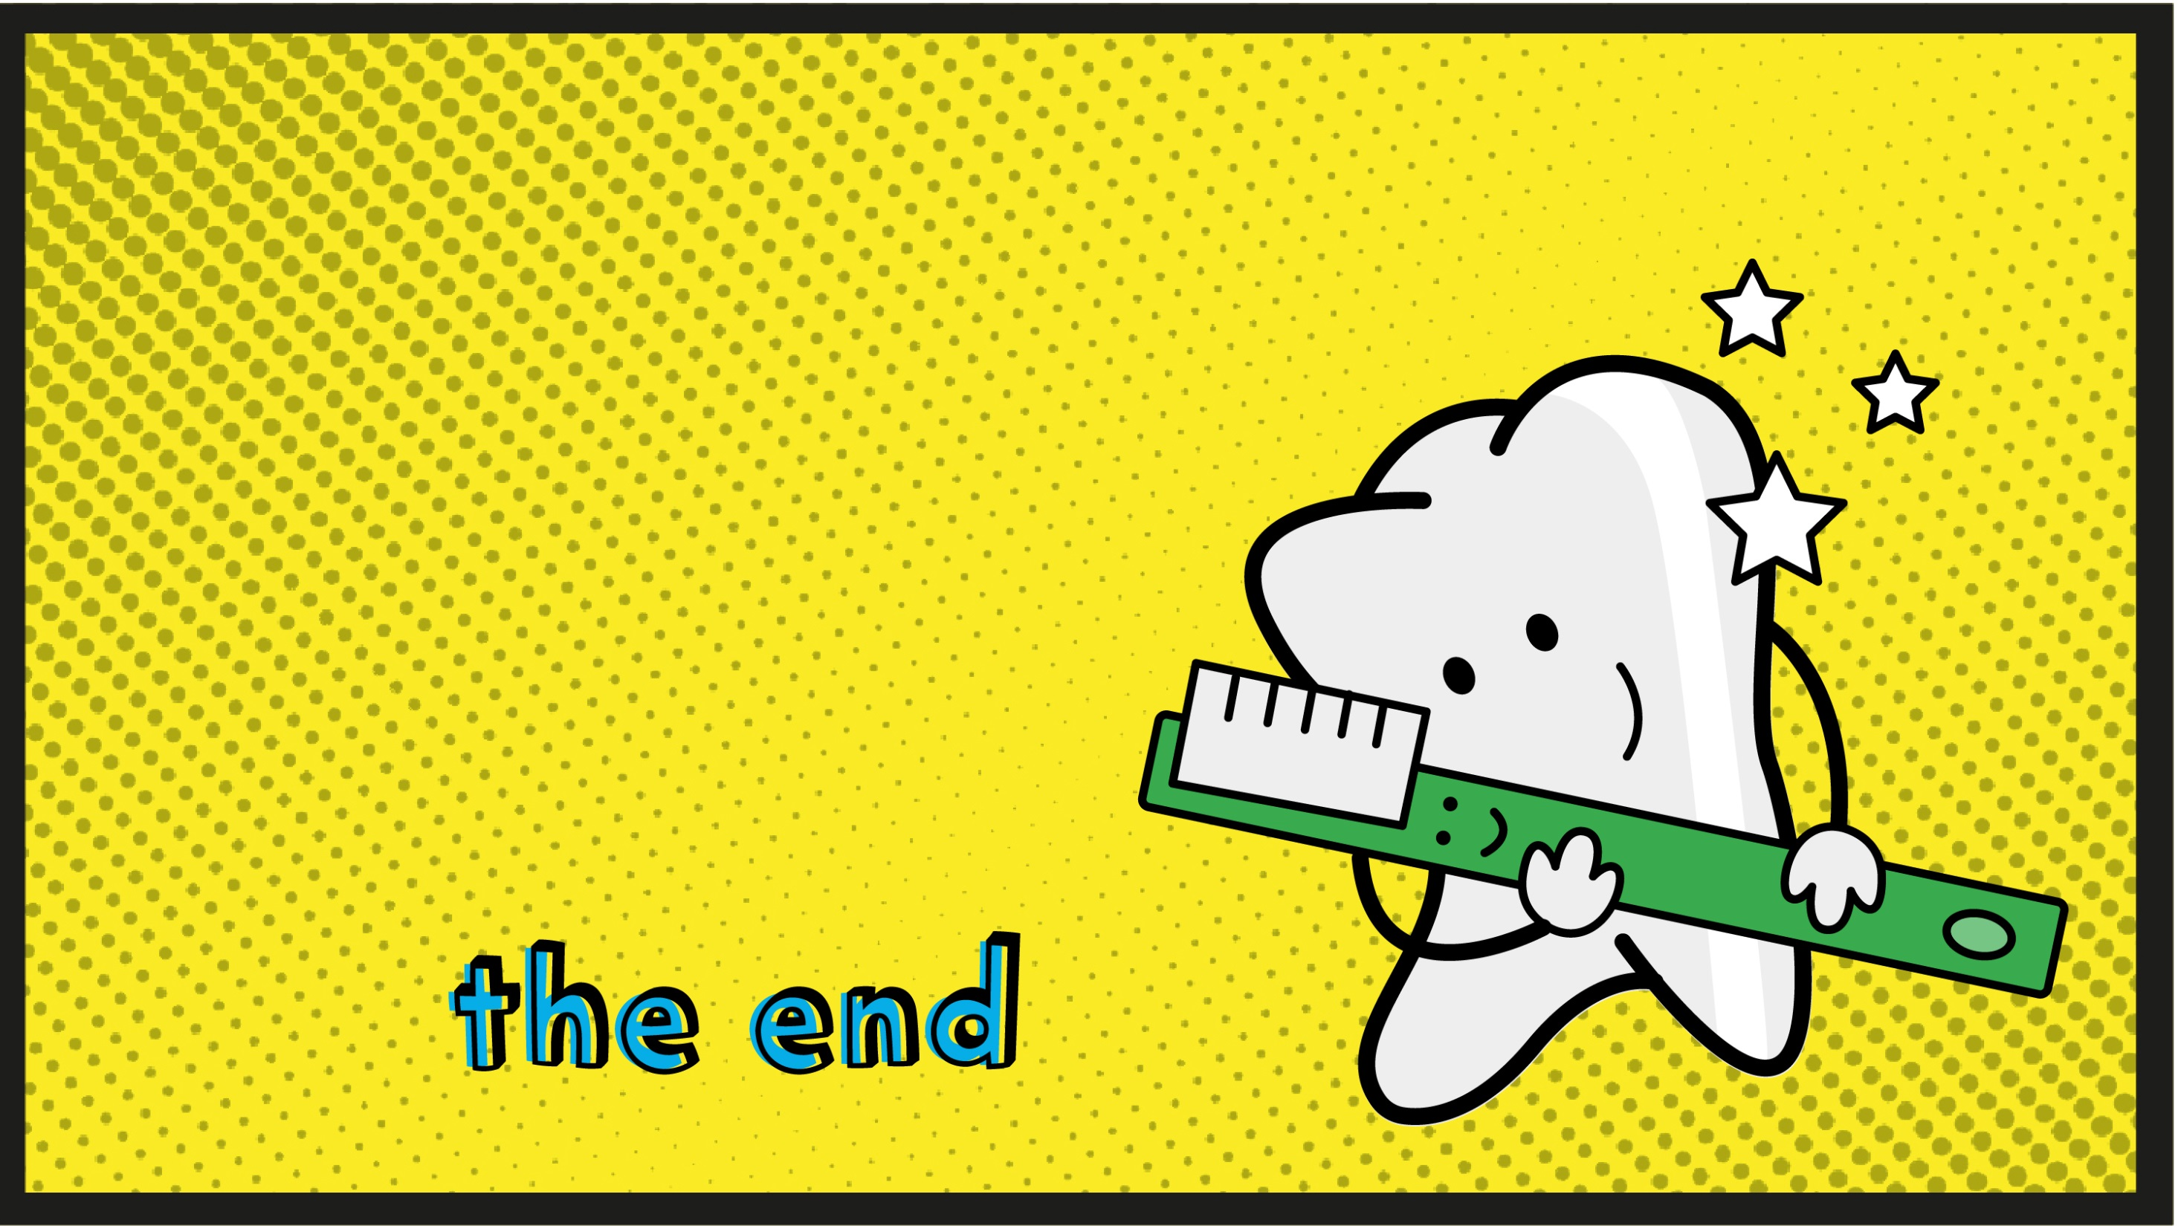

Slide 38
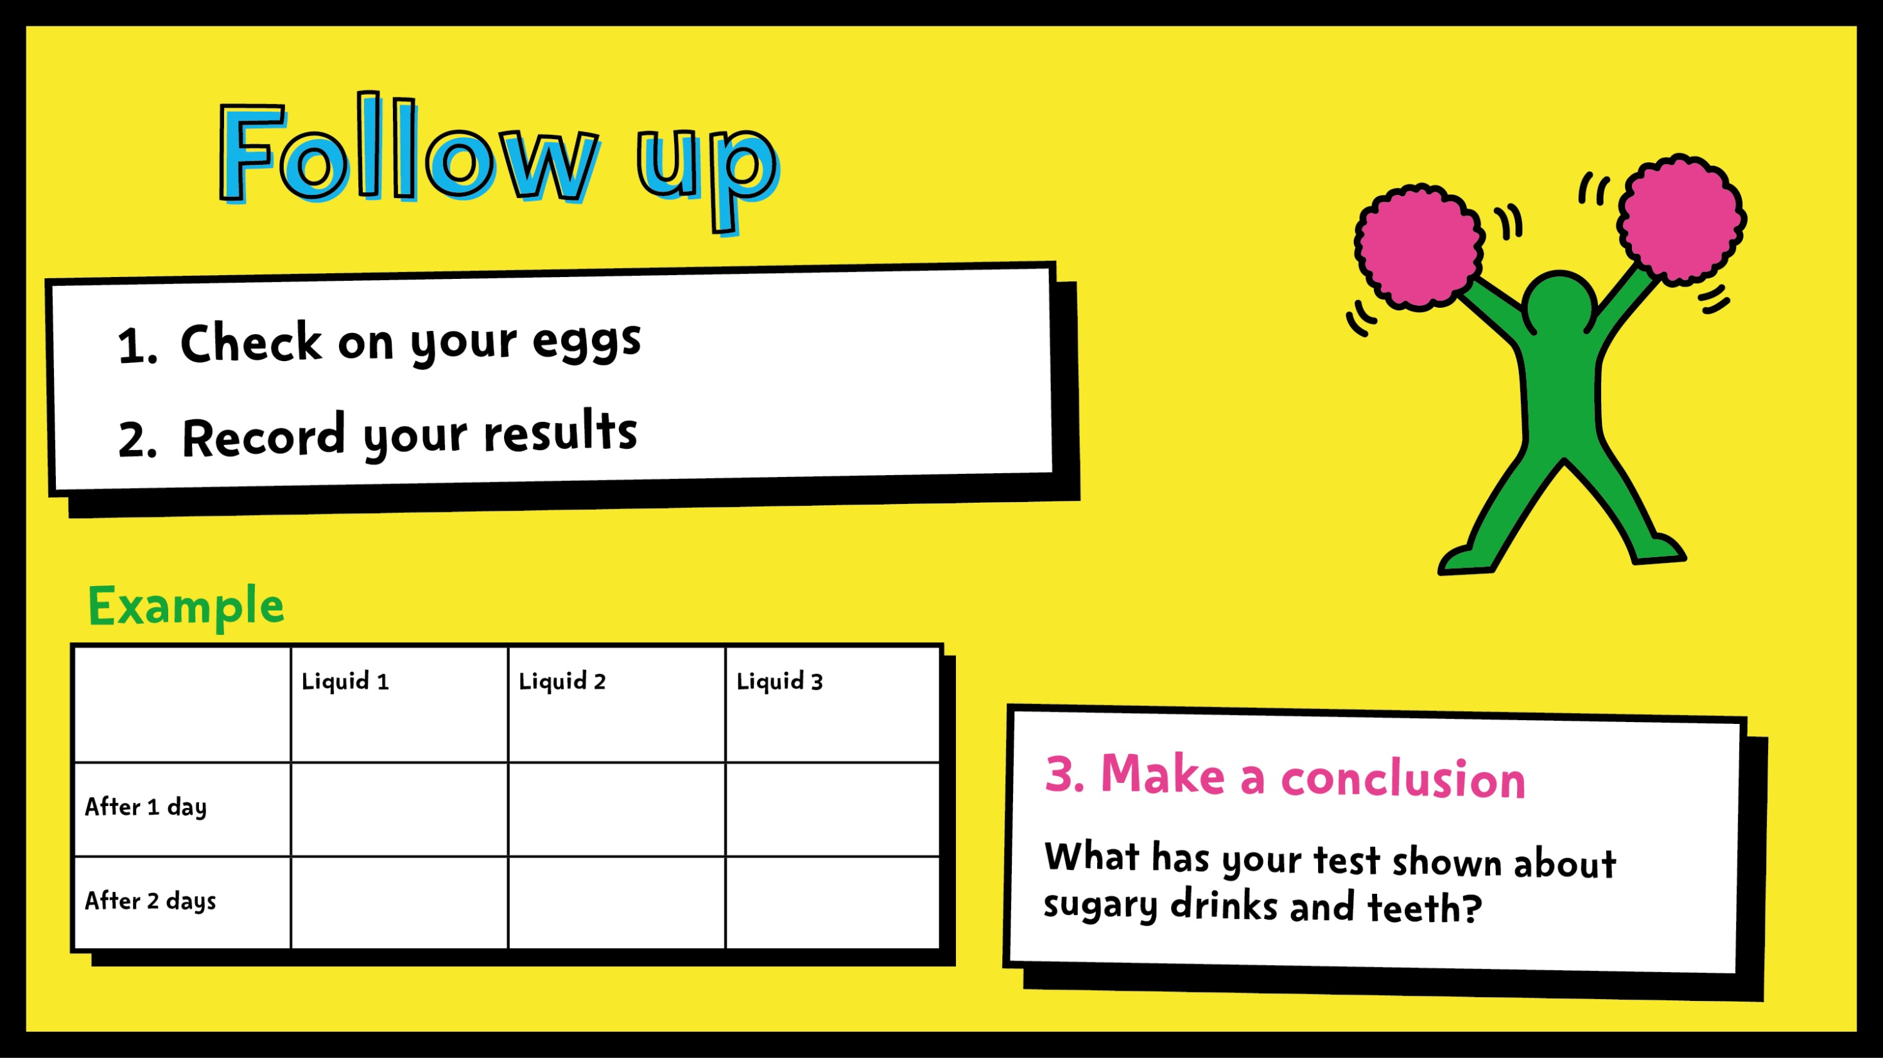
Notes:
Ask pupils to check in on their eggs and record their results. They can create their own chart based on the example.
They should then write a conclusion based on their experiment.
Optional
If you’ve used a boiled egg, ask pupils what they think will happen if they (gently!) brush their egg with toothpaste and a toothbrush? Answer: this should remove some of the staining on the egg.

Slide 39
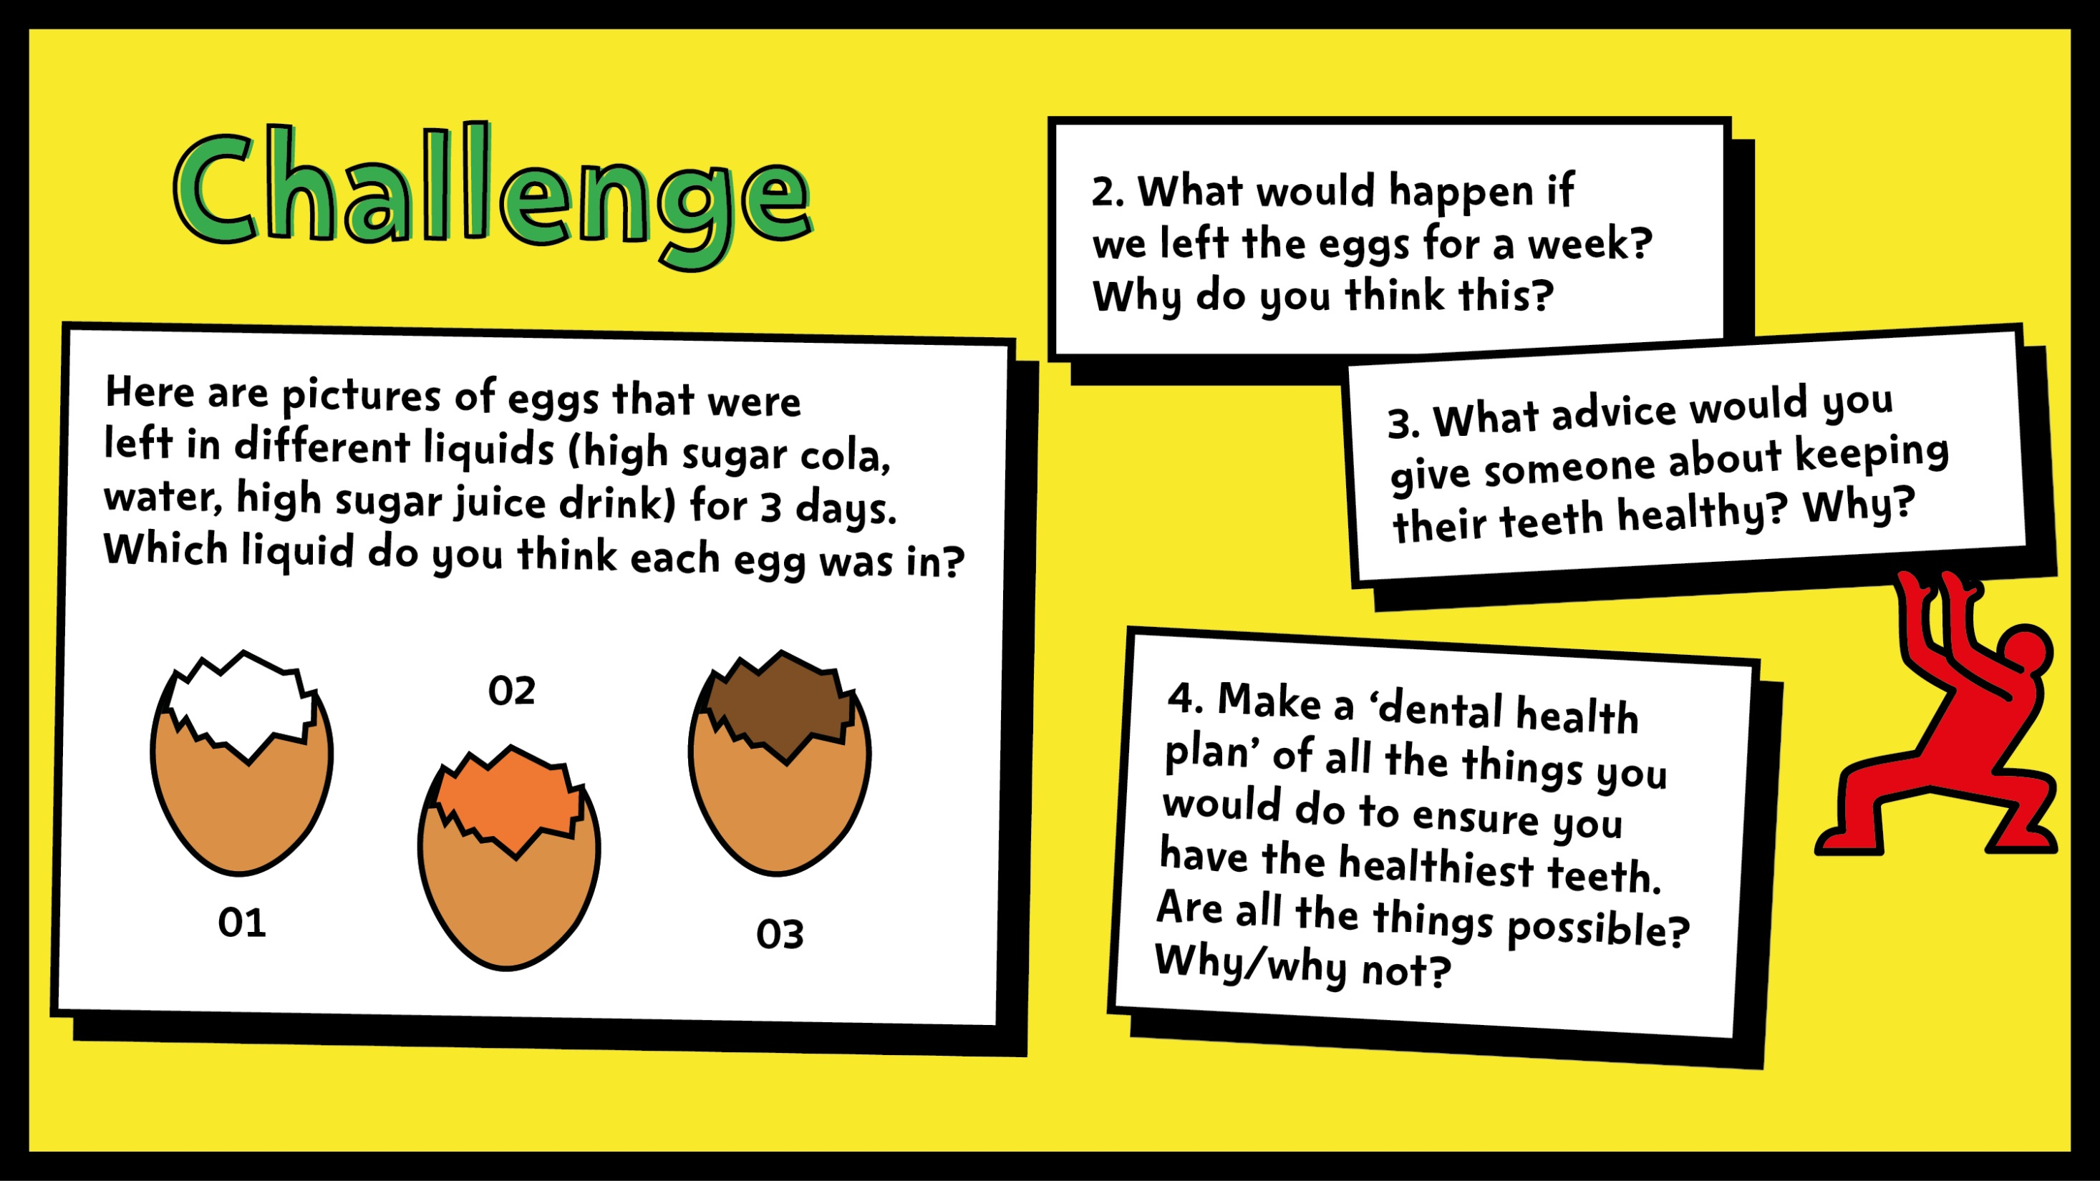
Notes:
For an extra challenge, ask pupils to share their ideas about the questions on the slide.
Ask them what kind of advice they can give to others about keeping their teeth healthy. Answers should include:
avoid sugary food and drinks. Remember they should be eaten less often and only at mealtimes
brush your teeth twice a day (right before bed at night and one other time)
use a pea-sized amount of fluoride toothpaste
spit, don’t rinse!
visit your dentist regularly.

